Slide 1
NLP
Applications
Challenges
A good source:
https://huggingface.co/spaces/dlouapre/nlp-before-llms

Slide 2
What is NLP ?
Natural language processing (NLP) is the discipline of building machines that can manipulate human language in the way that it is written, spoken, and organized.
NLP can be divided into two overlapping subfields:
Natural language understanding (NLU), which focuses on semantic analysis or determining the intended meaning of text, and
Natural language generation (NLG), which focuses on text generation by a machine.

Slide 3
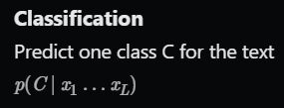
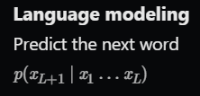
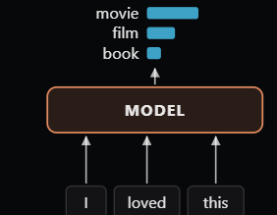
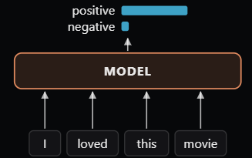
NLP Tasks – 4 main types
Source: https://huggingface.co/spaces/dlouapre/nlp-before-llms#1-the-typical-tasks-of-nlp

Slide 4
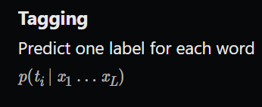
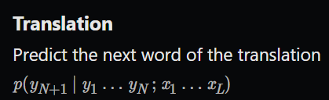
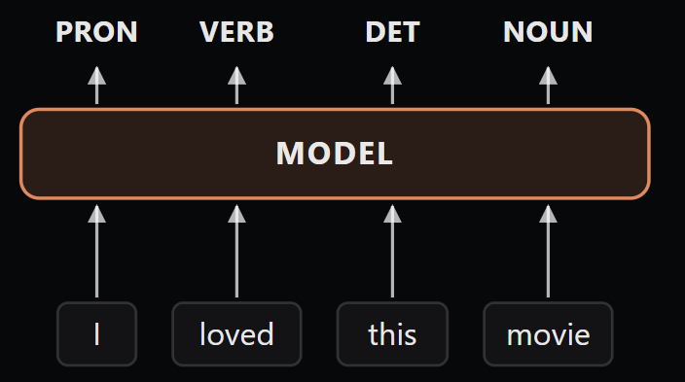
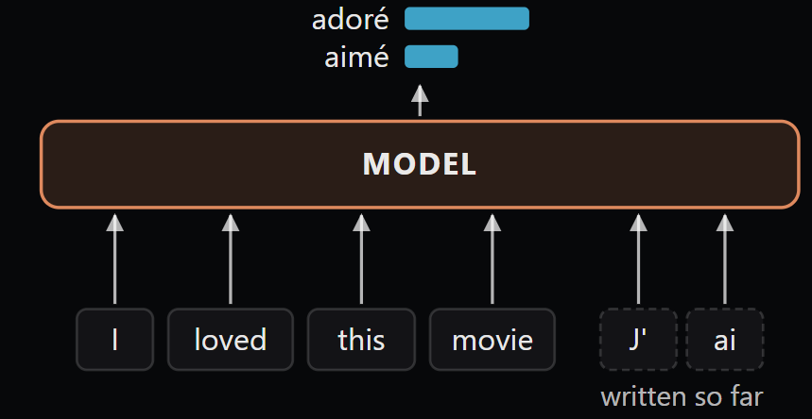
NLP Tasks – 4 main types
Source: https://huggingface.co/spaces/dlouapre/nlp-before-llms#1-the-typical-tasks-of-nlp

Slide 5
NLP : Applications

Slide 6
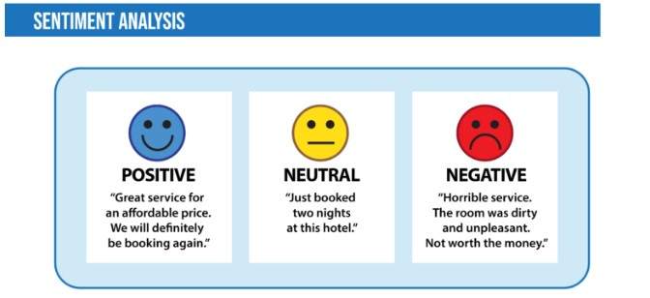
Classification - Sentiment analysis
Process of classifying the emotional intent of text. Generally, the input to a sentiment classification model is a piece of text, and the output is the probability that the sentiment expressed is positive, negative, or neutral.
Sentiment analysis is used to
classify customer reviews on various online platforms
identify signs of mental illness in online comments.

Slide 7
Toxicity classification
Here the aim is to classify particular categories such as threats, insults, obscenities, and hatred towards certain identities.
The input to such a model is text, and the output is generally the probability of each class of toxicity. Toxicity classification models can be used to moderate and improve online conversations by silencing offensive comments, detecting hate speech, or scanning documents for defamation.

Slide 8

Language Translator
Want to translate a text from English to Spanish ?
Google Translate and other translation tools as well as use Sequence to sequence modeling that is a technique in Natural Language Processing.

Slide 9
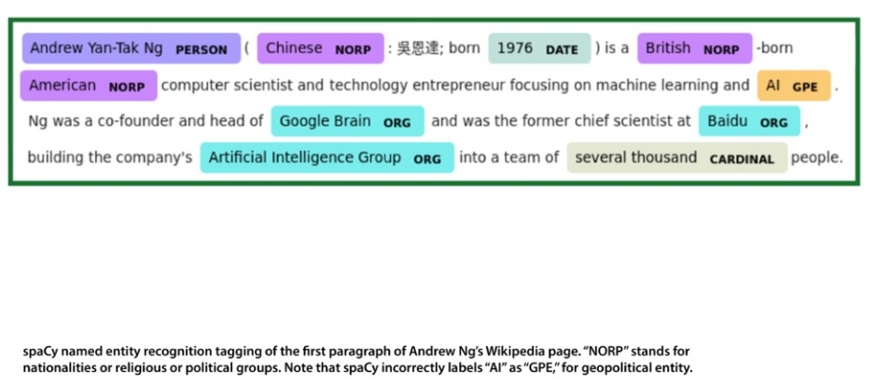
Tagging - Named entity recognition
It aims to extract entities in a piece of text into predefined categories such as personal names, organizations, locations, and quantities.
The input to such a model is generally text, and the output is the various named entities along with their start and end positions.
Named entity recognition is useful in applications such as summarizing news articles and combating disinformation. For example, here is what a named entity recognition model could provide:

Slide 10
Grammatical error correction
Models encode grammatical rules to correct the grammar within text. This is viewed mainly as a sequence-to-sequence task, where a model is trained on an ungrammatical sentence as input and a correct sentence as output.
Online grammar checkers like Grammarly and word-processing systems like Microsoft Word use such systems to provide a better writing experience to their customers.
Schools also use them to grade student essays.

Slide 11
Topic modeling
It is an unsupervised text mining task that takes a corpus of documents and discovers abstract topics within that corpus.
The input to a topic model is a collection of documents, and the output is a list of topics.
2 main techniques used here:
Latent Semantic Analysis (LSA) and
Latent Dirichlet Allocation (LDA)
Latent Dirichlet Allocation (LDA), one of the most popular topic modeling techniques, tries to view a document as a collection of topics and a topic as a collection of words. Topic modeling is being used commercially to help lawyers find evidence in legal documents.

Slide 12
Text generation
Formally known as natural language generation (NLG), produces text that’s similar to human-written text.
Such models can be fine-tuned to produce text in different genres and formats — including tweets, blogs, and even computer code. Text generation has been performed using Markov processes, LSTMs, BERT, GPT-2, LaMDA, and other approaches.
It’s particularly useful for autocomplete and chatbots.
Information retrieval
Finds the documents that are most relevant to a query. This is a problem every search and recommendation system faces.
The goal is not to answer a particular query but to retrieve, from a collection of documents that may be numbered in the millions, a set that is most relevant to the query.

Slide 13
Automatic MOM(Minutes of Meeting) Generation:
It can be used to generate MOM from the meeting transcription
Summarization:
NLP algorithms can summarize the main points of the meeting, identify key speakers, and highlight important decisions and action items.

Slide 14
NLP challenges

Slide 15
1. Ambiguity and Polysemy:
Issue: Natural language is inherently ambiguous, with words and phrases having multiple meanings depending on context. NLP systems need to understand the intended meaning in different situations.
Example:
a) Lexical Ambiguity (Polysemy):
Ritesh went to the bank (Institution or beach???)
Ritesh swung the bat in an attempt to hit the flying bat.
b) Syntactic Ambiguity
Sentence: "I saw the man with the telescope."
Interpretation 1: I used a telescope to see the man.
Interpretation 2: I saw a man who was holding a telescope.

Slide 16
c) Pragmatic Ambiguity
Sentence: "Can you pass the salt?"
Literally, it's a yes/no question about ability.
Pragmatically, it's a polite request to pass the salt.
d) Punctuation ambiguity
She found inspiration in cooking, her family, and her dog (right meaning)
She found inspiration in cooking her family and her dog (weird meaning)
e) Slang
Sentence: "Dude your pants are on fire!"
Literal interpretation: pants are on fire.
Slang meaning: The pants was amazing or pants have design depicting fire

Slide 17
f) Sarcasm Ambiguity
"Oh great, another Monday. I’m so excited."
Literal meaning: The speaker is excited.
Actual (sarcastic) meaning: The speaker dreads it.
g) Spelling mistake:
"I cleaned the horse all morning.“….meant house

Slide 18
2. Data Quality and Availability:
Issue: NLP models rely on large amounts of training data, and the quality of this data significantly impacts performance.
Noisy, incomplete, or biased data can lead to inaccurate results.
Example: Training data with gendered stereotypes can result in NLP models perpetuating biases.

Slide 19
Training Data Example (Biased)
Suppose a language model is trained on large-scale web data (like Common Crawl) that includes sentences like:
"Women are nurses. Men are doctors. He is a brilliant scientist. She is a beautiful actress. The secretary scheduled his meeting. The boss signed the contract."
These examples reinforce stereotypical gender roles (e.g., associating women with appearance or support roles, and men with intelligence or leadership).
You ask a model: "The doctor went to the hospital because __ was needed."
It may respond: "he" — even if gender wasn’t specified in the question.
Solution: Carefully selecting and cleaning training data, and developing techniques to mitigate biases.

Slide 20
3. Evolving Language:
Issue: Languages are constantly evolving, with new words, idioms, and slang emerging. NLP systems need to adapt to these changes.
Example: New slang terms and internet memes need to be understood by NLP systems.
“Flex”:
Old meaning: To "flex" meant to bend a muscle.
New meaning: "Flex" in modern slang refers to showing off or boasting (e.g., "He’s flexing his new car.").
Solution:
Developing NLP techniques that can adapt to evolving language and incorporating knowledge from online resources.
Example: regularly update models with new language data, particularly from social media, forums, and new books.

Slide 22
EXTRA
Xxxxxxxxxxx
xxxxxxxxxxxx

