Slide 2
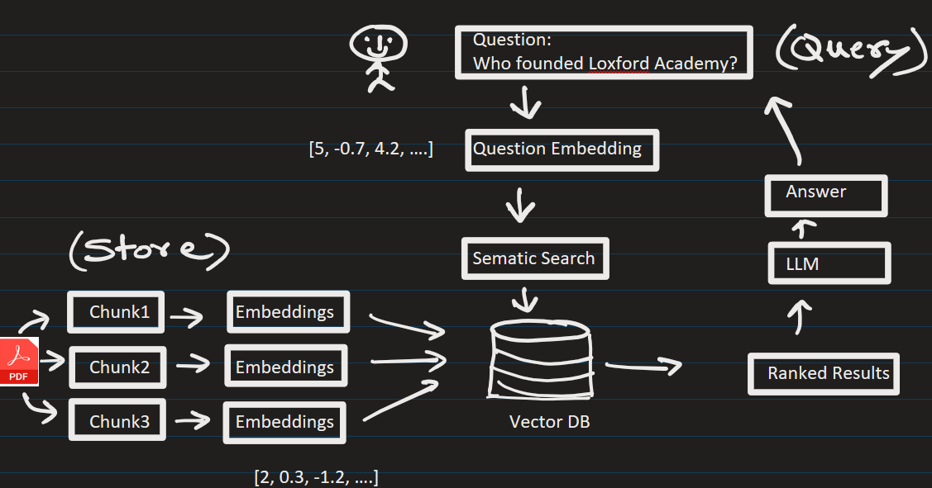


Data Input Validation (The Knowledge Base Asset)
Before testing any models, you must validate the "ground truth" data feeding your AI.
Data Deduplication & Governance: Clean out duplicate, contradictory, or superseded PDF files living side-by-side.
Ingestion & Parsing Validation: Ensure file parsers preserve complex elements like markdown tables, hierarchies, and footnotes rather than flattening them into unreadable text strings.
Chunking Strategy Optimization: Confirm that text chunk boundaries do not slice an atomic fact in half.
Metadata Tagging: Verify that every chunk carries structural metadata (e.g., source URL, effective date) required for filtering during retrieval

Slide 3
We can evaluate the RAG system using four core pillars
Metric Pillar | What it Validates | How it works
1. Retrieval Relevance | Did we fetch the right data? | Compares the user's question directly to the retrieved text chunks to check for semantic alignment.
2. Groundedness (Faithfulness) | Is the AI making things up? | Compares the final AI response against the retrieved chunks to check if any facts were hallucinated.
3. Answer Relevance | Did the AI actually answer the question? | Compares the final response directly to the initial query, filtering out helpful context from filler.
4. Answer Correctness | Is the answer factually correct? | Compares the AI response against a human-verified "golden dataset" or reference answer.

Slide 4
How to execute RAG validation:
Build a Golden Evaluation Set: Curate a static test collection of 100+ representative user questions matched with human-verified ground-truth answers.
Deploy an LLM-as-a-Judge: Use a highly capable model (such as GPT-4 or specialized evaluation models like JudgeLM) to score the test outputs automatically. Provide explicit scoring guidelines (e.g., a 1–5 rubrics scale) to ensure the judge remains mathematically consistent.
Human-in-the-Loop Validation:Regularly inject manual validation phases where domain experts cross-check the automated judge's findings

Slide 5
Frameworks like LangSmith or Ragas can be used to evaluate the RAG

