Slide 2
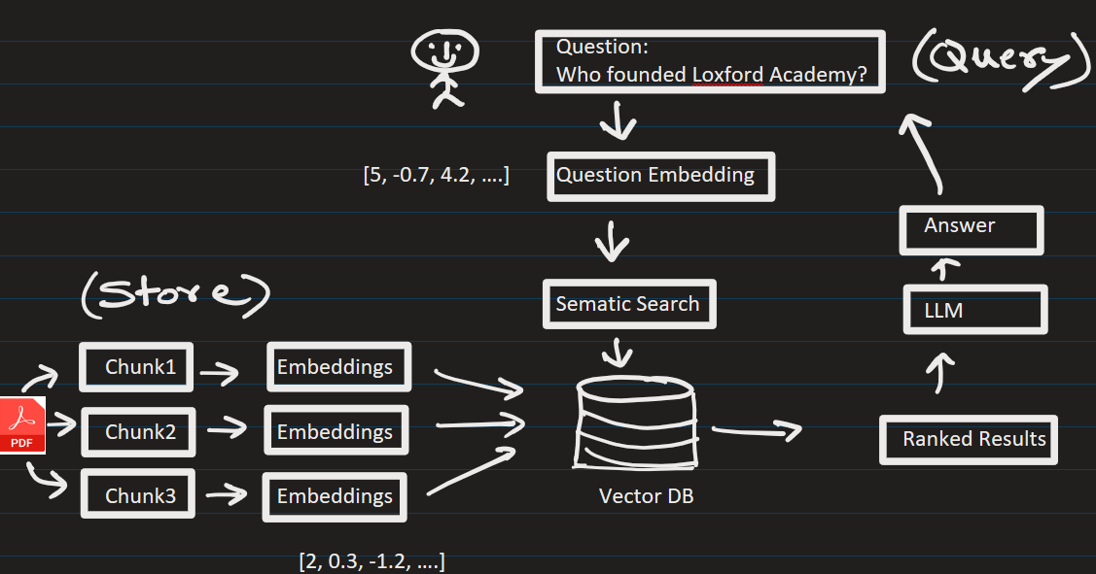


RAG problems usually break down into two categories:
2) Generation Failures (the system has the right information but writes a bad response).
1) Retrieval Failures (the system fetches the wrong information) or

Slide 3
Here is a practical, step-by-step diagnostic playbook to isolate and solve implementation bottlenecks:

Slide 4
Step 1: Isolate the Failure (The "Split-Screen" Test)
Before changing any code, determine where the pipeline is leaking quality. Take the failing query and manually inspect the raw intermediate payload.
Check the Context: Look at the text chunks your vector database returned.
The Diagnostic Split:
Scenario A: The correct answer is not in the retrieved chunks → This is a Retrieval Problem (Fix via Step 2).
Scenario B: The correct answer is in the retrieved chunks, but the LLM ignored it or hallucinated → This is a Generation Problem (Fix via Step 3).

Slide 5
Step 2: How to Fix Retrieval Failures

Slide 6
If your vector DB is returning irrelevant noise, the LLM stands no chance. Use these strategies to fix it:
a) Implement Query Rewriting:
Problem: Users write vague or poorly formatted prompts that don't match the technical phrasing inside your documentation.
Solution: Pass the user's prompt through a lightweight LLM step first to rephrase, expand acronyms, or generate multiple variations of the question before hitting the database.

Slide 7
b) Optimize the Chunking Strategy:
Problem: Fixed-size chunking (e.g., blindly cutting text every 500 characters) splits sentences or tables in half, destroying context.
Solution: Switch to semantic chunking or parent-child chunking. Keep small chunks (e.g., 128 tokens) for the vector database to search, but retrieve the larger "parent" paragraph (e.g., 512 tokens) to feed into the LLM.

Slide 8
c) Upgrade to Hybrid Search:
Problem: Vector embeddings excel at conceptual meaning but are terrible at matching exact product IDs, serial numbers, or specific legal codes.
Solution: Combine dense vector search with sparse keyword search (BM25). Use a Reciprocal Rank Fusion (RRF) algorithm to merge and score the results.

Slide 9
d) Add a Re-ranker Node:
Problem: The top 10 results from a vector search often contain duplicate or semi-relevant information.
Solution: Introduce a cross-encoder model (like Cohere Rerank or BGE-Reranker). It acts as a secondary filter, shuffling the absolute highest-quality facts to the very top of the list.

Slide 10
Step 3: How to Fix Generation Failures

Slide 11
If the right data is getting to the LLM but the output is still incorrect, hallucinated, or formatting-compromised:
a) Combat the "Lost in the Middle" Phenomenon:
Problem: LLMs pay great attention to the very beginning and very end of a prompt, but tend to ignore data buried in the middle of a massive context block.
Solution: Limit your context window. Instead of passing 20 chunks, pass the top 3–5 highest-scoring chunks, or structurally sort them so the most critical data sits at the absolute top of the prompt.

Slide 12
b) Harden the System Prompt (Prompt Engineering):
Problem: The LLM relies on its pre-trained baseline knowledge.
Solution: Inject strict, explicit guardrails into the system instruction.
  Example: "You are a strict QA assistant.
  Answer the user query based ONLY on the provided context. If the answer cannot be found in the context, reply exactly with 'I do not have access to that information.’ Do not use any outside knowledge."

Slide 13
c) Upgrade the Model or Adjust Temperature:
Problem: A smaller or quantized model lacks the reasoning capabilities to process complex data.
Solution: Lower your model's temperature configuration to 0.0 to make it entirely deterministic and literal. If it still fails, evaluate upgrading from a smaller model to a larger, highly capable reasoning model.

