Slide 1
Micro services
https://www.youtube.com/watch?v=rv4LlmLmVWk&t=198s

Slide 2
Service 1
Service 4
Service 1
Service 4
Service 2
Service 5
Service 2
Service 5
Service 3
Service 6
Service 3
Service 6
Micro services:
Break a big application into smaller ones (microservices)

Slide 3
An ecommerce website might have separate services for:
Managing products
Maintaining shopping carts
Processing orders
Handling payments
Tracking inventory
Providing AI recommendations
Together, these services power one shopping experience.

Slide 4
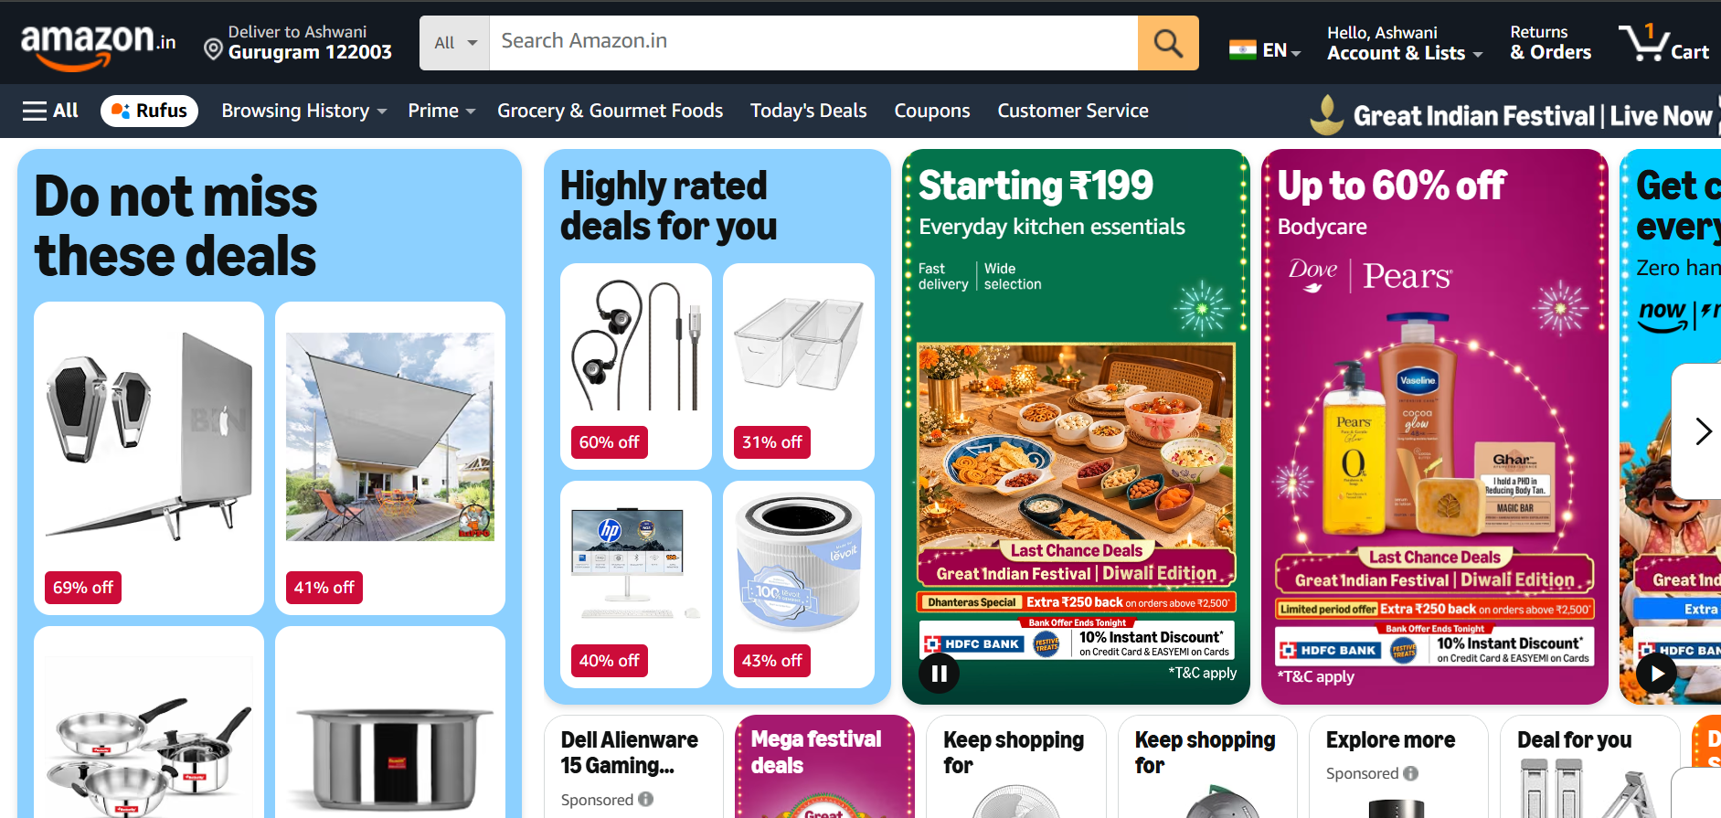

Example of microservice

Slide 5
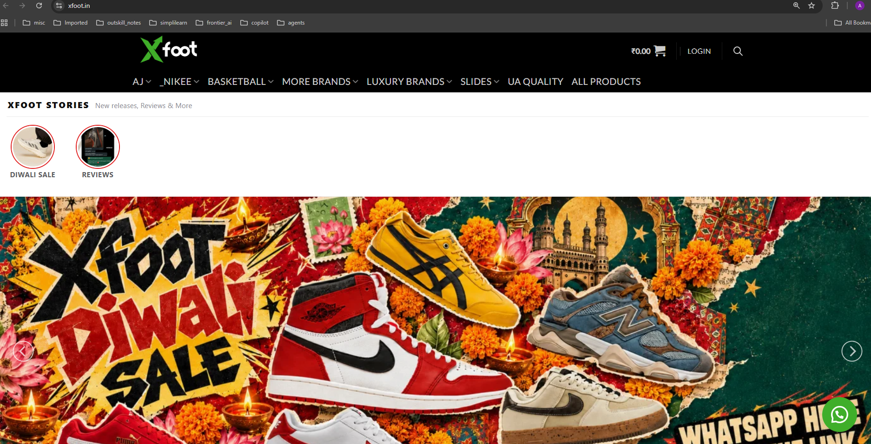




Example of microservice

Slide 6
Running Example
Imagine an ecommerce website called xFoot.com.
A customer visits xFoot.com to:
Search for running shoes.
Add a pair to their shopping cart.
Place an order and pay.
Receive delivery updates.
The customer sees one website. Behind the scenes, several services work together.

Slide 7

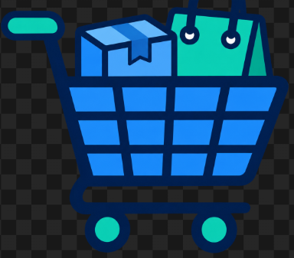
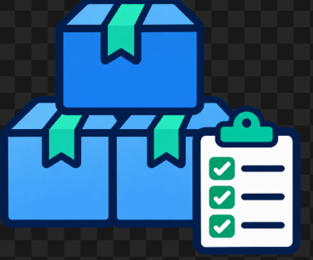
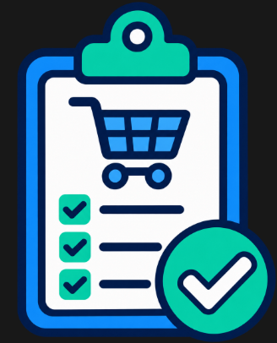
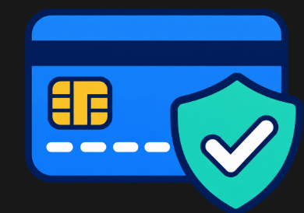


Each service owns its business logic and data. It is self-contained + independant
Service | Main responsibility
Product Service | Stores product descriptions, prices, and images
Cart Service | Tracks the products a customer wants to buy
Inventory Service | Tracks available stock and reserves items
Order Service | Creates orders and tracks their status
Payment Service | Coordinates payments with a payment provider
Notification Service | Sends order confirmations and delivery updates
AI Recommendation Service | Suggests products relevant to the customer

Slide 8
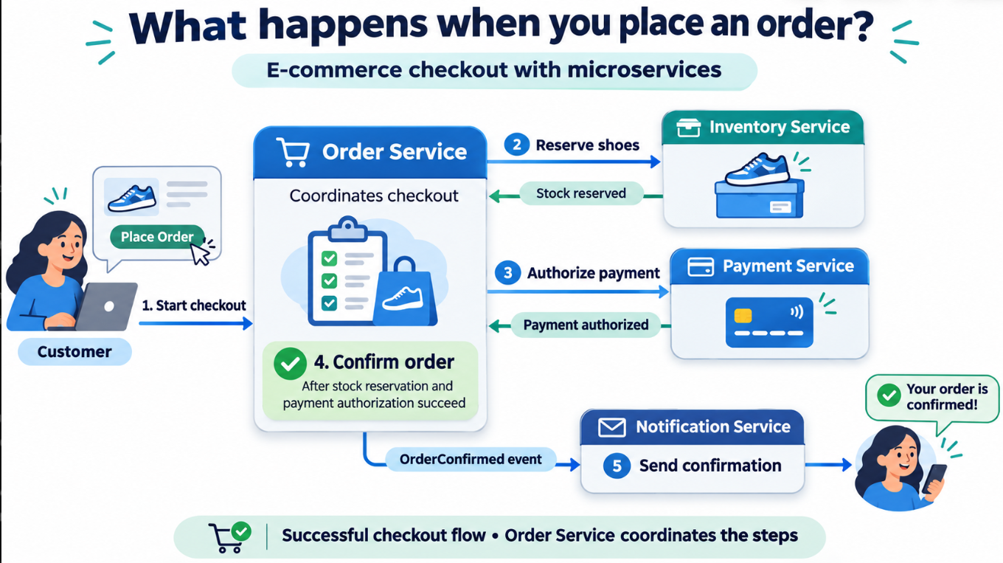
Example - Checkout
When the customer clicks “Place Order”:
The Order Service starts the checkout process.
The Inventory Service attempts to reserve the shoes.
The Payment Service requests payment authorization.
The Order Service confirms the order when the required steps succeed.
The Notification Service sends a confirmation.

Slide 9
Communication between services
2 main ways: synchronous requests and asynchronous messages.

Slide 10

Synchronous : One service calls another service and waits for a response.
Services can communicate with each other through HTTP API requests
Adding a Product to the Cart
The User clicks “Add to Cart ” on website. It sends an API request.
The Cart Service records the product and quantity.
The service returns the updated cart.
The website displays the result top the user.
Payment
Cart Service
User
User account
Example API request: POST /cart/items
Information sent: Product ID: SHOE-101; Quantity: 1
Information returned: Updated cart contents
Main challenge of synchronous:
If the other service is slow or unavailable, the caller is affected. Use timeouts and handle failures.

Slide 11
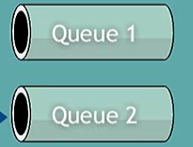
Asynchronous:
A service sends a message through a message broker. Another service processes it later.
The sender does not wait for the business task to finish.
Message Broker
Payment
User account
Checkout
Publisher
Subscriber
Example: RabbitMQ, Kafka, and cloud messaging services

Slide 12
Asynchronous:
Use when: work takes time, traffic arrives in bursts, or several services should react independently.
Message Broker
Payment
User account
Checkout
Publisher
Subscriber
Main challenge: results arrive later, and messages may be delivered more than once. Services need retry handling and protection against duplicate processing.

Slide 13
CI / CD for microservices
Mono Repo
Poly Repo

Slide 14
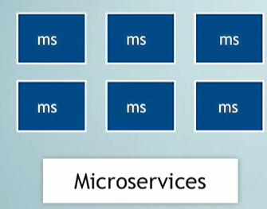


Mono Repo
One repo contains many projects/microservices

Slide 15
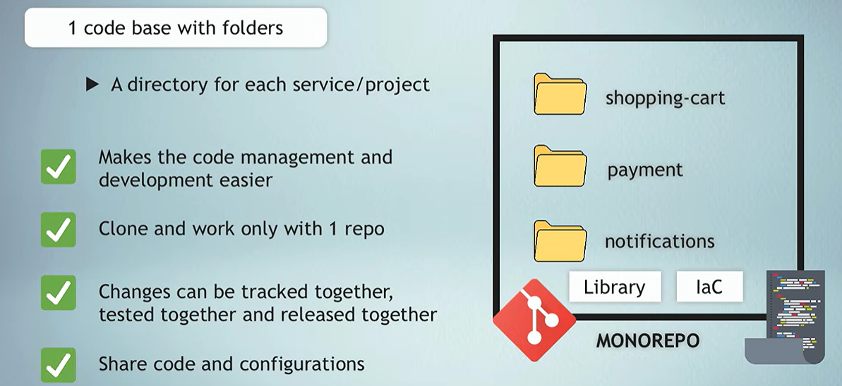
Mono Repo
Mono Repo good for small projects.
They are ideal when you want one CI/CD pipeline.

Slide 16
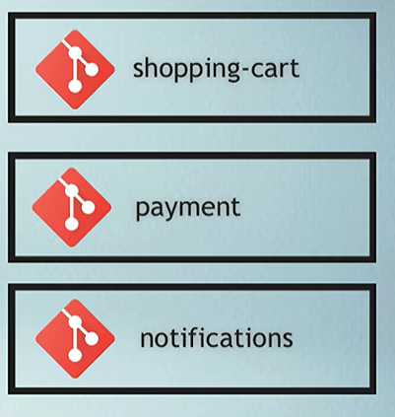
Poly Repo:
1 repo for each service
Code is isolated -> Developers can clone and work on them separatly
When to Use:
Many services and each using different frameworks (Java, Python, etc.)
You have separate teams for each service. Each team will have separate CI/CD pipeline
You want your code base to be small

Slide 17



Benefits for Microservices
User Account
Shopping cart
Each microservice team can choose its own tech stack
Payment
Each team can work independently
Recommendation
Contain some failures: Recommendations service can be unavailable while Shopping service continues.
Update 1 microservice without redeploying others.

Slide 18
Challenges
More services to deploy, monitor, and secure.
Network calls can be slow or fail.
User Account
Shopping cart
Payment
Recommendation
More complexity: Keeping orders, payments, and inventory consistent is harder.

