Slide 1
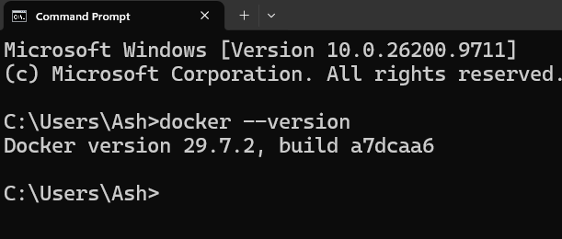
1) Install docker
2) Check docker version

Slide 2
3) Pull n8n from dockerhub
> docker pull n8nio/n8n

Slide 3
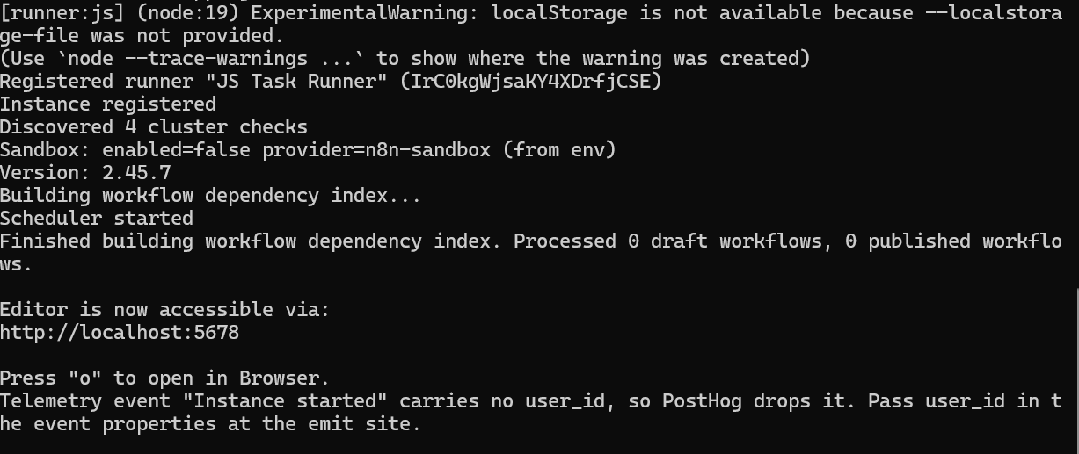
4) Start container:
> docker run -it --rm --name n8n -p 5678:5678 -v ~/.n8n:/home/node/.n8n n8nio/n8n

Slide 4
5) Open web browser on http://localhost:5678
Username: (email) ash322.ash422@gmail.com
Password: 123456

