Slide 1
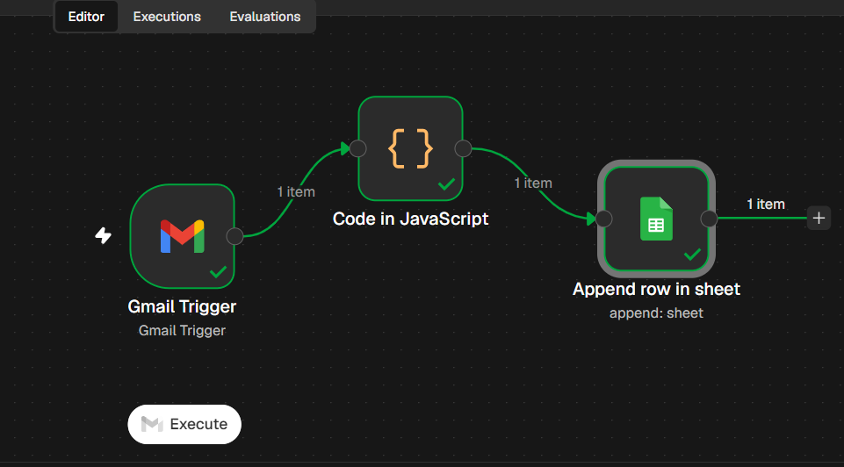
Final workflow

Slide 2
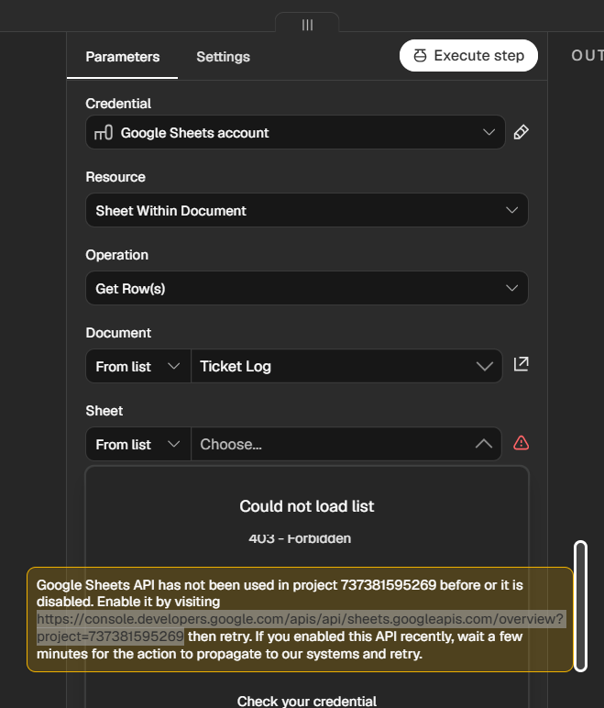
Have to enable this by visiting this URL

Slide 3








