Slide 1
The difference between the type of problems that are solved by
Traditional Algorithm
versus
AI/ML

Slide 2
PART1

Slide 3
When Are Traditional algorithms Superior ?

Slide 4
a) The problem has clear, explicit rules that can be precisely defined
Example:
Sorting algorithms like Merge Sort, Quick Sort, or Bubble Sort.
These problems have strict rules
(e.g., "place smaller elements before larger ones")
and can be solved efficiently with deterministic logic.
2, 4, 6, 2, 6 → 2, 2, 4, 6, 6
Example:
Mathematical calculations:
Simple Interest = P x R x T
Voltage = I x R,

Slide 5
b) Complete accuracy is required with no room for probabilistic outcomes
Example: Encryption/decryption - Cryptographic algorithms like RSA encryption or SHA-256 hashing.
Security demands precise, repeatable outcomes — there's no tolerance for approximation or probabilistic errors.
Example: Database queries - Finding exact matches in structured data
Why:
When querying a database (e.g., SELECT * FROM users WHERE id = 123), you're expecting an exact, deterministic match. Any fuzziness would be incorrect in this context.

Slide 6
c) The solution path is well-understood and can be explicitly programmed
Example:
Pathfinding in a grid-based game using A* or Dijkstra’s algorithm.
The optimal path can be deterministically computed using known algorithms without needing to learn from data.
Example:
Path-finding with known constraints: Like GPS navigation with defined roads

Slide 7
d) The problem space is relatively small or constrained
Example:
Sudoku solvers(or Tic-Tac-Toe) using backtracking algorithms.
Because the space of possibilities is finite and relatively small, exhaustive or optimized deterministic techniques perform well.

Slide 8
e) Explainability and transparency are critical requirements
Example:
Tax calculation software using fixed rules from tax laws.
Auditors and users need to see the exact steps, logic, and formulas used, which rule-based algorithms can clearly provide.

Slide 9
Cases where it may seem that AI is needed but is not

Slide 10
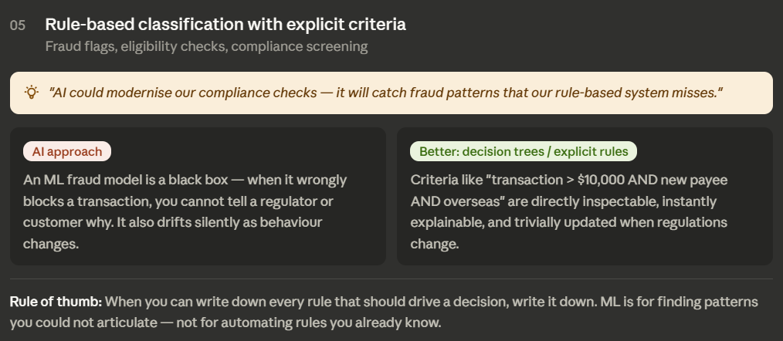

Slide 11
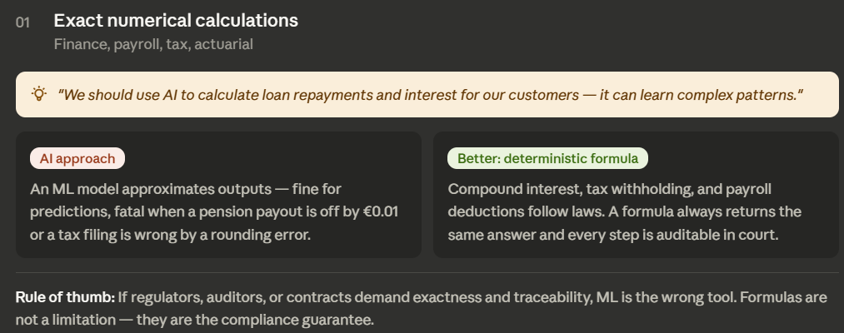

Slide 12
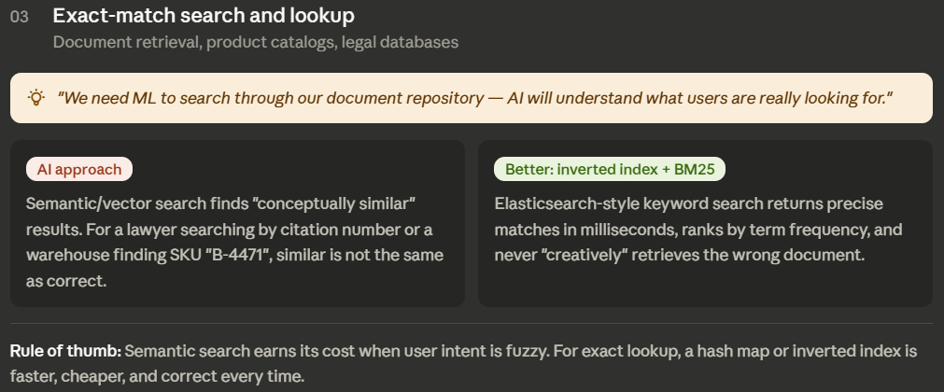

Slide 13
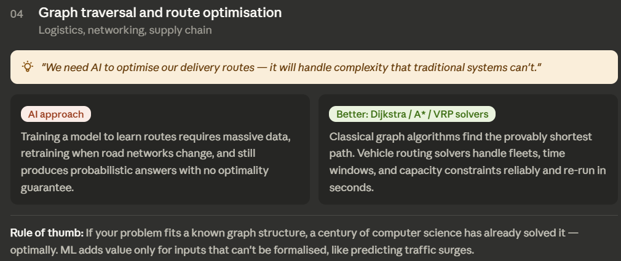

Slide 14
Traditional approach will be faster, cheaper, auditable, and correct.

Slide 15
Part 2
When do we need AI/ML algorithms ?

Slide 16
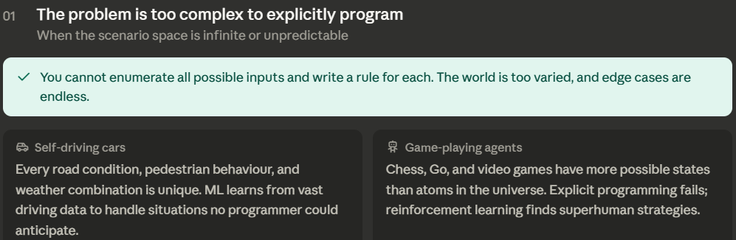
The problem is too complex to explicitly program all possible scenarios
Example: Self-driving cars
You can’t manually code every possible road condition, pedestrian behavior, or traffic situation.
ML models learn from vast driving data to handle unpredictable situations.

Slide 17
2. Patterns are subtle or hidden within vast amounts of data
Example: Predictive maintenance:
Machines give off subtle signals --
vibration,
temperature,
steady increase in current usage, etc.
before failure.
ML models can detect trends and predict breakdowns earlier than rule-based thresholds
Real-World Success:
GE reduced unplanned downtime by 20% in power plants using ML-based predictive maintenance
Mining companies reduced equipment failures by 25% using sensor data and ML
Airlines reduced delays and cancellations

Slide 18
Example: Detecting fraudulent transactions in banking
Fraud patterns are often rare, dynamic, and subtle — ML models can learn from millions of examples and detect anomalies that aren’t apparent to humans or rule-based systems.
Real-World Success:
PayPal's fraud detection system (reduced fraud rates by 10% while improving customer experience)
Insurance claim fraud detection (identifying connections between seemingly unrelated claims)

Slide 19

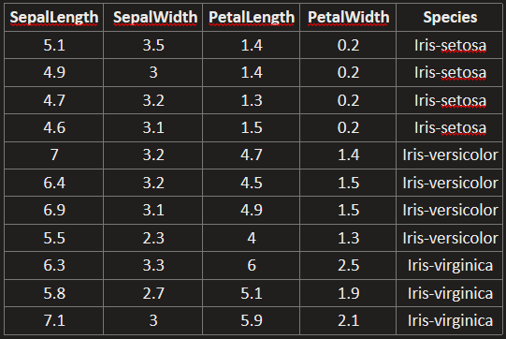


3. Rules are difficult to articulate but examples are plentiful
Example: Flower classification
We have measurement of flowers and their species types, but do not have any specific rule / formula that relates measurement with species

Slide 20
3. Rules are difficult to articulate but examples are plentiful
Example: Facial recognition
We can’t write explicit rules to define every possible human face, but we can train a model on millions of labeled images to recognize faces effectively.
Example: Natural Language Processing (NLP): Understanding context, sentiment, and meaning in text. It's nearly impossible to write deterministic rules for
sarcasm,
sentiment,
grammar, or
slang

Slide 21
4. The problem requires prediction based on incomplete information
Example: Medical diagnosis based on symptoms and patient history
Symptoms may vary or be incomplete.
ML models can make informed predictions based on patterns learned from prior patient data.

Slide 22
5. The environment is dynamic and continually changing
Example: Stock market trading algorithms
The market shifts constantly based on news, sentiment, and global events.
Adaptive ML models can continuously retrain and adjust to changes better than static logic.

Slide 23
6. The solution needs to improve with experience
Example: Personalized recommendation systems (e.g., Netflix, Amazon)
The system gets better over time by
learning user preferences and
adjusting recommendations accordingly.
Real-World Success:
Netflix credits its recommendation engine with saving over $1 billion annually through improved retention
Amazon generates 35% of its revenue from its recommendation system

Slide 24
7. Approximation is acceptable and preferable to no solution
Example: Language translation (e.g., Google Translate)
Perfect translation is impossible.
Here it's better to have an approximate translation than none at all, especially across languages.
Example: Speech recognition
Converting spoken language to text may be 90% accurate.

