Slide 1
AI for Documents — Word
Business writing and documentation
Draft business proposals, memos, and emails.
Summarize lengthy reports and meeting minutes.
Convert rough notes into formal documents.
Create SOPs, policy documents, and business plans.
Review documents for clarity, tone, and grammar.

Slide 2
Create a business proposal

Slide 3
Activity — Create a business proposal
Skill: Professional writing and structured documentation
Prompt to try in MS Word CoPilot:
You are a business development manager at Loxford Retail Ltd.
Prepare a business proposal for launching an online clothing store in three new cities having warm climate. The clothing items would be for school children for class 10 to 12.
Include the business objective, target customers, proposed strategy, resource requirements, estimated budget categories, potential risks, implementation timeline, and success metrics.
Use a professional management-report format.
Clearly label any assumptions rather than inventing actual business data.

Slide 4
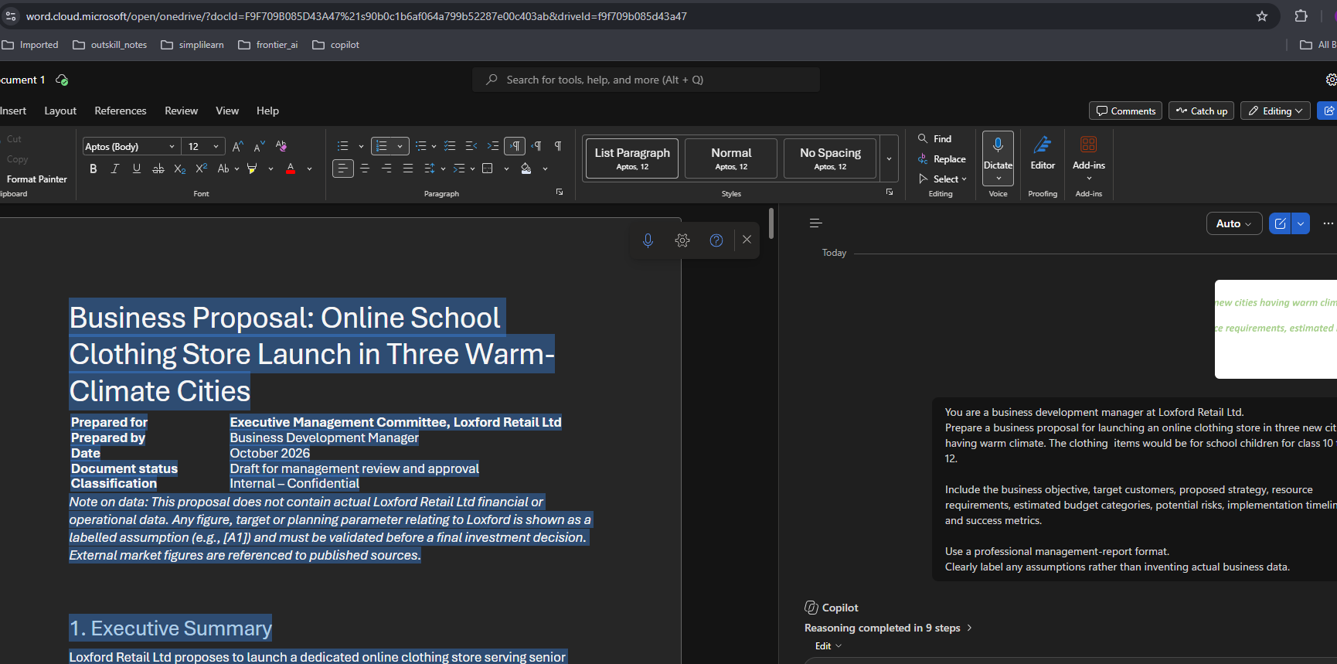
Output: An 8 – page proposal

Slide 5
Activity — Convert rough notes into an SOP
Convert the following rough notes into a Standard Operating Procedure (SOP) for handling customer complaints. Include purpose, scope, responsibilities, step-by-step procedures, escalation rules, response-time targets, and documentation requirements.
Identify missing policies that management must confirm instead of making them up.
(PTO)

Slide 6
Rough Notes to Formal documents

Slide 7
Activity — Rough Notes: Customer Complaint Process (Draft) – (From Text file)
Goal: Need a way to fix customer complaints so people don’t post bad reviews online and we keep our QA standards good.
Channels: Complaints come arrive via support emails, phone calls to the front desk, and sometimes direct messages on our official Instagram page.
First Steps: Whoever sees the complaint needs to write down what happened. Front desk handles phone calls, social media manager handles Instagram, and the support team handles the ticketing queue.
Logging: Put the details somewhere. Right now, few people use the Excel sheet on the shared drive, and others just update the Zendesk ticket. We need a single system.
Investigation: Basic tech issues go to IT. Product defects go to the Quality Assurance (QA) team. Billing error isssues, goes to Finance. The person investigating needs to find the root cause, but if it takes more than a week, they should probably update someone.
Resolution: Once fixed, email the customer the solution. But what if they want a refund? Right now, tier 1 agents just ask a manager, but there’s no clear rule on how much money an agent can refund on their own before needing approval.
Escalation stuff: If a customer starts swearing or threatens to sue us, the agent should immediately pass it to a manager. Also, if a high-value enterprise client complains, it needs to go straight to the Director of Support. What defines a "high-value client"? We usually just know based on the company name.
Timelines: Try to reply fast. Maybe acknowledge it within a day? And try to close the whole thing in 5 to 10 days, depending on how complicated it is. Priority items (like system downtime) need to be handled faster, but we don't have exact hours written down for SLAs.
Closing it out: Mark the ticket as closed. We should probably keep a record of these for a few years in case audits happen, but nobody knows what the exact corporate data retention policy is for compliance.

Slide 8
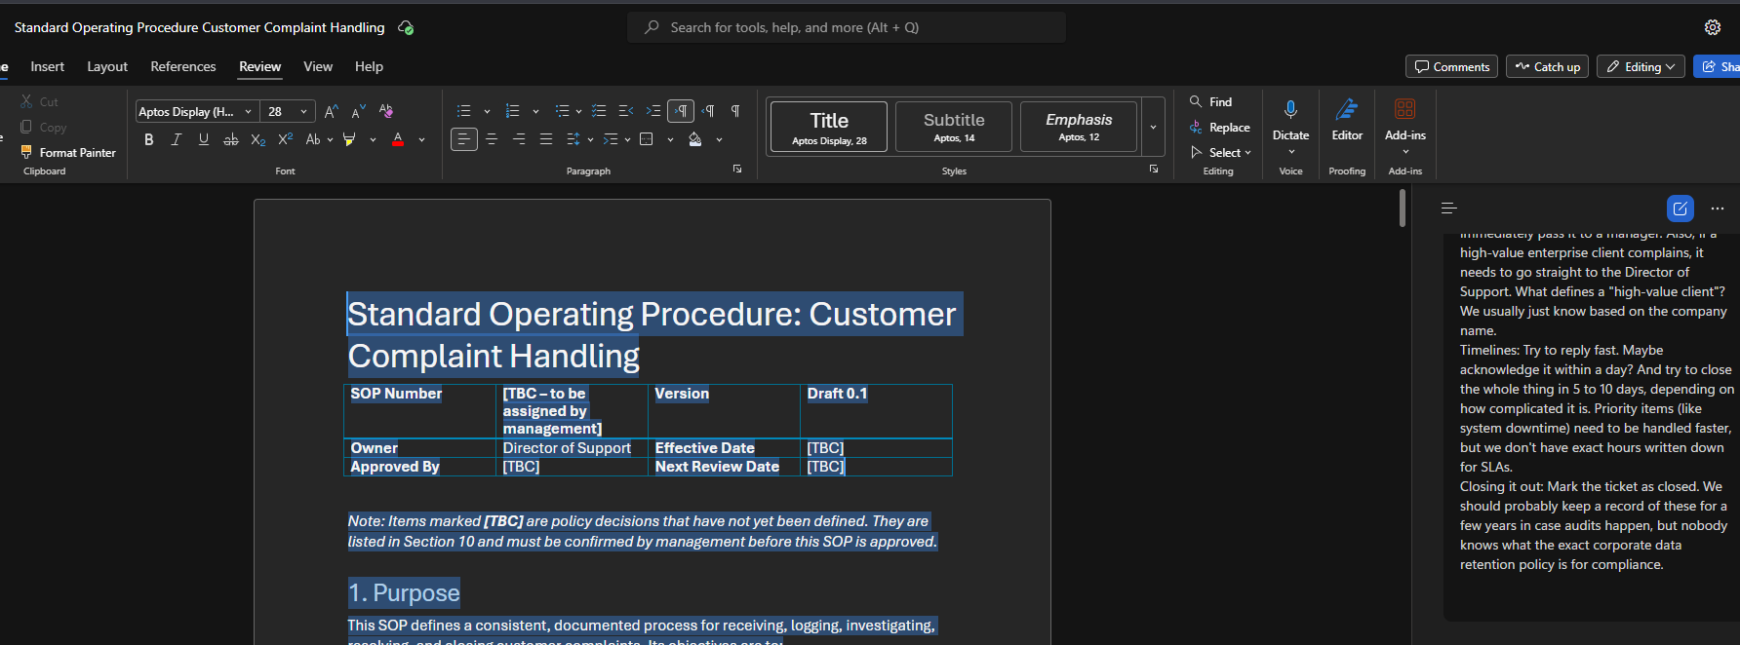
Sample output

Slide 9
Meeting Minutes

Slide 10
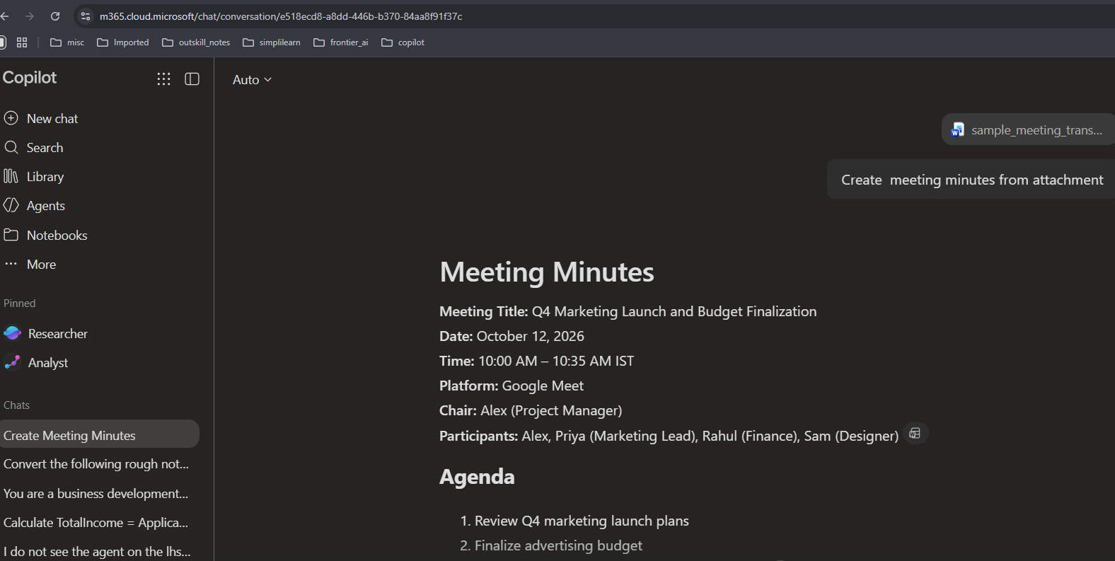
Activity — Upload the sample_meeting_transcript.docx onto Microsoft copilot
Ask: Create meeting minutes from attachment

Slide 11
Summarize lengthy reports

Slide 12
Activity — Upload the sample_Businessreport.pdf onto Microsoft copilot
Ask:
Summarize this business report for a busy department manager.
Provide an executive summary, five key findings, major risks, important numerical results, and three recommended actions.
Separate facts stated in the report from your own interpretations.
Cite page numbers or sections when available.

Slide 13
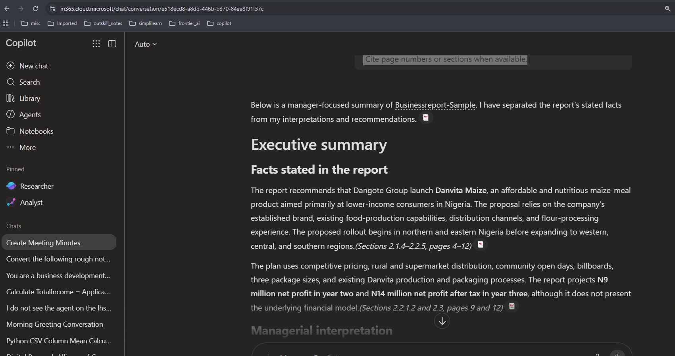
Sample output

