Slide 1
Loan Portfolio Analysis, Credit Risk Assessment, and Loan Approval Performance Report
Finance & Credit Risk Department
Senior Management Presentation
10 October 2026

Slide 2
Executive Summary
614 Applications | 422 Approved (68.7%) | 192 Rejected (31.3%)
Credit history is the strongest observed outcome differentiator
Semiurban approval rate highest observed
Data quality improvements required

Slide 3
Dataset Overview
614 records, 614 unique IDs, no duplicates
Missing values concentrated in Credit_History, Self_Employed, LoanAmount and Loan_Amount_Term
No repayment-performance data available

Slide 4
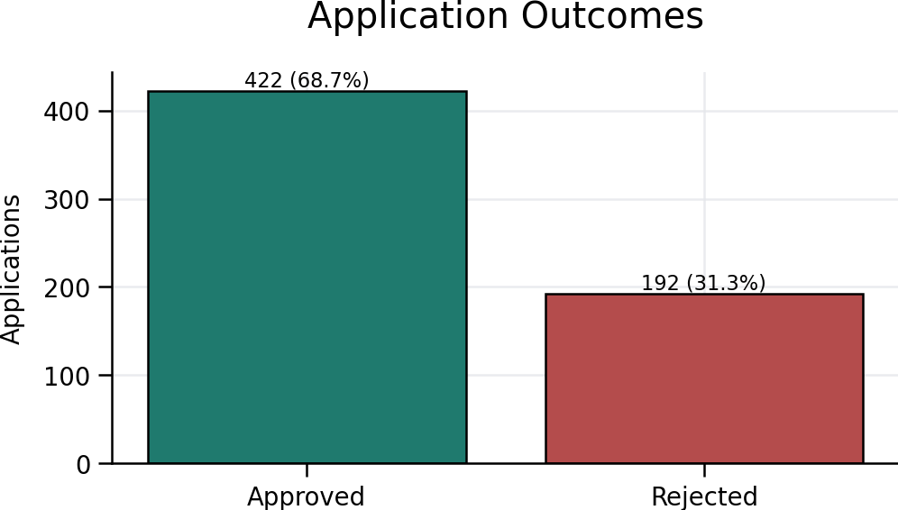
Loan Approval Performance
Approval and rejection rates based on application outcomes only

Slide 5
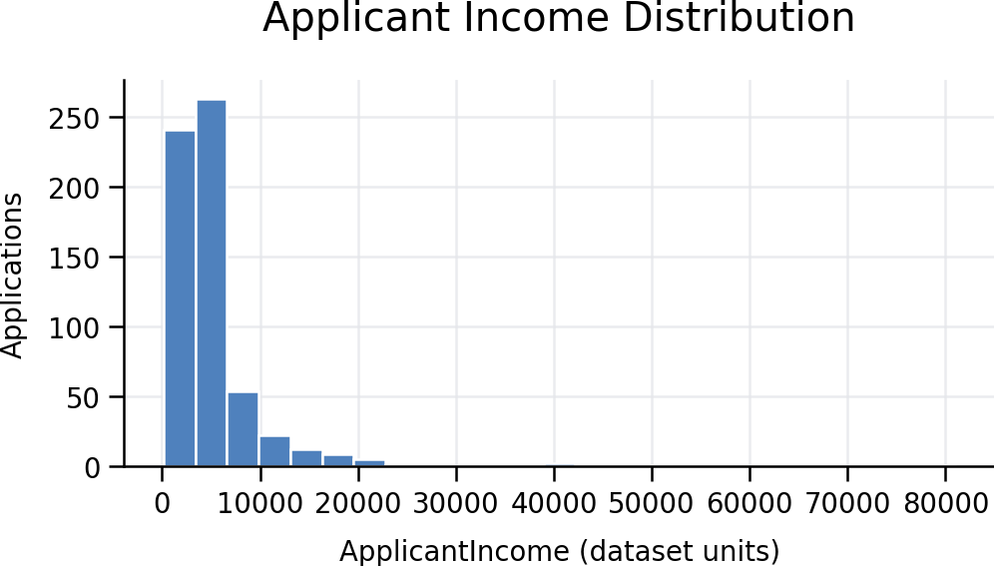
Key Financial Insights
Average Applicant Income: 5,403.5
Average Loan Amount: 146.4
Income is right-skewed
Loan amount distribution contains outliers

Slide 6
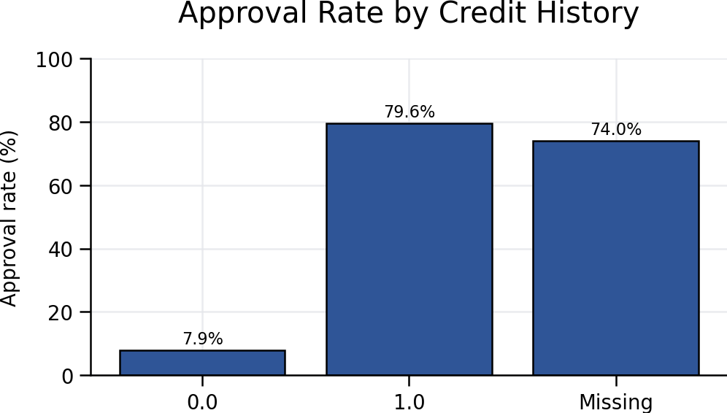
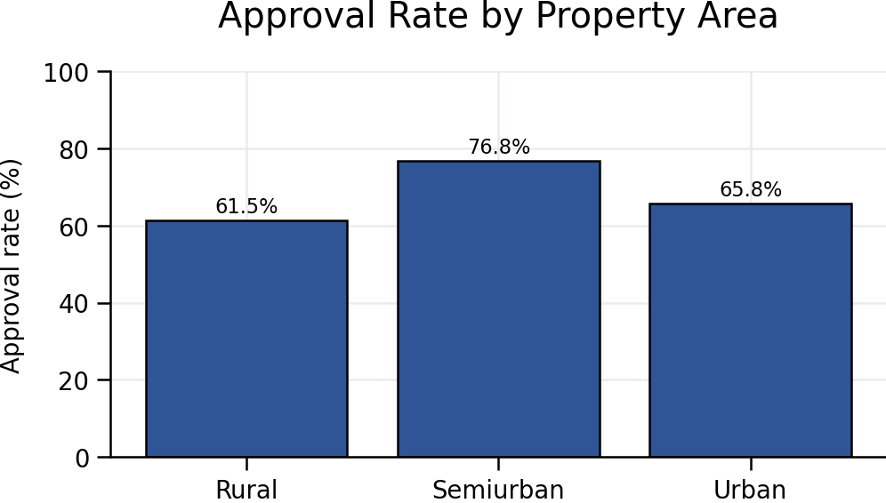
Credit Risk Analysis
Approval patterns vary significantly by recorded credit history and property area

Slide 7
KPI Dashboard
Applications: 614
Approval Rate: 68.7%
Rejection Rate: 31.3%
Unique IDs: 614

Slide 8
Key Risks and Limitations
No default/delinquency data
Undocumented monetary units
Missing values
Affordability cannot be confirmed

Slide 9
Recommendations & Action Plan
Improve data quality
Document field definitions
Capture decision reasons
Link applications to repayment outcomes

Slide 10
Conclusion & Next Steps
Build a governed finance and credit-risk data model and repayment-linked analytics

