Slide 1
Data used:
https://github.com/ash322ash422/data/blob/main/data_CC_GENERAL.csv

Slide 2
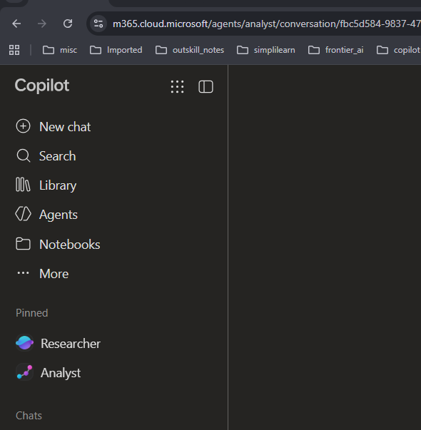

Agent used: Analyst

Slide 3
Activity: Quick Analysis of Data

Slide 4
You uploaded a file and want a quick analysis of the data file

Slide 5
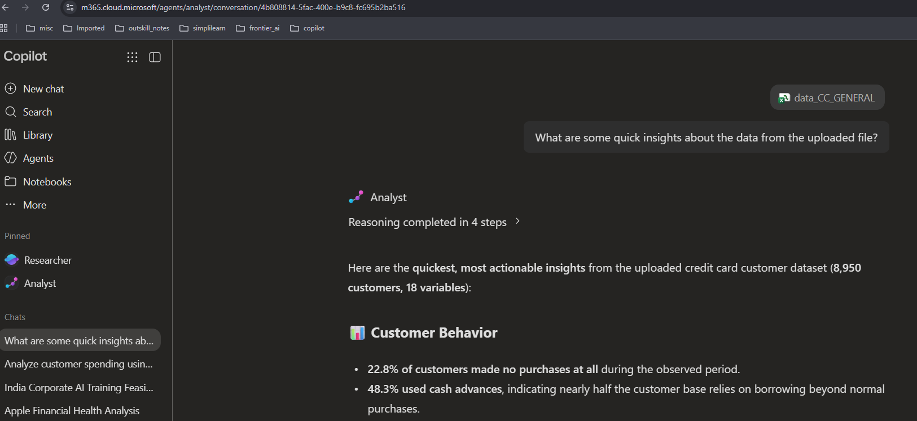
Output: Also see the OUPUT file

