Slide 1
Data used:
https://github.com/ash322ash422/data/blob/main/data_CC_GENERAL.csv

Slide 2
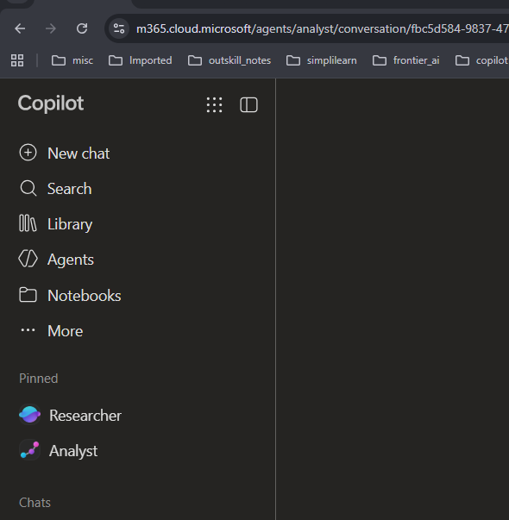

Agent used: Analyst

Slide 3
Activity 1: Customer Spending Analysis

Slide 4
Business question: Who spends the most, and how do customers use their credit cards?
Copilot prompt:
Analyze customer spending using PURCHASES, ONEOFF_PURCHASES, INSTALLMENTS_PURCHASES, and PURCHASES_TRX.
Identify high-spending and low-spending customers
Compare one-time purchases with installment purchases
Create suitable charts with key insights.

Slide 5
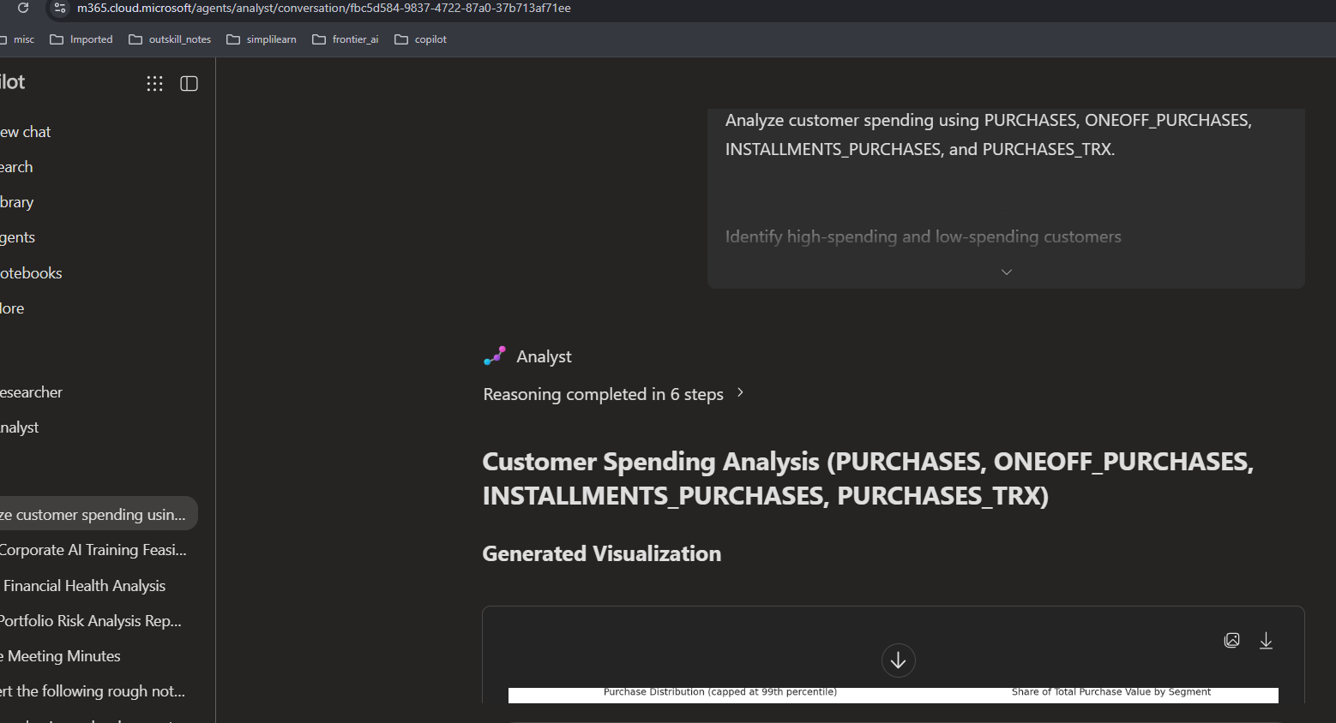
Output: Also see the OUPUT file

