Slide 1
Data used:
https://github.com/ash322ash422/data/blob/main/data_CC_GENERAL.csv

Slide 2
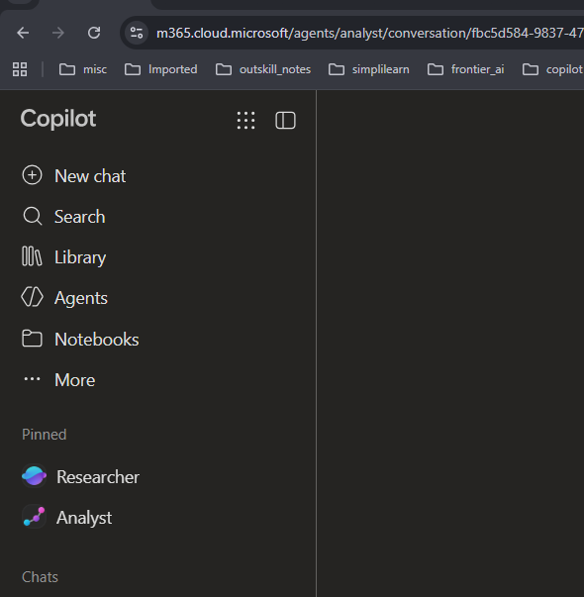

Agent used: Analyst

Slide 3
Activity: Cash Advance Behavior
Management value:
Understand customer behavior and potential credit-risk indicators without automatically labeling customers as risky.

Slide 4
Business question:
Which customers rely heavily on cash advances rather than purchases?
Copilot prompt:
Analyze CASH_ADVANCE, CASH_ADVANCE_FREQUENCY, CASH_ADVANCE_TRX, and PURCHASES.
Identify customers with high cash advances and low purchase activity.
Compare their behavior with other customers
Suggest questions a bank analyst should investigate.

Slide 5
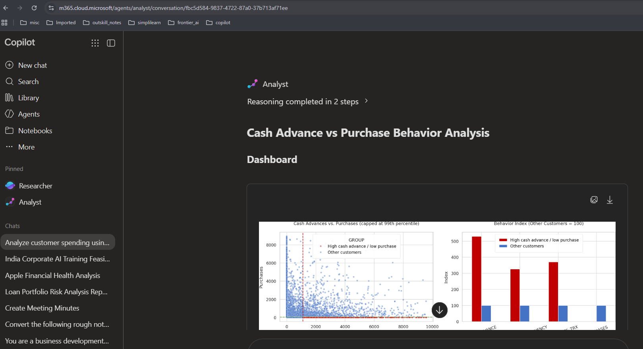
Output: Also see the OUPUT file

