Slide 1
Data used:
https://github.com/ash322ash422/data/blob/main/data_CC_GENERAL.csv

Slide 2
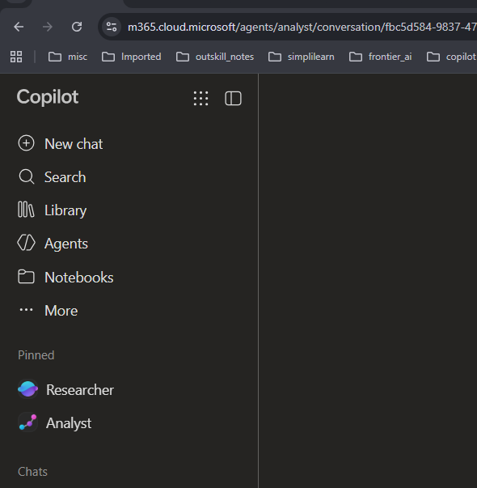

Agent used: Analyst

Slide 3
Activity 1: Credit Limit and Balance Analysis
Data used: https://github.com/ash322ash422/data/blob/main/data_CC_GENERAL.csv
Business question:
Which customers have balances high relative to their credit limits?
Copilot prompt:
Calculate balance-to-credit-limit ratio as BALANCE divided by CREDIT_LIMIT.
Identify customers with high ratios, compare their purchases and payments, and create a chart showing the distribution of these ratios.
Flag missing or invalid values before calculating.
Management value:
Explore credit utilization and identify customers who may need further review. A high balance alone does not establish default risk.

Slide 4
Activity 2: Customer Segmentation
Data used: https://github.com/ash322ash422/data/blob/main/data_CC_GENERAL.csv
Business question:
What different types of credit-card customers does the bank have?
Copilot prompt:
Segment customers using their spending, cash advances, purchase frequency, balance, and payment behavior. Suggest meaningful customer groups, describe the characteristics of each group, estimate the number of customers in each group, and recommend suitable marketing or service strategies.
Possible segments to investigate:
Frequent shoppers
Installment-focused customers
Cash-advance-heavy customers
Low-activity customers
Customers who frequently pay in full

Slide 5
Activity 2: Customer Segmentation
Data used: https://github.com/ash322ash422/data/blob/main/data_CC_GENERAL.csv
Business question:
What different types of credit-card customers does the bank have?
Copilot prompt:
Segment customers using their spending, cash advances, purchase frequency, balance, and payment behavior. Suggest meaningful customer groups, describe the characteristics of each group, estimate the number of customers in each group, and recommend suitable marketing or service strategies.
Possible segments to investigate:
Frequent shoppers
Installment-focused customers
Cash-advance-heavy customers
Low-activity customers
Customers who frequently pay in full

