Slide 1
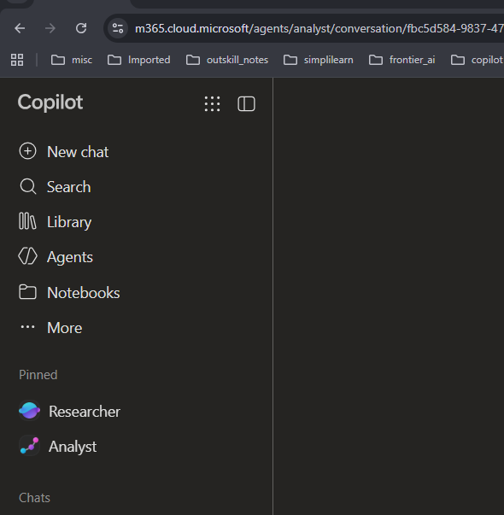

Agent used: Analyst

Slide 2
Activity 1: Planets
Copilot prompt:
Create a table with the volume of planets, add a column to show the volume as multiple of Earth's, and a row to show how the sum compares to the volume of the sun.

Slide 3
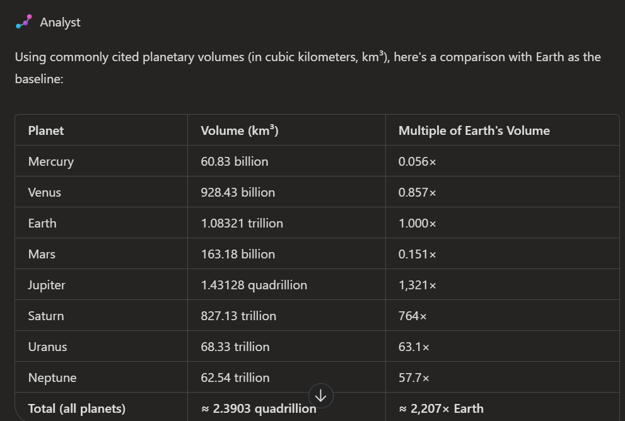
Output

