Slide 1
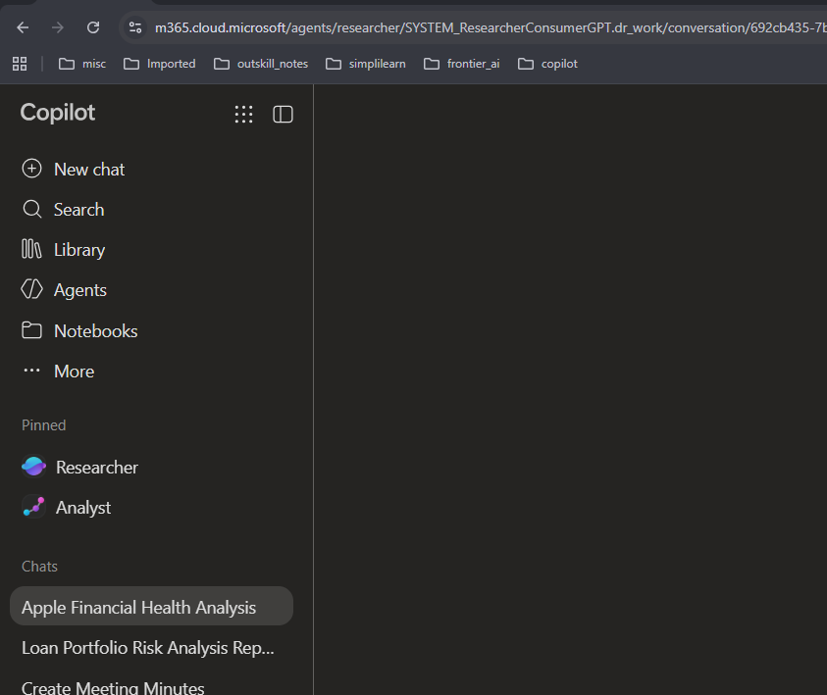

Researcher Agent

Slide 2
Scenario:
Suppose you want to buy stocks of Apple and want to research before buying it

Slide 3
Act as a financial research analyst.
Research Apple company financial health using its latest available annual report, official financial statements, and credible financial sources.
Analyze:
Revenue and revenue growth.
Net income and profit margin.
Debt and liquidity position.
Operating cash flow and free cash flow, where available.
Major financial risks and business challenges.
Performance trends over the last three fiscal years.
Present the findings in a structured report. Include a table of key financial metrics, cite sources for factual claims, distinguish reported figures from your own calculations, and identify any limitations in the data.
Conclude with five questions an investor should investigate further. Do not make unsupported investment recommendations. Make it 5+ page. Use the latest annual report + subsequent quartely filing

Slide 4
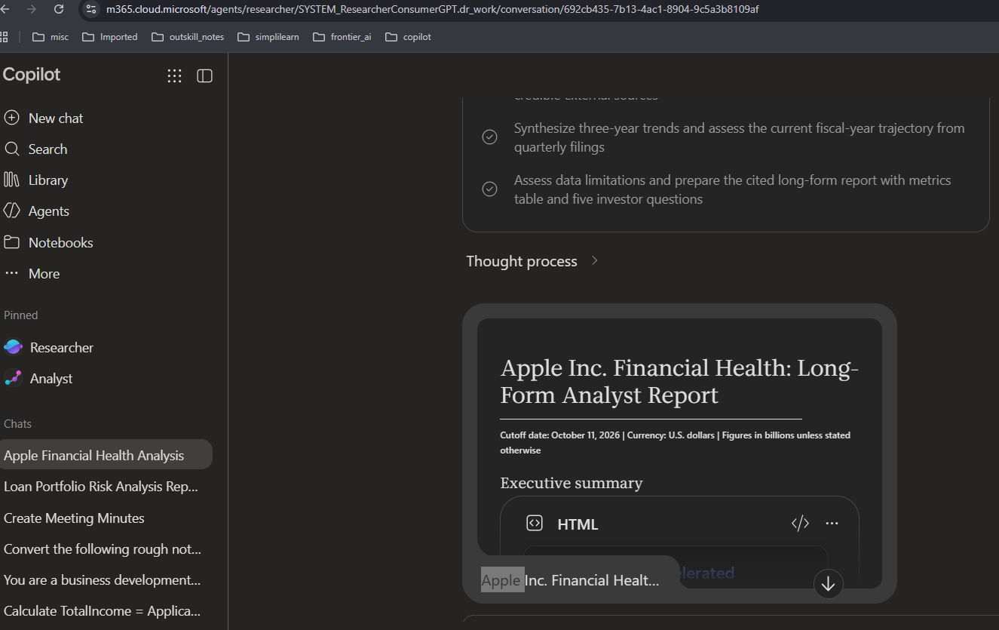
Output after 5 minutes:
Open the report and copy paste in word or convert to word. See the OUTPUT file

