Slide 1
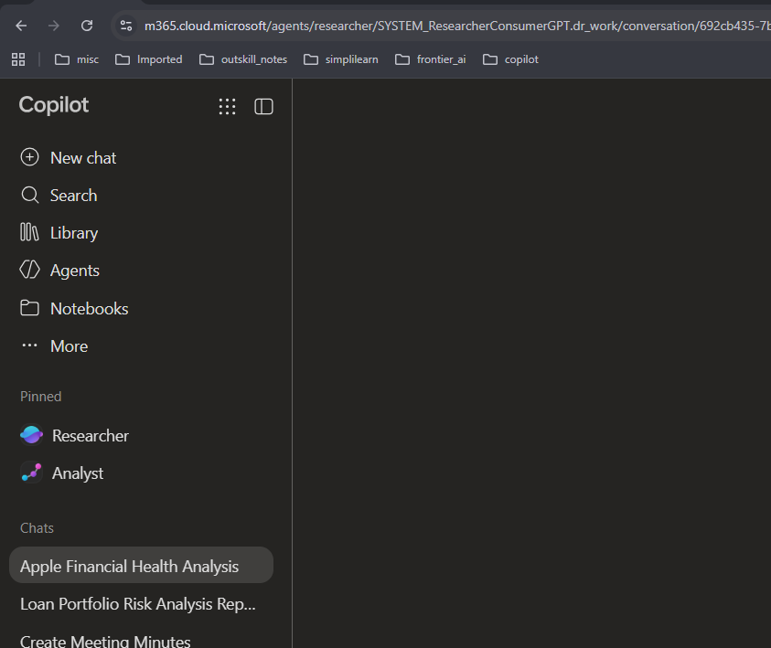

Researcher Agent

Slide 2
Scenario:
Suppose you want to launch an AI training institute with budget of 2 lakh. Your institute would train corporate employees

Slide 3
Role: Act as a business strategy consultant and market researcher.
Objective: Research the feasibility of launching an AI training institute for corporate employees and management teams in India.
Business Background:
Initial budget: ₹2,00,000.
Trainer: 5+ years of teaching experience and 10+ years of software development experience using AI/ML.
The trainer has an existing MSME company called XYZ.
Delivery: Online and onsite corporate training.
Target: Secure the first 3–5 paying corporate clients within 90 days.
Training Areas:
Generative AI and Microsoft Copilot for office productivity.
AI for managers and business decision-making.
AI automation and AI agents.
Continued….

Slide 4
Continued….
Research Tasks:
Analyze the Indian corporate AI training market and identify promising customer segments.
Research at least 5 competitors, their services, positioning, and publicly available pricing.
Recommend suitable training packages and realistic prices for half-day and full-day workshops.
Prepare a ₹2 lakh startup budget and estimate revenue, expenses, and break-even scenarios.
Compare operating through XYZ versus establishing a separate business.
Recommend practical ways to acquire corporate clients through direct sales.
Identify relevant Indian business, tax, contractual, and compliance considerations.
Create a practical 90-day launch plan with weekly milestones.
Research Requirements:
Use credible, current sources, including official websites, government sources, competitor websites, and industry reports. Cite sources and links. Clearly distinguish verified facts from estimates and assumptions. Do not invent prices or market statistics.
Final Output:
Provide an executive summary, competitor comparison table, suggested pricing, budget allocation, customer acquisition strategy, and prioritized action plan. Conclude with a go/no-go recommendation and the first three actions to take. Keep the report practical for a small business with limited capital.

Slide 5
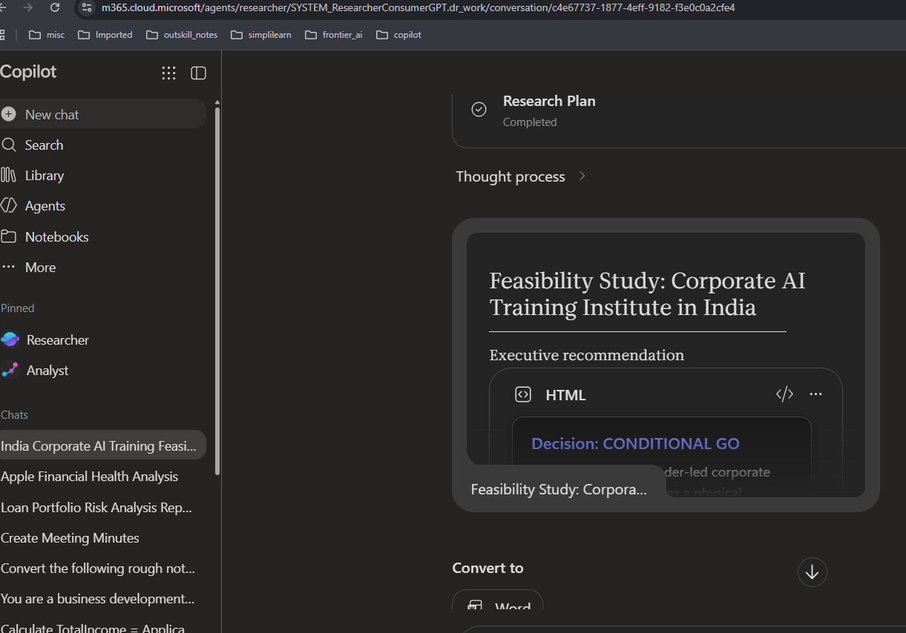
Output after 5 minutes:
Open the report and copy paste in word or convert to word. See the OUTPUT file

