Slide 1
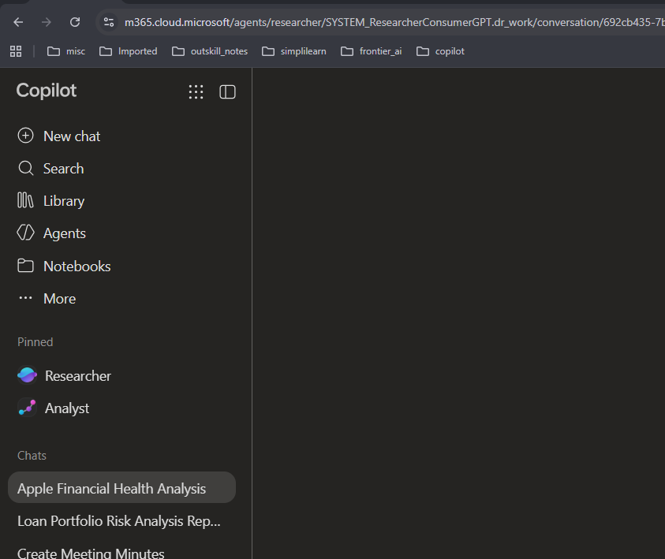

Researcher Agent

Slide 2
Scenario:
A company is considering launching an AI-powered personal finance app for young professionals in India.

Slide 3
Act as a senior product manager.
Research the market opportunity for an AI-powered personal finance app targeting young professionals in India.
Investigate:
The major financial management problems faced by the target segment.
Existing competing apps and their main features.
Customer needs that existing products may not adequately address.
Current trends in AI-powered budgeting, expense tracking, and financial education.
Potential privacy, security, regulatory, and trust concerns.
Three possible product concepts, each with its target user and value proposition.
Use credible industry reports, official product websites, regulatory sources, and published customer research where available. Cite your sources and identify gaps in the available evidence.
Recommend one concept for further validation. Include assumptions, risks, and five customer interview questions to test whether the problem is real. Do not present unverified customer needs as established facts.

Slide 4
Scenario:
You want to open a business of selling textbooks to school.

Slide 5
Act as a business research consultant.
Help me evaluate launching a school textbook selling business in India, targeting private schools.
Research and provide:
Market demand: Identify target schools, their textbook purchasing process, and major opportunities.
Competitors: Find at least five textbook publishers or suppliers and compare their offerings and business models.
Business model: Compare buying books from publishers and reselling them to schools versus becoming a distributor.
Investment and profits: Estimate startup costs, pricing, profit margins, and break-even sales.
Customer acquisition: Suggest practical ways to approach school principals, administrators, and procurement teams.
Action plan: Create a 90-day launch plan with clear milestones.
Use current, credible sources and provide citations. Clearly separate verified facts from estimates and assumptions. Do not invent prices or market statistics.
Finish with a recommendation on whether this business is viable, its key risks, and the first three actions I should take.

