Slide 1
Generative AI Assistant

Slide 2
What is a Generative AI Assistant?
A Generative AI (GenAI) Assistant is an AI-powered application that understands a user's request in natural language and generates useful responses, such as explanations, summaries, recommendations, reports, or answers based on data.
Explanation,
summaries, recommendations, charts,
reports, etc.
User Question.
Generative AI Assistant

Slide 3
Example 1: You ask “I earn ₹80,000 per month. Analyze my expenses and suggest how I can save ₹10,000 more every month.”
What Gen AI Assistant does:
Retrieves categorized transaction data, if authorized.
Groups spending into categories such as rent, food, travel, and shopping.
Calculates spending patterns and identifies possible savings.
Generates a personalized budget and recommendations.
“I earn ₹80,000 per month. Analyze my expenses and suggest how I can save ₹10,000 more every month.”
Generative AI Assistant
(Personal Finance Assistant)
Generates a personalized budget and recommendations
Excel sheet containing monthly expenses
Demo of above: Upload the expense file in Google Gemini and ask the above question

Slide 4
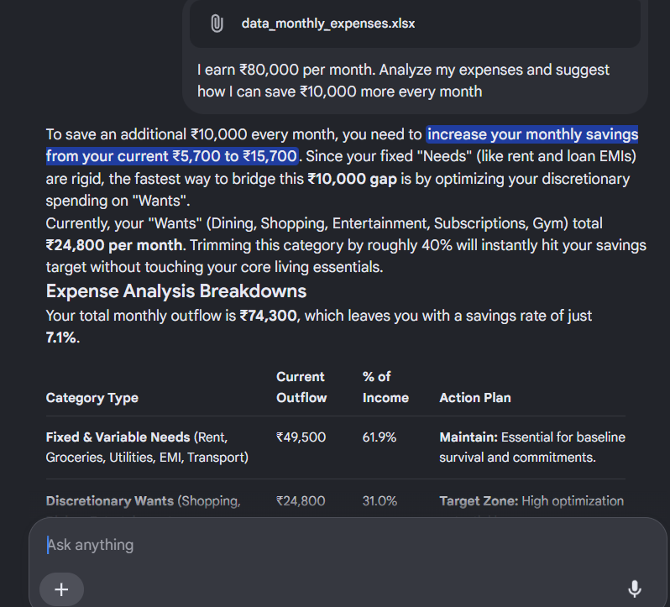
Output

Slide 5
Example 2: You ask “Analyze Apple's quarterly results and summarize its revenue growth, profitability, and major risks.”
What Gen AI Assistant does:
Retrieves financial reports and relevant financial data.
Extracts important metrics such as revenue, profit, and operating expenses.
Compares current results with previous quarters.
Generates a concise financial analysis in natural language.
“Analyze Apple's quarterly results and summarize its revenue growth, profitability, and major risks.”
Generates a financial analysis in natural language.
Generative AI Assistant
(Financial Report Analysis Assistant)
Website of Apple data

Slide 6
Example 3: You ask “Analyze my company's expenses this quarter and identify where we can save money.”
“Analyze my company's expenses this quarter and identify where we can save money.”
Summaries,
recommendations,
charts,
reports, etc.
Generative AI Assistant
(Expenses Analysis Assistant)
Excel file with data

