Slide 1
Micro services
What is Microservice ?
Examples of Microservice
Communication between Microservice
CI / CD for microservices
Benefits / Challenges of MS

Slide 2
What is micro service ?
Service 1
Service 4
Service 1
Service 4
Service 2
Service 5
Service 2
Service 5
Service 3
Service 6
Service 3
Service 6
Break a big application into smaller ones (microservices)

Slide 3
Example:
An ecommerce website might have separate services for:
Managing products – Buy / sell items
Maintaining shopping carts – Add / remove / update items
Handling payments
Tracking inventory
Providing AI recommendations
Together, these services power one shopping experience.

Slide 4
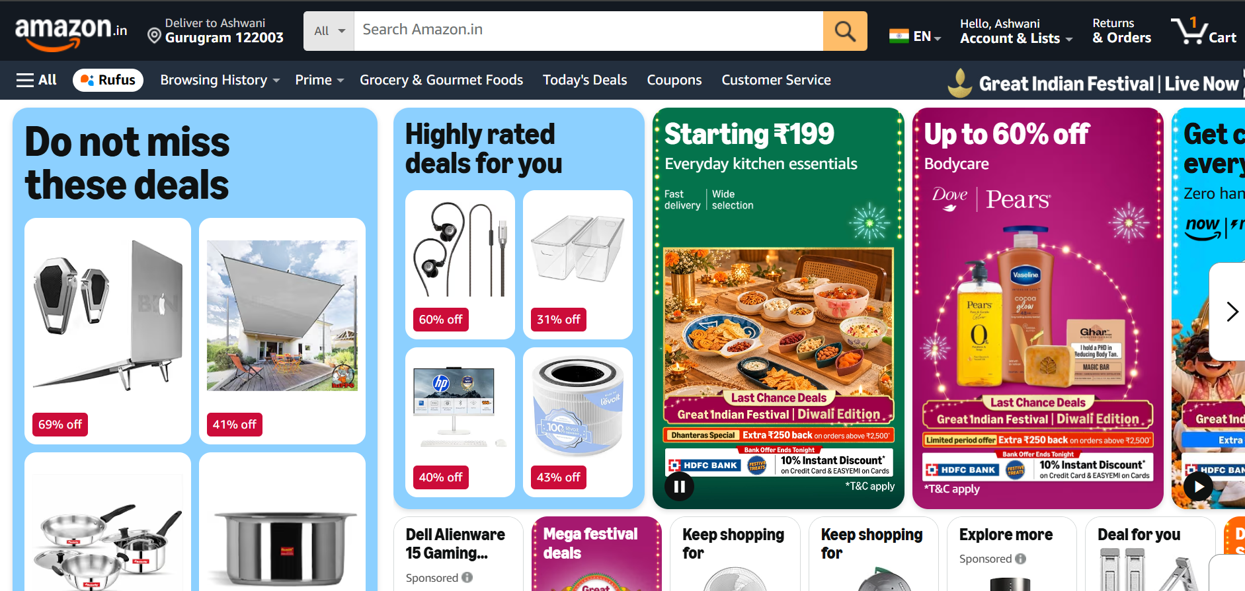

Example of microservice

Slide 5
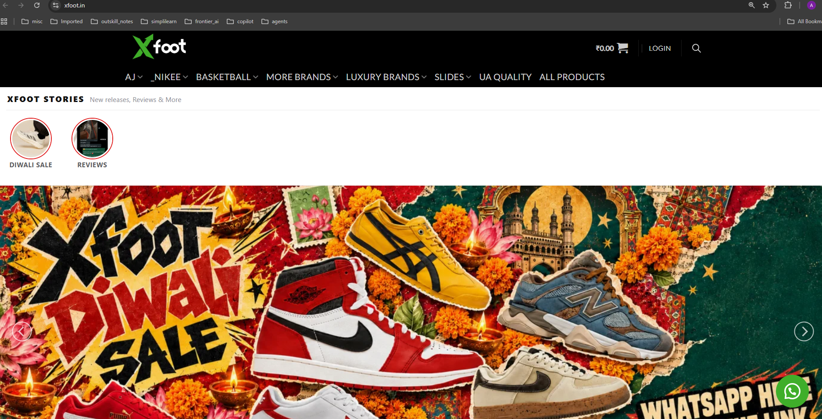




Example of microservice

Slide 6

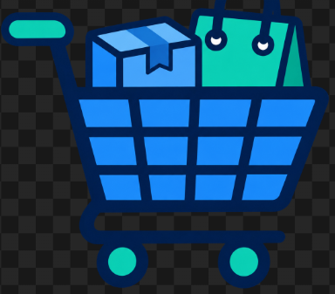
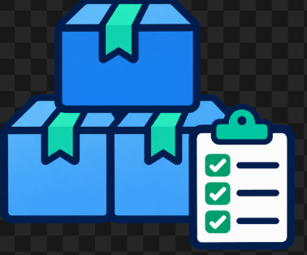
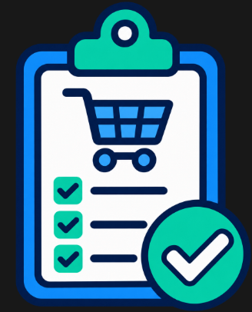
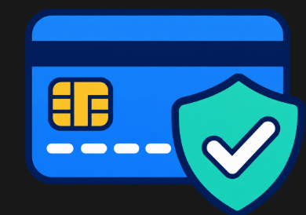


Each service owns its business logic and data. It is self-contained + independant
Service | Main responsibility
Product Service | Stores product descriptions, prices, and images
Cart Service | Tracks the products a customer wants to buy
Inventory Service | Tracks available stock and reserves items
Order Service | Creates orders and tracks their status
Payment Service | Coordinates payments with a payment provider
Notification Service | Sends order confirmations and delivery updates
AI Recommendation Service | Suggests products relevant to the customer

Slide 7
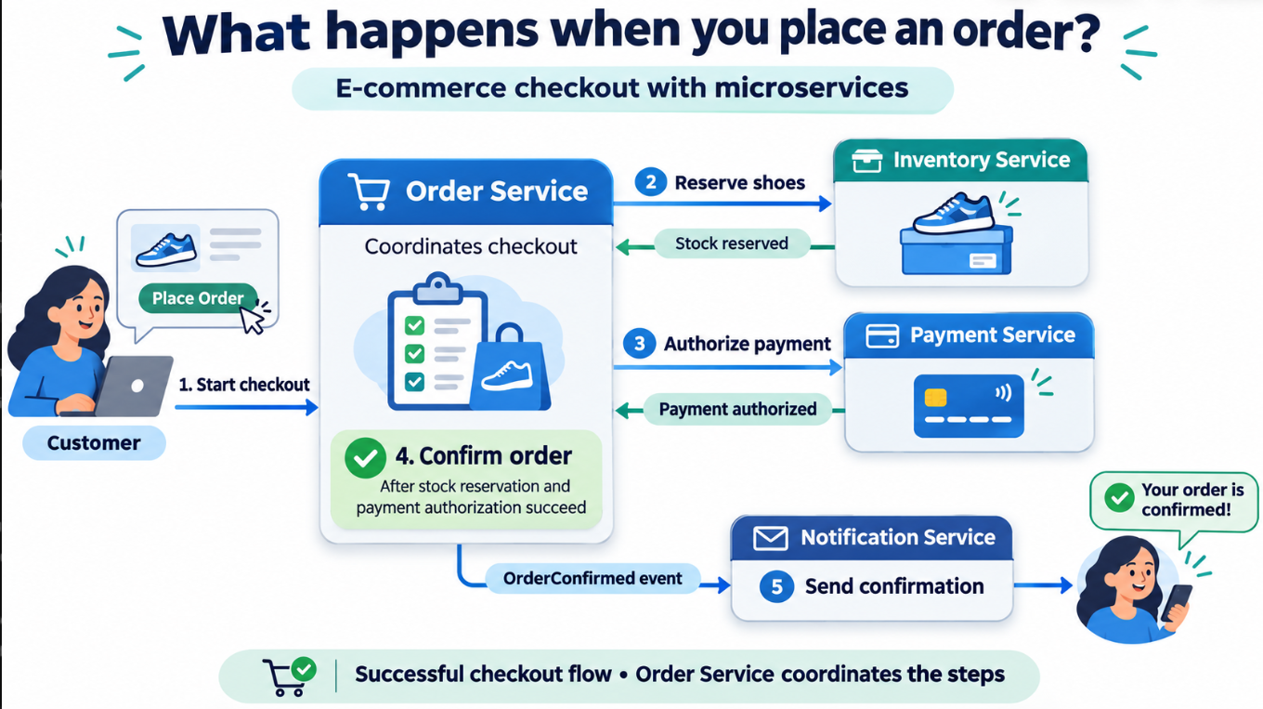
Example - Checkout
Imagine an ecommerce website called xFoot.in. When the customer clicks “Place Order”:
The Order Service starts the checkout process.
The Inventory Service attempts to reserve the shoes.
The Payment Service requests payment authorization.
The Order Service confirms the order when the required steps succeed.
The Notification Service sends a confirmation.

Slide 8
Communication between services
2 main ways: Synchronous requests and Asynchronous messages.

Slide 9

Synchronous : One service calls another service and waits for a response.
Services can communicate with each other through HTTP API requests
Payment
Cart Service
Adding a Product to the Cart
The User clicks “Add to Cart ” on website. It sends an API request.
Example API request: POST /cart/items
Information sent: Product ID: SHOE-101; Quantity: 1
2. The Cart Service records the product and quantity.
3. The service returns the updated cart.
Information returned: Updated cart contents
4. The website displays the result top the user.
User
User account

Slide 10
Payment
Cart Service
User
User account
Main challenge of synchronous:
If the other service is slow or unavailable, the caller is affected. Use timeouts and handle failures.

Slide 11
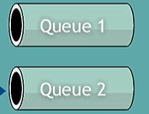
Asynchronous:
A service sends a message through a message broker. Another service processes it later.
The sender does not wait for the business task to finish.
Message Broker
Payment
User account
Review of Product
Publisher
Subscriber
Example: RabbitMQ, Kafka, and cloud messaging services

Slide 12
Asynchronous:
Use when: work takes time, traffic arrives in bursts, or several services should react independently.
Message Broker
Payment
User account
Checkout
Publisher
Subscriber
Main challenge:
Results arrive later, and messages may be delivered more than once. Solution: Services need retry handling and protection against duplicate processing.

Slide 13
CI / CD Pipeline for microservices
Mono Repo
Poly Repo

Slide 14
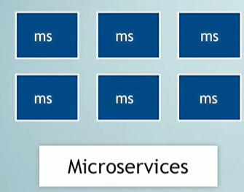


Mono Repo
Single repo contains many projects/microservices

Slide 15
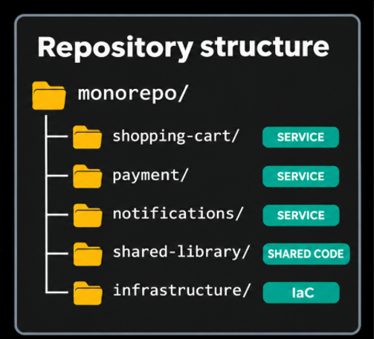
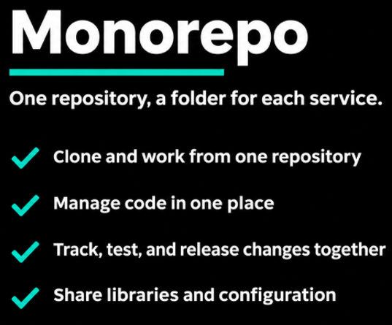
Mono Repo
Mono Repo good for
small projects.
when you want one CI/CD pipeline.

Slide 16
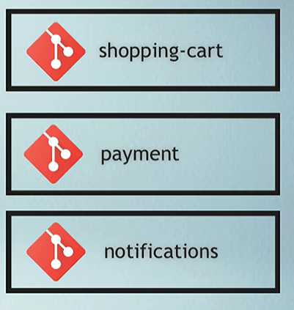
Poly Repo:
1 repo for each service
Code is isolated -> Developers can clone and work on them separatly
When to Use:
Many services and each using different frameworks (Java, Python, etc.)
You have separate teams for each service. Each team will have separate CI/CD pipeline
You want your code base to be small

Slide 17



Benefits for Microservices
User Account
Shopping cart
Each microservice team can choose its own tech stack
Payment
Each team can work independently
Update 1 microservice without redeploying others.
Recommendation
Contain some failures: Recommendations service can be unavailable while Shopping service continues.

Slide 18
Challenges of MS
User Account
Shopping cart
More services to deploy, monitor, and secure.
Network calls can be slow or fail.
Payment
Recommendation
More complexity: Keeping orders, payments, and inventory consistent is harder.

Slide 19
Demo of Microservice

