Slide 1
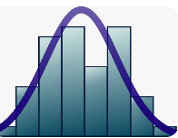

Definition of DA
Data = Information represented in numbers, text, images, etc.
Generally, in form of tables.
Can also be in form of semi-structure (XML, JSON, etc.) or unstructured (audio, video, blog, etc. )
Analysis: Making sense out of data…
Visually (histogram, scatterplot, line plot, radar plot, tree plot, etc.) or
Numerically (mean, mode, median, variance, standard deviation, hypothesis testing, A/B Testing, etc. )

Slide 2
Definition of DA
DA is more focused aspect of the broader data science field, which involves
examining,
cleaning,
transforming, and
modeling data
to uncover useful information, draw conclusions, and support decision-making.
DA is subset of Data Science

Slide 3
What type of general question does DA answer ?

Slide 4
Case study: For an e-commerce dataset, what type of question can DA answer ?
OrderID | Cust_ID | OrderDate | Prod_ID | Category | Qty | Price | Discount | Revenue | Region | DeviceType | Age | Returned | Campaign | Rating
1001 | C102 | 2024-04-10 | P98 | Electronics | 1 | 399.99 | 0.1 | 359.99 | West | Mobile | 28 | No | SpringSale | 4.5
1002 | C105 | 2024-04-10 | P43 | Kitchen | 6 | 20.87 | 0 | 100 | North | Spoon | 54 | No | WinterSale | 3.5
Exploratory Questions
(What patterns exist?)
Used in early stages of analysis:
Are there any customer segments (groups) based on behavior?
What trends can we see in user activity over time?
Are there any outliers in the data?
Example:
Are there distinct customer segments by age and purchase behavior?
Do some product categories see higher returns or lower ratings?
Explore relationships between region, campaign, and revenue.

Slide 5
Case study: For an e-commerce dataset, what type of question can DA answer ?
OrderID | Cust_ID | OrderDate | Prod_ID | Category | Qty | Price | Discount | Revenue | Region | DeviceType | Age | Returned | Campaign | Rating
1001 | C102 | 2024-04-10 | P98 | Electronics | 1 | 399.99 | 0.1 | 359.99 | West | Mobile | 28 | No | SpringSale | 4.5
1002 | C105 | 2024-04-10 | P43 | Kitchen | 6 | 20.87 | 0 | 100 | North | Spoon | 54 | No | WinterSale | 3.5
2) Descriptive Questions
(What happened?)
These questions aim to summarize past data:
What were the total sales last quarter?
How many users signed up last month?
What is the average customer age?
EXAMPLE
What were total monthly revenues in Q2? (Determined rom OrderDate)
What is the average customer rating for certain product?
How many products were returned last year?

Slide 6
Case study: For an e-commerce dataset, what type of question can DA answer ?
OrderID | Cust_ID | OrderDate | Prod_ID | Category | Qty | Price | Discount | Revenue | Region | DeviceType | Age | Returned | Campaign | Rating
1001 | C102 | 2024-04-10 | P98 | Electronics | 1 | 399.99 | 0.1 | 359.99 | West | Mobile | 28 | No | SpringSale | 4.5
1002 | C105 | 2024-04-10 | P43 | Kitchen | 6 | 20.87 | 0 | 100 | North | Spoon | 54 | No | WinterSale | 3.5
3) Diagnostic Questions
(Why did it happen?)
These look deeper to find causes or correlations:
Why did sales drop in March?
Which marketing campaign performed best?
What factors are linked to high customer churn?
EXAMPLE
Why were sales/orders low in March? Here Qty will give you the sales order amount
Is there a pattern between discounts and returns?
Do younger customers give lower ratings? Here we can find Younger status from age column

Slide 7
Case study: For an e-commerce dataset, what type of question can DA answer ?
OrderID | Cust_ID | OrderDate | Prod_ID | Category | Qty | Price | Discount | Revenue | Region | DeviceType | Age | Returned | Campaign | Rating
1001 | C102 | 2024-04-10 | P98 | Electronics | 1 | 399.99 | 0.1 | 359.99 | West | Mobile | 28 | No | SpringSale | 4.5
1002 | C105 | 2024-04-10 | P43 | Kitchen | 6 | 20.87 | 0 | 100 | North | Spoon | 54 | No | WinterSale | 3.5
4. Predictive Questions
(What is likely to happen ?)
Using statistics to make forecasts:
What will our revenue look like next month?
Which customers are likely to churn?
How many support tickets can we expect next week?
EXAMPLE
Are customers buying more kitchen items in summer?
Which customers are likely to return a product?
Forecast demand for each category in the next quarter.

Slide 8
Case study: For an e-commerce dataset, what type of question can DA answer ?
OrderID | Cust_ID | OrderDate | Prod_ID | Category | Qty | Price | Discount | Revenue | Region | DeviceType | Age | Returned | Campaign | Rating
1001 | C102 | 2024-04-10 | P98 | Electronics | 1 | 399.99 | 0.1 | 359.99 | West | Mobile | 28 | No | SpringSale | 4.5
1002 | C105 | 2024-04-10 | P43 | Kitchen | 6 | 20.87 | 0 | 100 | North | Spoon | 54 | No | WinterSale | 3.5
5. Prescriptive Questions
(What should we do?)
These suggest actions based on data:
Which product should we promote more to increase sales?
How can we reduce operational costs to minimize loss?
What pricing strategy will maximize profit?
EXAMPLE
Which discount strategy leads to more conversions in ReturnStatus?
What device type should we target for ads in the West region?
Recommend the optimal time to launch a marketing campaign.

Slide 9
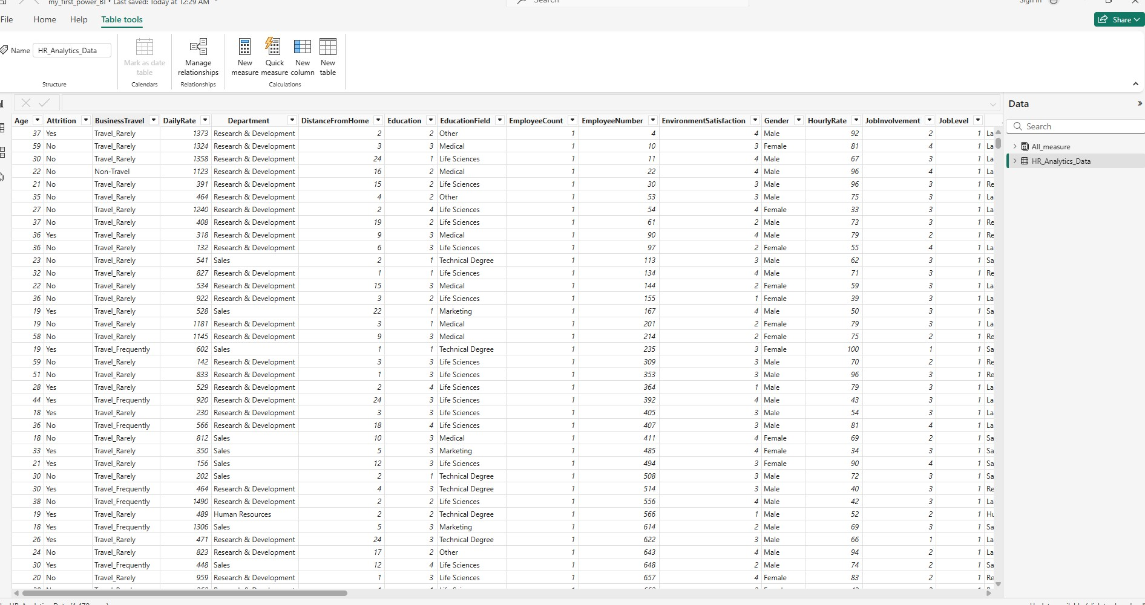
Power of Visual Tools in DA(p1): There is a story inside this table. Find that story

Slide 10
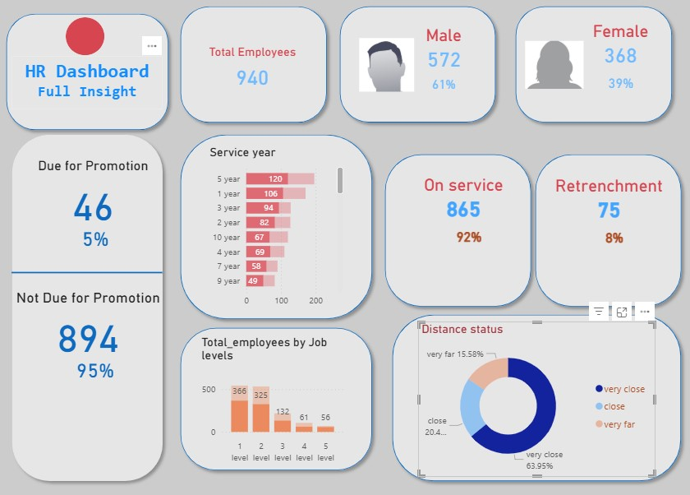
Power of Visual Tools in DA(p2): Below is a story/dashboard for HR department.
Dashboard would be different for other department like Accounting, IT, etc.

Slide 11
5 Steps in DA
Data Collection
Data Cleaning
Exploratory Data Analysis (EDA)
Statistical Analysis
Interpretation + Reporting

Slide 12
Data Collection:
Gathering the data relevant to the analysis task (similar to data science).
- Can be Internal or External: Internal data is your company data. External data is from outside of your company: can be free or paid
If data is tabular, then columns are called features, rows are called instances, records, etc.
No labels/response variable
Tabular data would be in CSV(Comma Separated Value) file can use comma, semi-colon, colon, etc.

Slide 13
Example of CSV Comma separated value file:
age,name,income,experience
23,Ash,34000,12
45,Jim,54000,3
45,Nancy,54000,3
45,Carls,59000,7
Example of Tab separated vales in case values contain comma , (for example 34,000):
age name income experience
23 Ash 34,000 12
45 Jim, Gary 54,000 3
45 Nancy 54,000 3
45 Carl 59,000 7
Separator=delimiter

Slide 14
Certain external website for data
https://www.kaggle.com/datasets
https://datasetsearch.research.google.com/
https://archive.ics.uci.edu/datasets
https://cloud.google.com/solutions/datasets (PAID)
https://www.kaggle.com/competitions (for competitions)
Ninja Dataset (vision data)
https://ml-cheatsheet.readthedocs.io/en/latest/datasets.html
https://catalog.data.gov/dataset/
https://www.kdnuggets.com/2020/03/20-machine-learning-datasets-project-ideas.html
https://data.worldbank.org/
https://data.fivethirtyeight.com/ (Topics: Politics, Sports, Science+health, Economics, Culture)
https://www.earthdata.nasa.gov/
Databricks : paid
https://datarade.ai/data-categories/ai-ml-training-data (paid)
Biggest Data generator are Walmart, Amazon in Retail sector

Slide 15
2. Data Cleaning: Ensuring the data is clean and free from errors such as
Duplicates rows
Redundant columns:
Redundant columns like both [TotalPrice and Qty * UnitPrice],
[Age and DateOfBirth],
[customer_id], etc.
Missing values
Inconsistencies: Data doesn't follow expected formats, rules, or logic. For example,customerID=3 is not following expected format
CustomerID | Name | Age | DateOfBirth | Country | Gender | ProductCategory | Quantity | UnitPrice | TotalPrice | OrderDate | DeliveryDate | Comments
001 | John Doe | 30 | 5/15/1994 | USA | Male | Electronics | 2 | 100 | 200 | 12/1/2024 | 12/5/2024 | Delivered
001 | John Doe | 30 | 5/15/1994 | usa | Male | Electonics | 2 | 100 | 200 | 12/1/2024 | 5/12/2024 | Delivered
002 | Jane Smith | 25 | 7/20/1999 | United States | F | Electronics | -5 | 50 | -250 | 2/28/2024 | 2/27/2024 | Retunred
3 | Bob Johnson | 99999 | 3/10/1925 | UsA | m | Electronics | 1 | 1,000.00 | 1000 | 31/12/2024 | 31-Dec | 2024 | Delivered
004 | Alice Lee |  | 11/2/1988 | USA | Female | Electronics | 3 | 75 | 225 | 2024-02-30 | 3/1/2024 | Returned
005 | Tom Brown | 40 |  | usa | M | Electronics | 1 | 200 | 200 | 11/15/2024 | 11/20/2024 | ?
006 | Mary Davis | 35 | 1/5/1989 | USA | Female | Electronics | 1 | $250.00 | 250 | 11/10/2024 | 11/15/2024 | Delivered

Slide 16
Types of inconsistencies:
2.1. Text Inconsistencies
Different spellings or capitalization for the same value: "USA", "usa", "Usa", "United States"
Extra whitespace or invisible characters: " Alice Lee " instead of "Alice Lee"
Typos:"Electonics" instead of "Electronics"
CustomerID | Name | Age | DateOfBirth | Country | Gender | ProductCategory | Quantity | UnitPrice | TotalPrice | OrderDate | DeliveryDate | Comments
001 | John Doe | 30 | 5/15/1994 | USA | Male | Electronics | 2 | 100 | 200 | 12/1/2024 | 12/5/2024 | Delivered
001 | John Doe | 30 | 5/15/1994 | usa | Male | Electonics | 2 | 100 | 200 | 12/1/2024 | 5/12/2024 | Delivered
002 | Jane Smith | 25 | 7/20/1999 | United States | F | Electronics | -5 | 50 | -250 | 2/28/2024 | 2/27/2024 | Retunred
3 | Bob Johnson | 99999 | 3/10/1925 | UsA | m | Electronics | 1 | 1,000.00 | 1000 | 31/12/2024 | 31-Dec | 2024 | Delivered
004 | Alice Lee |  | 11/2/1988 | USA | Female | Electronics | 3 | 75 | 225 | 2024-02-30 | 3/1/2024 | Returned
005 | Tom Brown | 40 |  | usa | M | Electronics | 1 | 200 | 200 | 11/15/2024 | 11/20/2024 | ?
006 | Mary Davis | 35 | 1/5/1989 | USA | Female | Electronics | 1 | $250.00 | 250 | 11/10/2024 | 11/15/2024 | Delivered

Slide 17
2.2) Numeric Inconsistencies
Negative values where they don’t make sense: -5 in a Quantity column
Extremely large or small values (outliers or data entry errors): 99999 in an Age column
Commas or symbols in numbers:"1,000" or "$250.00" as strings instead of numeric
CustomerID | Name | Age | DateOfBirth | Country | Gender | ProductCategory | Quantity | UnitPrice | TotalPrice | OrderDate | DeliveryDate | Comments
001 | John Doe | 30 | 5/15/1994 | USA | Male | Electronics | 2 | 100 | 200 | 12/1/2024 | 12/5/2024 | Delivered
001 | John Doe | 30 | 5/15/1994 | usa | Male | Electonics | 2 | 100 | 200 | 12/1/2024 | 5/12/2024 | Delivered
002 | Jane Smith | 25 | 7/20/1999 | United States | F | Electronics | -5 | 50 | -250 | 2/28/2024 | 2/27/2024 | Retunred
3 | Bob Johnson | 99999 | 3/10/1925 | UsA | m | Electronics | 1 | 1,000.00 | 1000 | 31/12/2024 | 31-Dec | 2024 | Delivered
004 | Alice Lee |  | 11/2/1988 | USA | Female | Electronics | 3 | 75 | 225 | 2024-02-30 | 3/1/2024 | Returned
005 | Tom Brown | 40 |  | usa | M | Electronics | 1 | 200 | 200 | 11/15/2024 | 11/20/2024 | ?
006 | Mary Davis | 35 | 1/5/1989 | USA | Female | Electronics | 1 | $250.00 | 250 | 11/10/2024 | 11/15/2024 | Delivered

Slide 18
2.3. Date/Time Inconsistencies
Mixed date formats: "2024-12-31" vs. "31/12/2024" vs. "Dec 31, 2024"
Impossible or inconsistent dates:
  2024-18-30 or
  OrderDate later than DeliveryDate
2.4. Categorical Inconsistencies
Multiple representations of the same category: "M", "Male", "male", "m" for gender
Misspelled or invalid category names:"Retunred" instead of "Returned"
Nulls or "junk" values in required categorical fields: "N/A", "?", "Unknown"
CustomerID | Name | Age | DateOfBirth | Country | Gender | ProductCategory | Quantity | UnitPrice | TotalPrice | OrderDate | DeliveryDate | Comments
001 | John Doe | 30 | 5/15/1994 | USA | Male | Electronics | 2 | 100 | 200 | 12/1/2024 | 12/5/2024 | Delivered
001 | John Doe | 30 | 5/15/1994 | usa | Male | Electonics | 2 | 100 | 200 | 12/1/2024 | 5/12/2024 | Delivered
002 | Jane Smith | 25 | 7/20/1999 | United States | F | Electronics | -5 | 50 | -250 | 2/28/2024 | 2/27/2024 | Retunred
3 | Bob Johnson | 99999 | 3/10/1925 | UsA | m | Electronics | 1 | 1,000.00 | 1000 | 31/12/2024 | 31-Dec | 2024 | Delivered
004 | Alice Lee |  | 11/2/1988 | USA | Female | Electronics | 3 | 75 | 225 | 2024-02-30 | 3/1/2024 | Returned
005 | Tom Brown | 40 |  | usa | M | Electronics | 1 | 200 | 200 | 11/15/2024 | 11/20/2024 | ?
006 | Mary Davis | 35 | 1/5/1989 | USA | Female | Electronics | 1 | $250.00 | 250 | 11/10/2024 | 11/15/2024 | Delivered

Slide 19
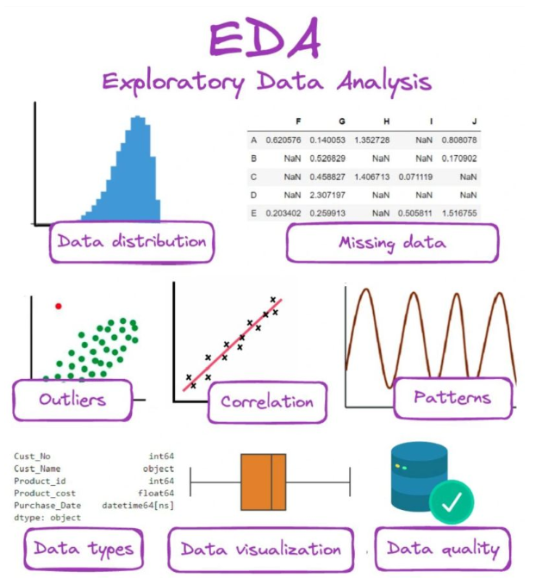
3. Exploratory Data Analysis (EDA):
Using statistical and graphical techniques to explore the data and understand its structure, trends, relationships, and distributions. Tell the story through numbers and graphs.
Its data analysis when we extract data summary or statistics: Mean, median, mode, variance, standard deviation, missing values, percentiles, anomalies etc.
Its data visualization when it’s represented in graphs: Histograms, boxplots, scatter plots, heatmaps, radar map, treemap, etc.

Slide 20
4. Statistical Analysis: Applying statistical methods to
test hypotheses,
calculate correlations, and
assess relationships within the data.
Typical Activities:
Hypothesis testing (e.g., z-value test, t-value tests, chi-square tests)
Example of hypothesis: “Salary is directly related to experience”
Based on data, test if above hypothesis is confirmed or refuted.
Regression modeling (e.g., linear regression, logistic regression): predicting numerical values, etc..
Confidence intervals and p-values
Probability distributions (e.g., normal, binomial, etc. )
Tools in Python: scipy.stats, statsmodels

Slide 21
Case study: Let’s say a company wants to use linear regression to model employee salary based on education level, experience, and department.
Use logistic regression to model probability of resignation (yes/no) based on same factors.
Statistical analysis involves:
Building the model using training data
Testing hypotheses (e.g., is experience a significant predictor of salary?)
Interpreting and communicating results to stakeholders

Slide 22
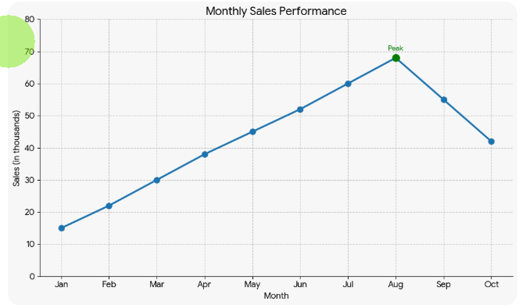
5. Interpretation & Reporting:
Summarizing the findings and making conclusions based on the analysis, often through visualizations and reports.
EXAMPLE: Sales Trend Interpretation
Observation: Monthly sales increased steadily from January to August,
followed by a decline in September and October.
Interpretation: The upward trend indicates strong customer demand and effective marketing campaigns during the first half of the year. The decline in later months suggests possible seasonality effects, reduced promotions, or increased competition.
Business Meaning: Sales performance is influenced by time-based factors.

Slide 23
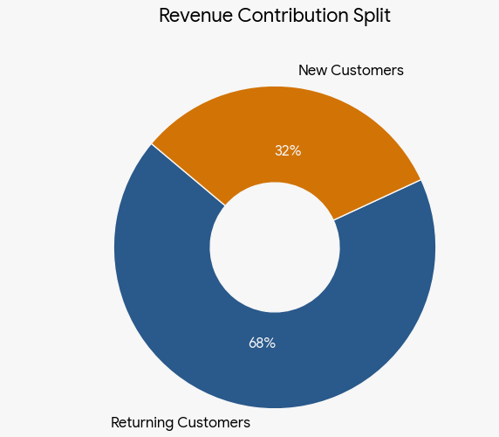
EXAMPLE: Customer Behavior Interpretation
Observation:
Returning customers contribute 68% of total revenue, while new customers contribute 32%.
Interpretation:
The business heavily depends on existing customers rather than new customer acquisition.
Business Meaning:
Customer retention strategies are effective, but growth may be limited without increasing new customer acquisition.

Slide 24
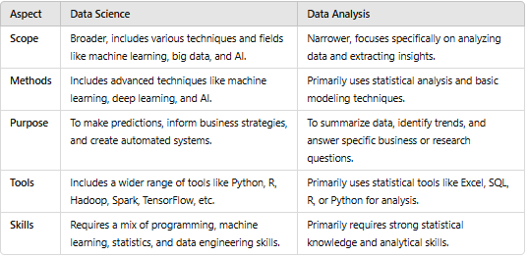
Difference between Data Science and Data Analysis

