Slide 1
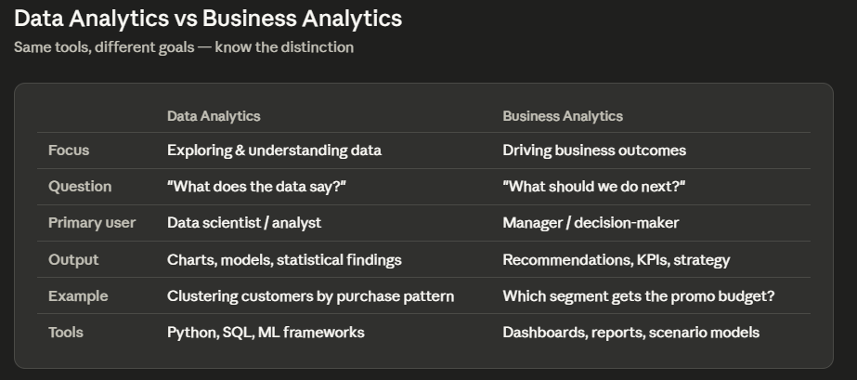

Slide 2
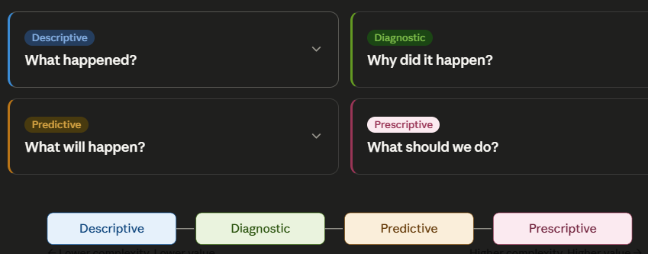
The 4 Types of Analytics

Slide 3
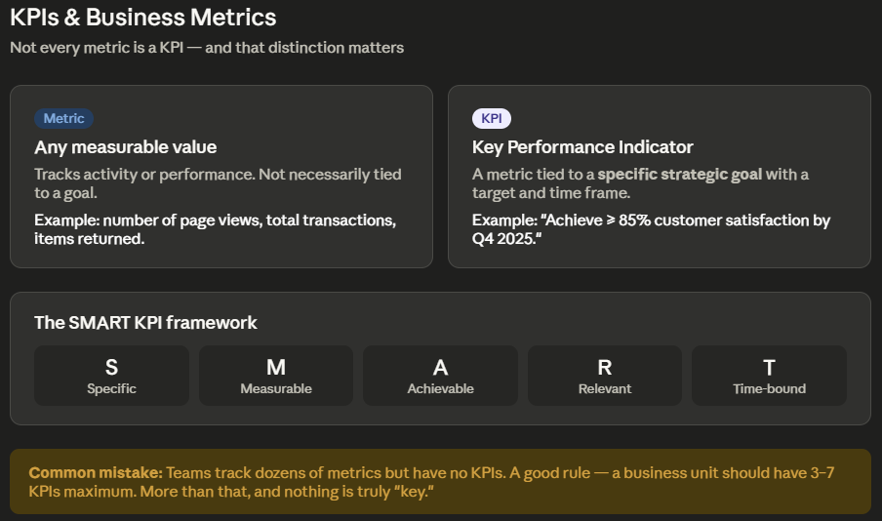

Slide 4
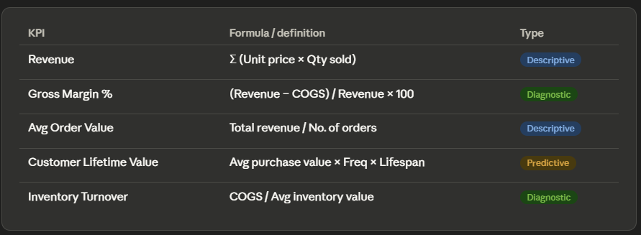
Retail KPI Categories

Slide 5




Retail KPI Categories

