Slide 1
Instructions

Slide 2
Here I use Power BI to load and lean up the data
Open PBI -> get data from CSV (Data_train.csv) and then click transform -> If necessary, then click use first row as header
Check : date_of_journey should be date type, etc…make sure all the columns are of required data type
Split dep_time column: select dep_time column -> split column -> by delimiter and choose colon. You should see 2 new columns -> rename them to dep_time_hours and dep_time_minutes
Split arrival_time column: select arrival_time column -> split column -> by delimiter and choose custom and use <space>. You should see 3 new columns -> keep the column that shows time in hh:mm:ss format and remove the other 2 columns. -> Then further split this arrival_time by delimiter colon -> make sure the data type of this 2 columns are whole numbers

Slide 3
Split column Duration based on space following same process as above -> For column Duration.1 replace the h with blank -> For column Duration.2 replace the null values with 0, replace m with blank
-> Then make the data type above 2 columns whole number
For the column Total-stops ->
1) replace non-stop with 0
2) replace stops with <blank>
3) replace stop with <blank>
-> Change the data type to whole number
Remove column additional_info
Change data type of column Price to fixed decimal number
Remove column Route
Close and apply
You will see one error -> click view error -> select that 1 record and click Remove rows icon -> remove error
Then also on LHS, delete the Errors in Data_train
Close and apply

Slide 4
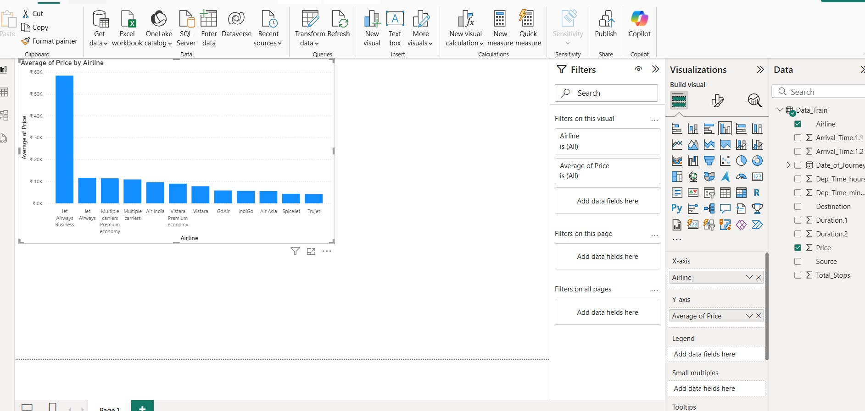



Select clustered column chart ->

Slide 5
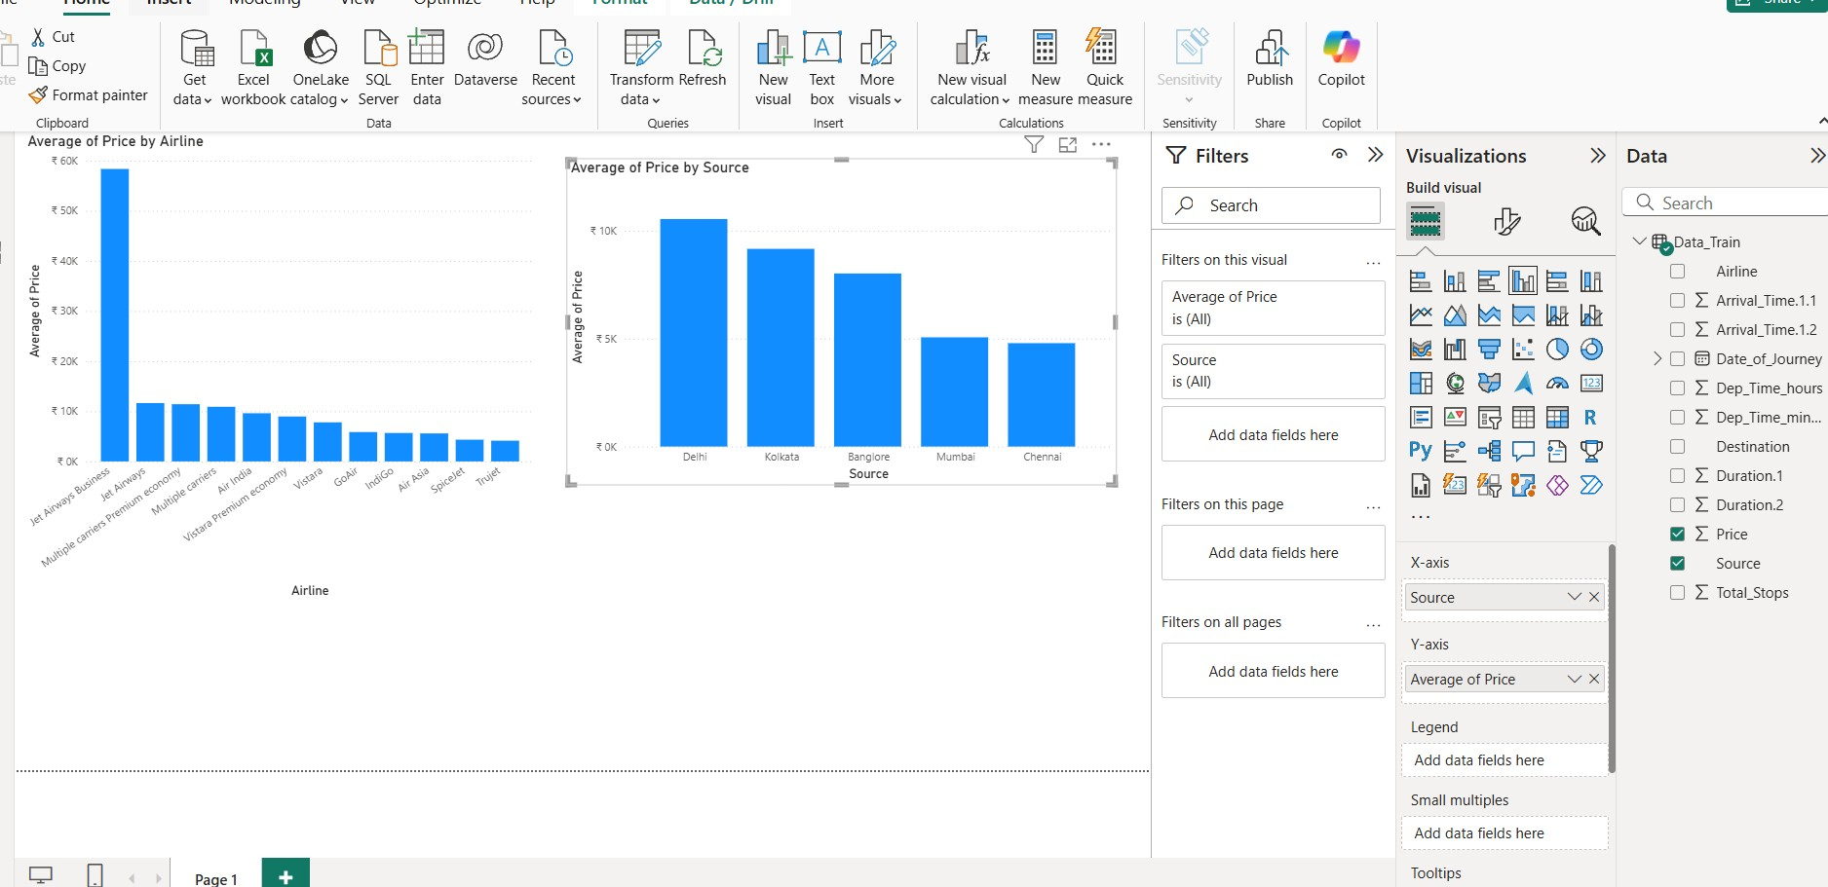





Slide 6
