Slide 1
Neo4J

Slide 2
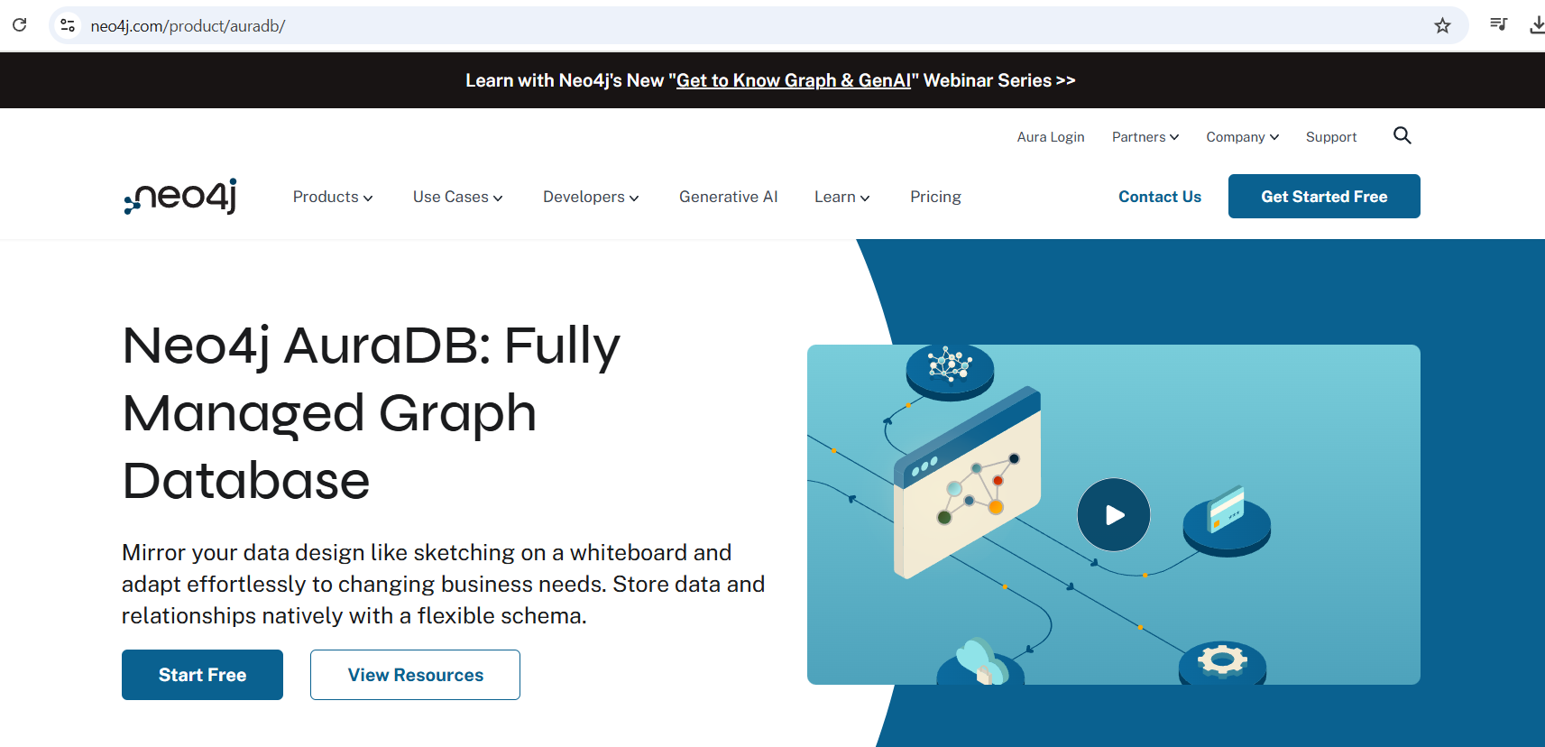
Set up (p1): Install Neo4j

Slide 3
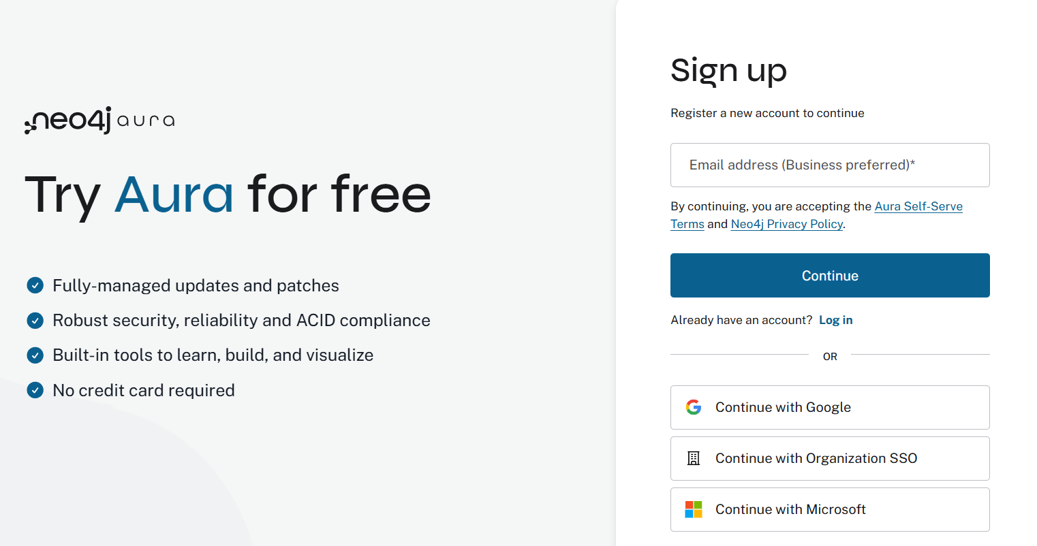
Set up (p2): Install Neo4j

Slide 4
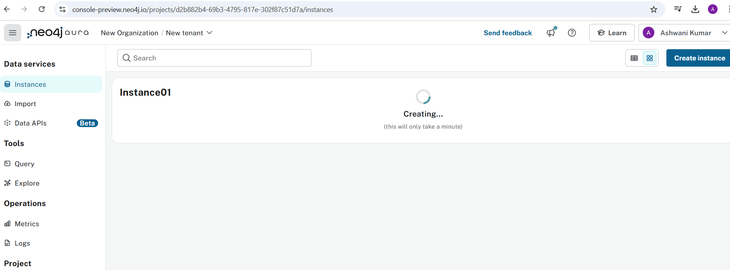
You will be directed to a page to create an instance.
- Create your instance
- choose the free plan, and username/password will be given to you. Download that

Slide 5
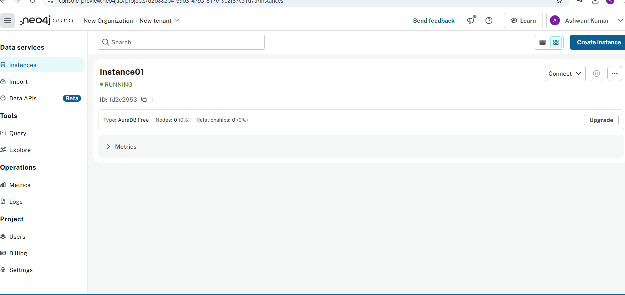
Instance would be created. Takes 4-5 minutes

