Slide 1
Neo4J

Slide 2
Create instance(TODO)

Slide 3
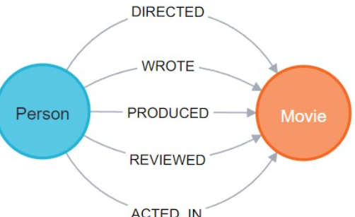
Graph Database
Graph databases are a type of NoSQL database (they don’t use SQL) designed for managing connected data. Graph databases use graph structures that are made up of:
Nodes (entities) such as people, places, concepts
Edges (relationships) that connect different nodes like person LIVES IN a place, or a football player SCORED IN a match.
Properties (attributes for nodes/edges) like the age of a person, or when in the match the goal was scored.
This structure makes graph databases ideal for handling interconnected data in fields and applications such as social networks, recommendations, fraud detection, etc., often outperforming relational DBs in terms of querying efficiency. Here is the structure of a sample graph database :
Node
Entitiy

