Slide 1
Extract Text from PDF of Patient Test result

Slide 2
Extract Text from PDF of Patient Test result
Task:
You are given a Rx PDF data files:
rep1.pdf
rep2.pdf
You want a summary of the lab test

Slide 3
Extract Text from PDF of Patient Test result
Using PDF24 Creator, combine rep1.pdf + rep2.pdf -> report-complete-Rx-name.pdf

Slide 4
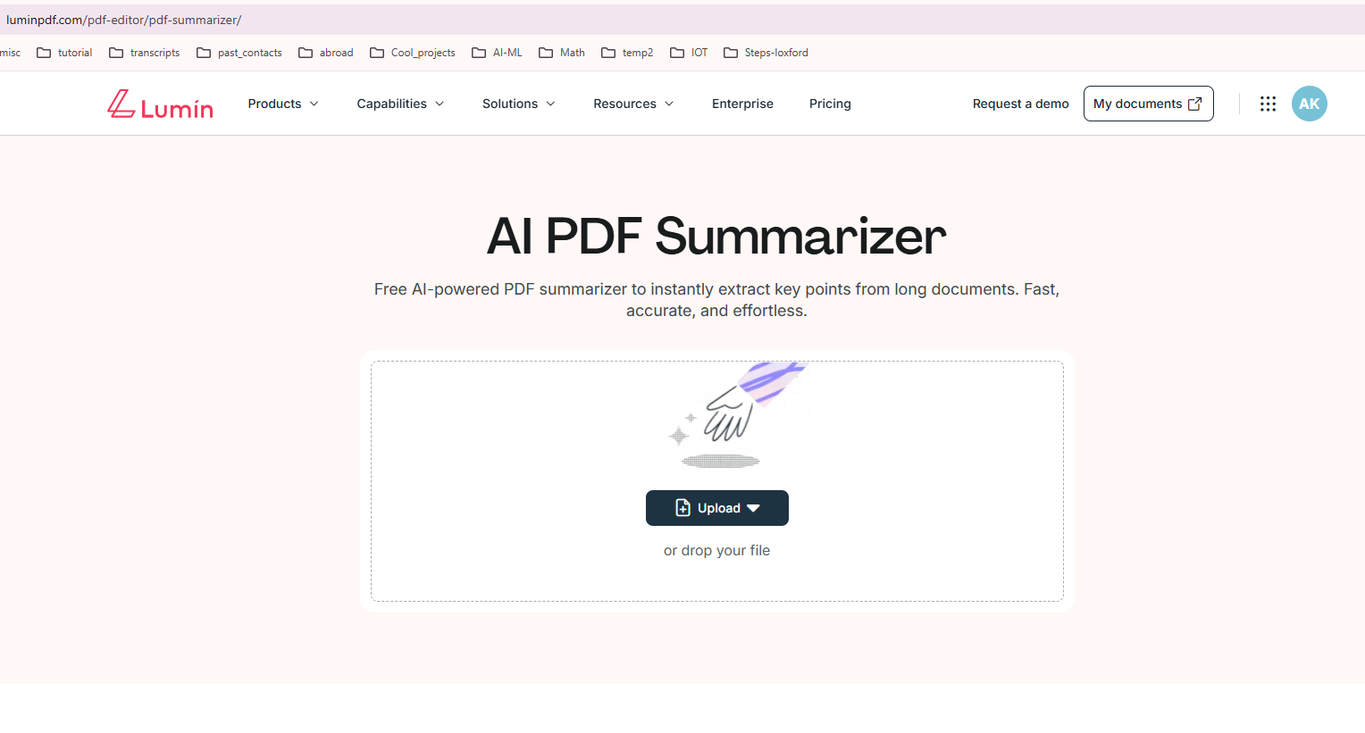
2) Login to https://www.luminpdf.com/pdf-editor/pdf-summarizer/ and drop the above PDF documents

Slide 5
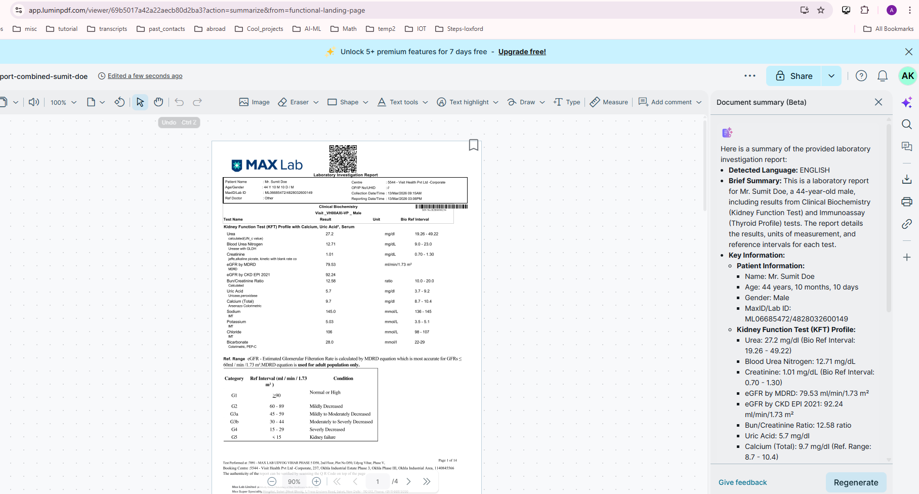


3) You should see the summary of your PDF on the right-hand side

Slide 6
SOME MORE AI TOOLS

Slide 7
ChatPDF

Slide 8
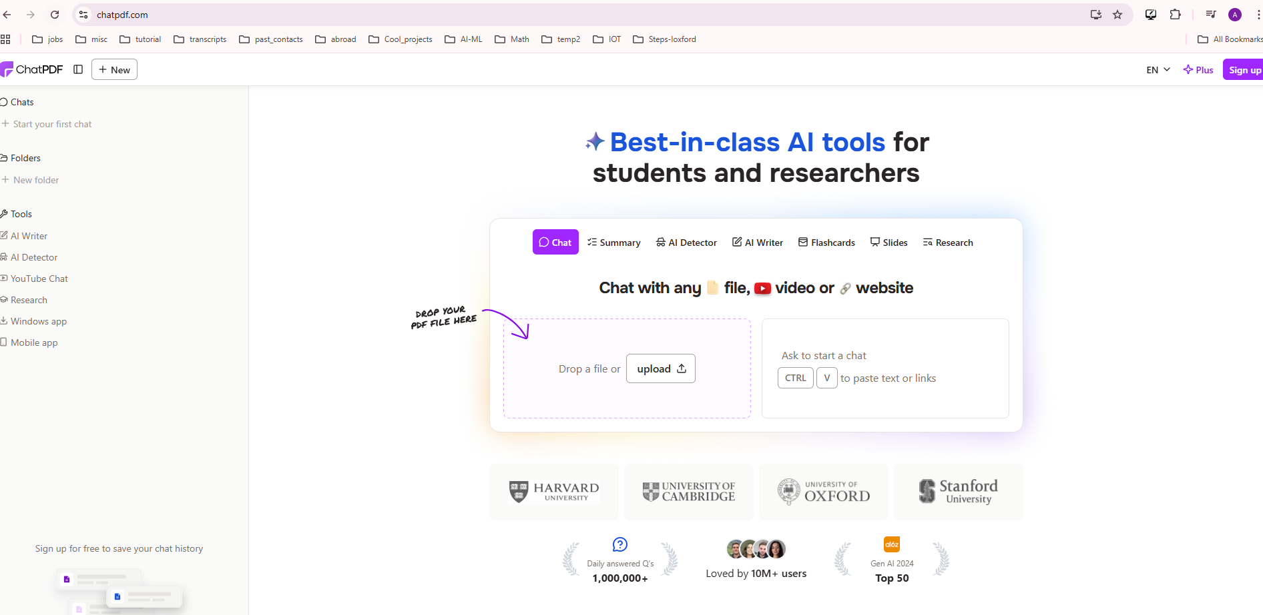


ChatPDF:
Chat with PDF, video or any website

Slide 9
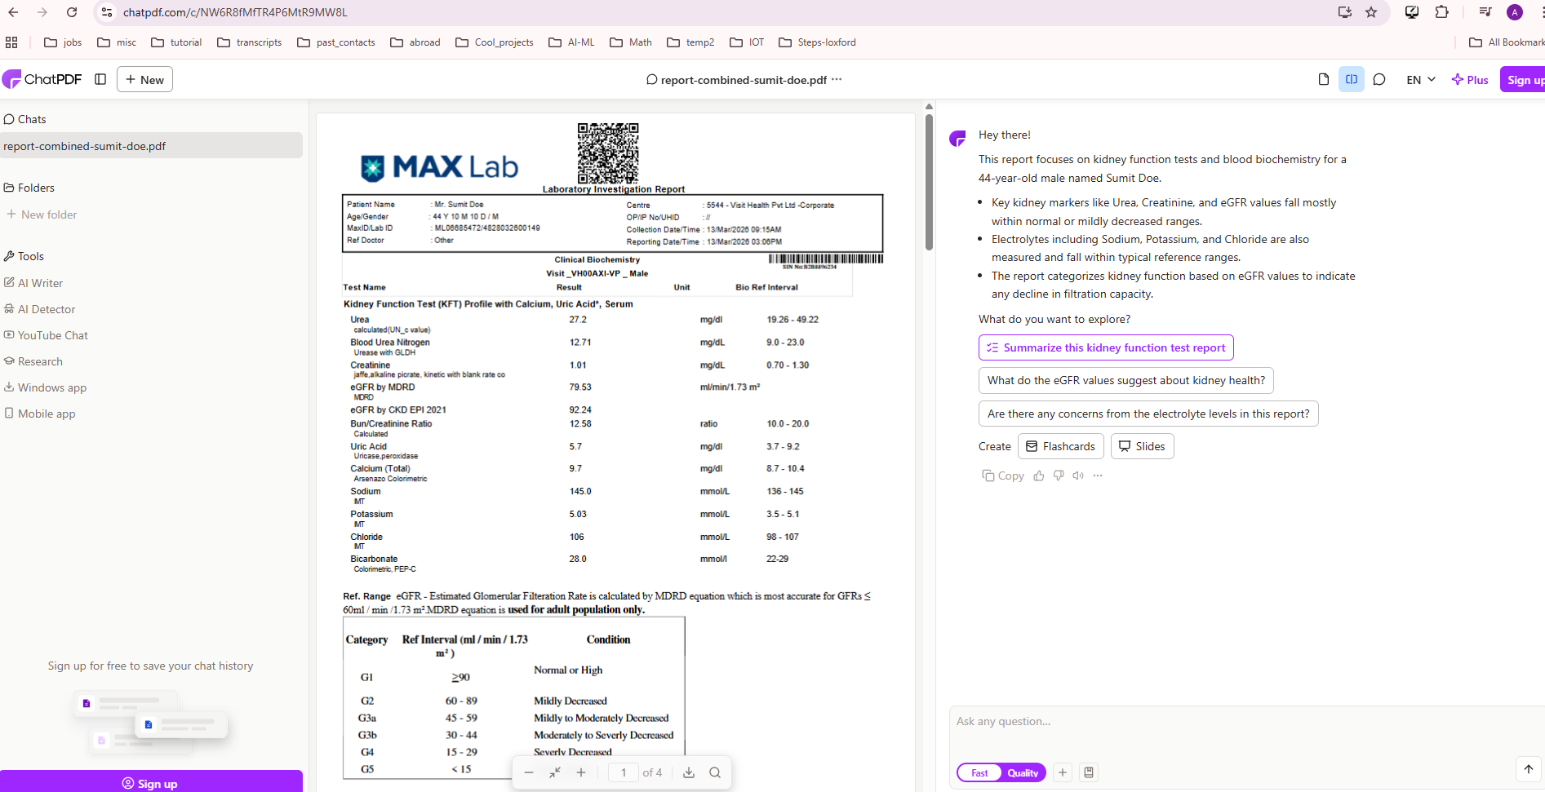




ChatPDF:
1) Upload the above PDF file. Now you can create flash cards, slides, ask specific questions, etc.

Slide 10


ChatPDF:
Copy and paste the video link on API: https://youtu.be/AXnMGzBQVuc?si=0EJ92Ob2v8SsHQwe
Continued….

Slide 11
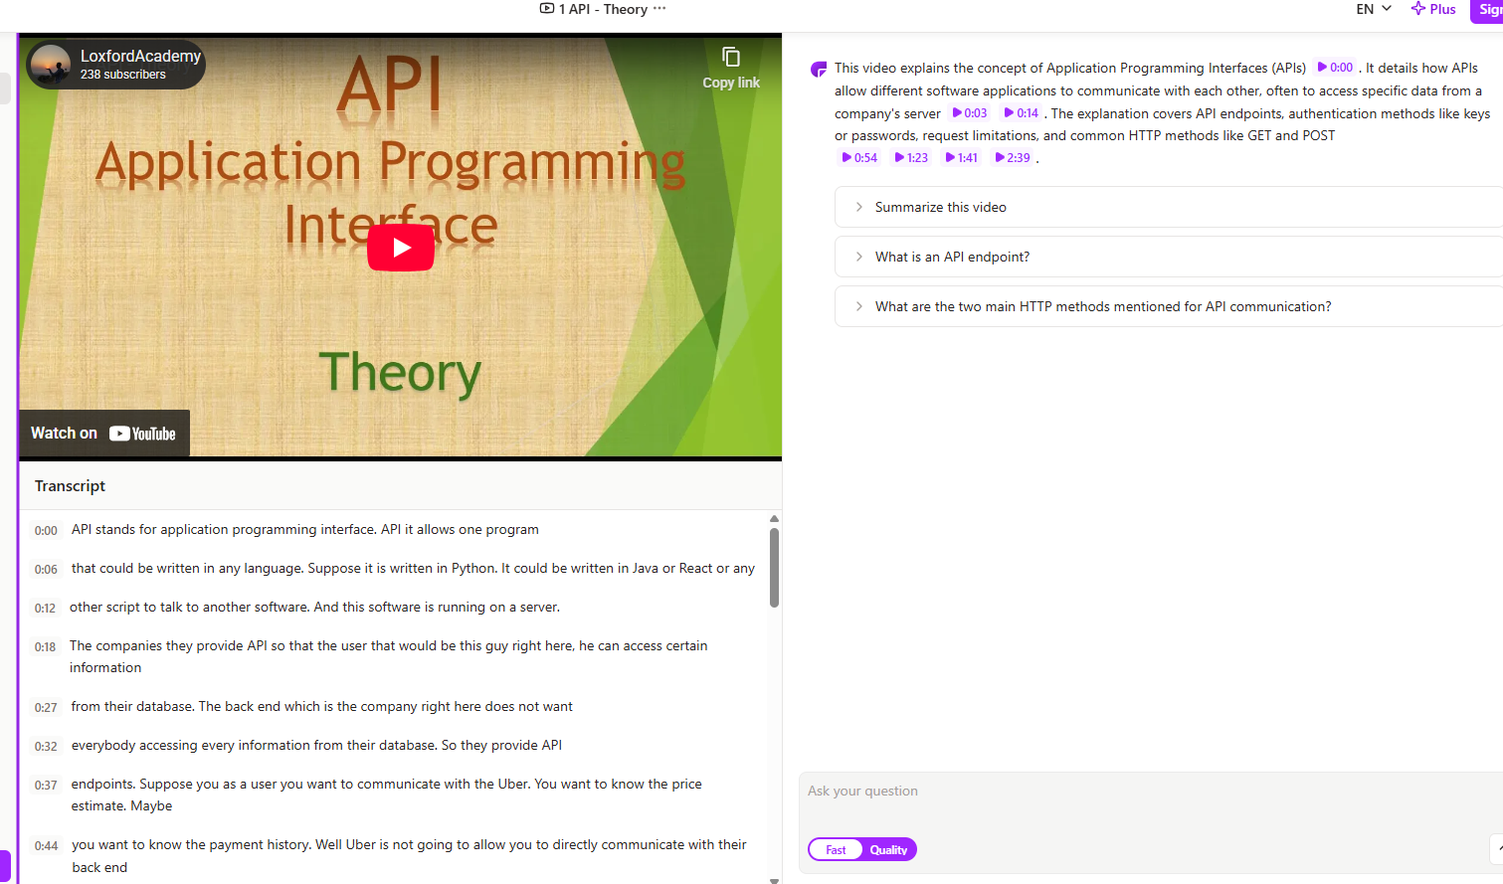






ChatPDF:
…continued. Now ask any questions, etc

Slide 12


ChatPDF:
Copy and paste the website link https://en.wikipedia.org/wiki/API
Continued….

Slide 13
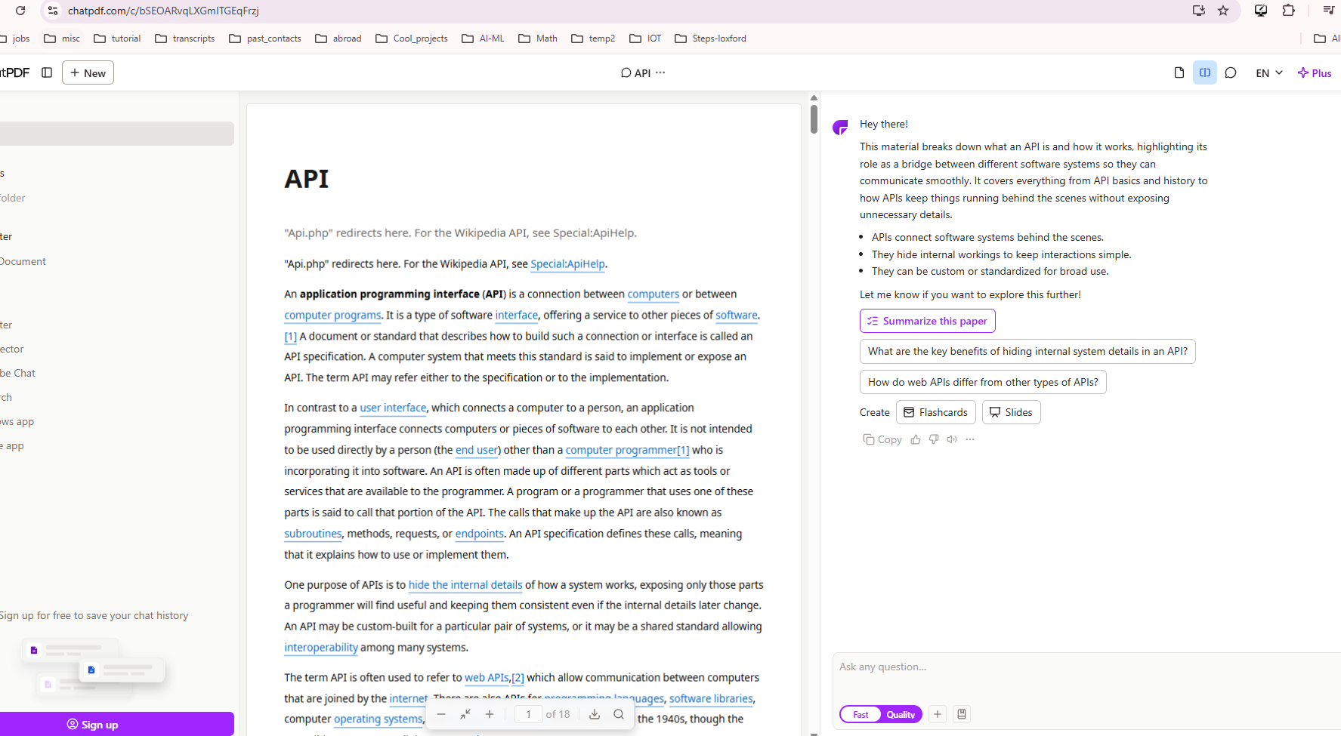
ChatPDF:
…Continued

Slide 14
NoteGPT

Slide 15
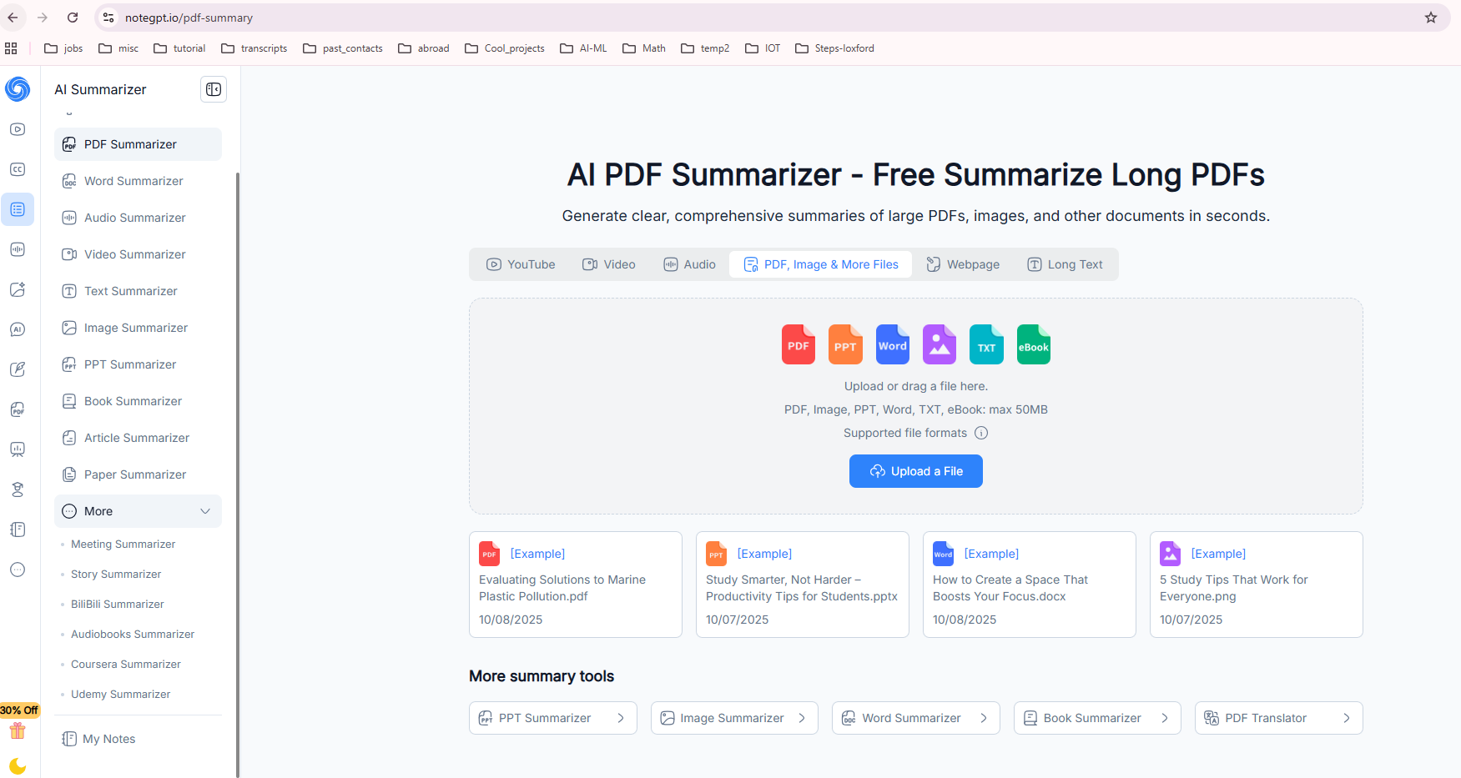


NoteGPT: Play around with this one

Slide 16
Top 10 AI PDF Summarizers (Subject to change)
ChatPDF: Best for interactive Q&A and analyzing smaller documents.
NoteGPT: Best for multi-format learning, converting PDFs into mind maps, and note-taking.
(Above are my 2 favorite besides notebookLM)
Smallpdf: User-friendly platform, excellent for quick, everyday summaries.
SciSpace: Specialized for academic research, providing summaries and detailed insights.
Humata AI: Ideal for handling long, technical documents with page-referenced answers.
PDFGPT: Known for accurate, structured summaries of large, complex files.
QuillBot: Great for generating concise summaries with rewriting options.
AskYourPDF: Offers research-friendly summaries with citations to sources.
Resoomer: Focuses on summarizing text by identifying key arguments, good for education.
Sharly AI: Excellent for professionals needing deep, secure analysis of documents.

Slide 17
Heading Goes Here
Fhdsklf
Fjdsklf
Fjskldf

