Slide 1
Extract Text from PDF of Patient Test result

Slide 2
Extract Text from PDF of Patient Test result
Task:
You are given a Rx PDF data files:
rep1.pdf
rep2.pdf
You want a summary of the lab test

Slide 3
Extract Text from PDF of Patient Test result
Using PDF24 Creator, combine rep1.pdf + rep2.pdf -> report-complete-Rx-name.pdf

Slide 4
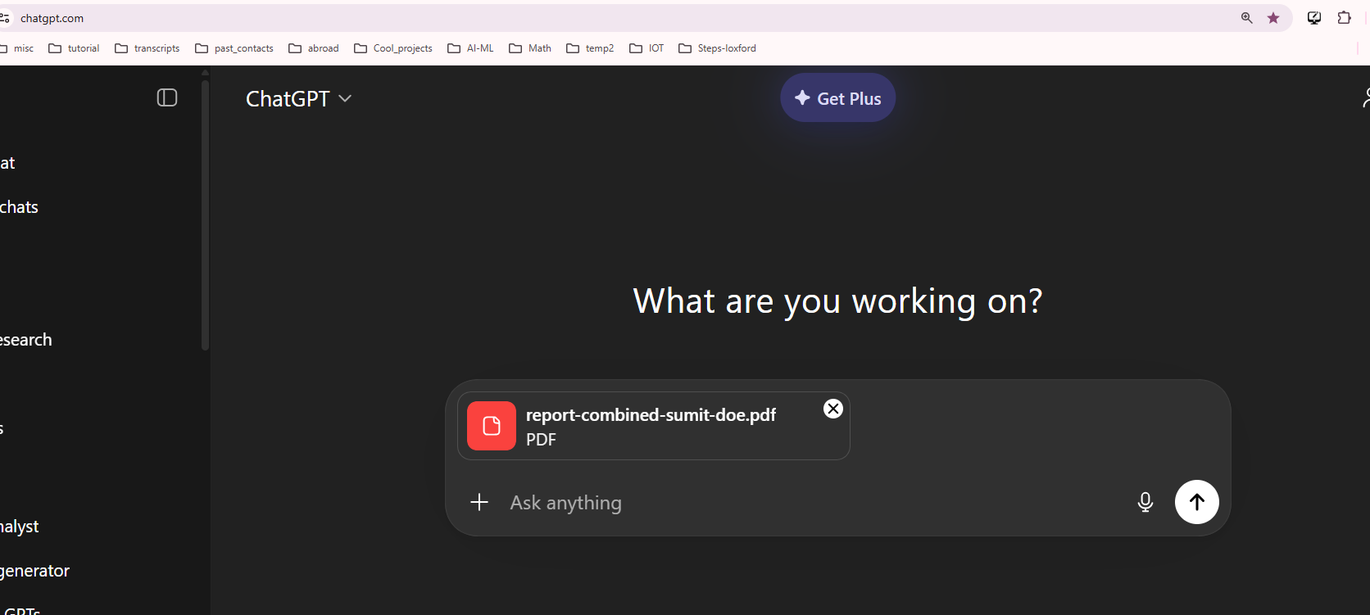
2) Login to ChatGPT and upload the above PDF documents

Slide 5
3) Use following prompt:
You are analyzing a medical lab report in PDF format.
Extract the following information from the document:
1. Patient Name
2. Reporting Date and Time
3. Sodium level
4. Potassium level
Instructions:
- Extract the exact values as written in the report.
- If any field is missing, return null.
- Return ONLY valid JSON with no explanation.
JSON format:
{
"patient_name": "<patient name>",
"reporting_datetime": "<reporting date and time>",
"sodium": "<sodium level>",
"potassium": "<potassium level>"
}

Slide 6
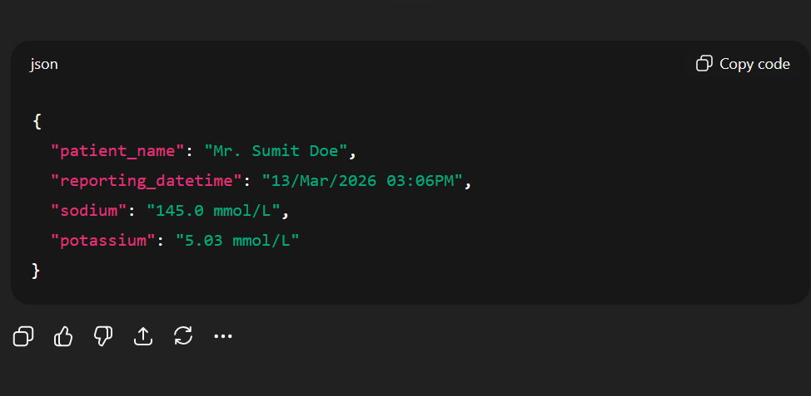
4) Output shown below

Slide 7
Heading Goes Here
Fhdsklf
Fjdsklf
Fjskldf

