Slide 1
Summarize PDF of Patient Test result

Slide 2
Summarize PDF of Patient Test result
Task:
You are given a Rx PDF data files:
rep1.pdf
rep2.pdf
You are not a medical expert. You have to find the meaning of the Lab test and extract relevant insight from it and present it to the Rx

Slide 3
Summarize PDF of Patient Test result
Using PDF24 Creator, combine rep1.pdf + rep2.pdf -> report-complete-Rx-name.pdf

Slide 4
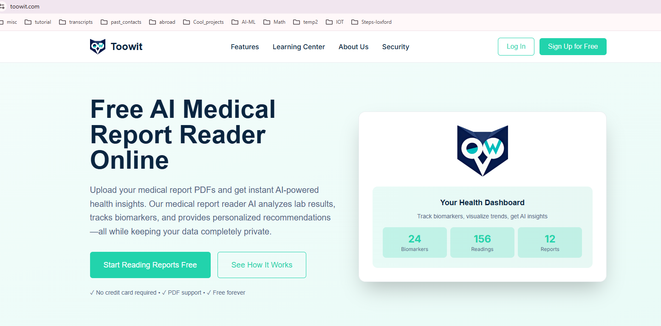
2) Goto Toowit.com
create an account with google
Try the free version
upload the PDF file report-complete-Rx-name.pdf

Slide 5
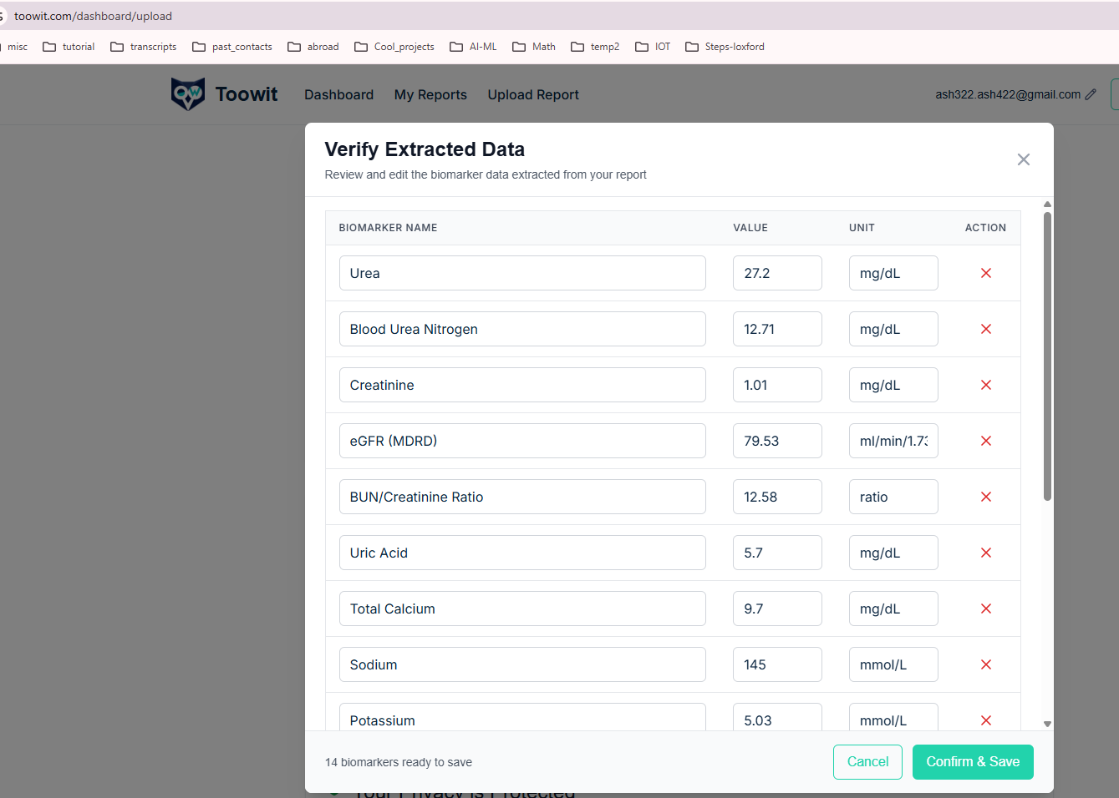
3) You will see the following page
Confirm and Save

Slide 6
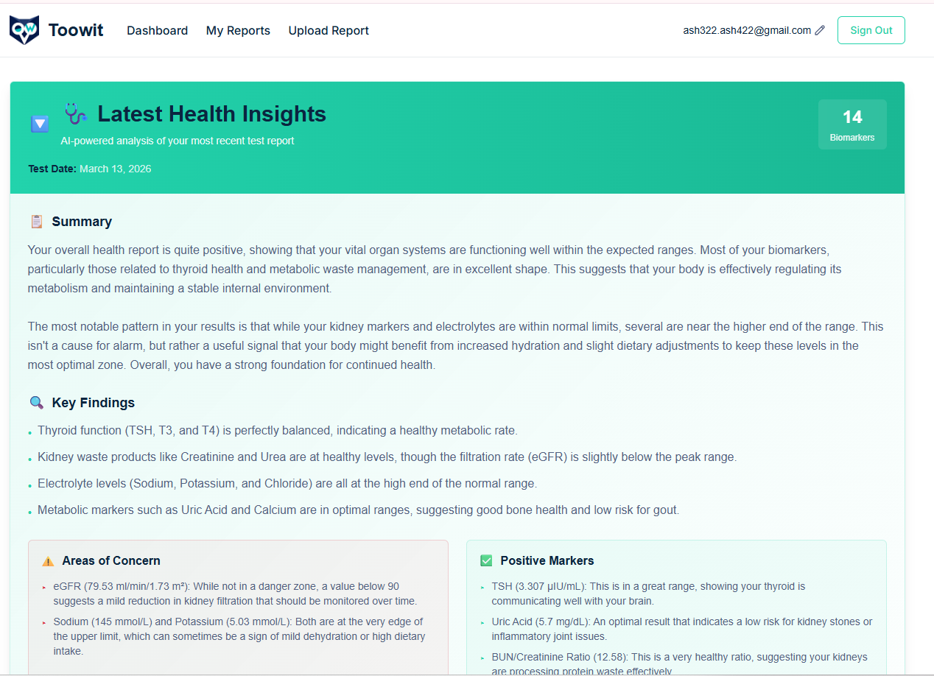





4) You will see the following page displaying your final result:
Biomarkers
Summary
Key findings
Areas Of concern
Recommendation
(PTO)

Slide 7
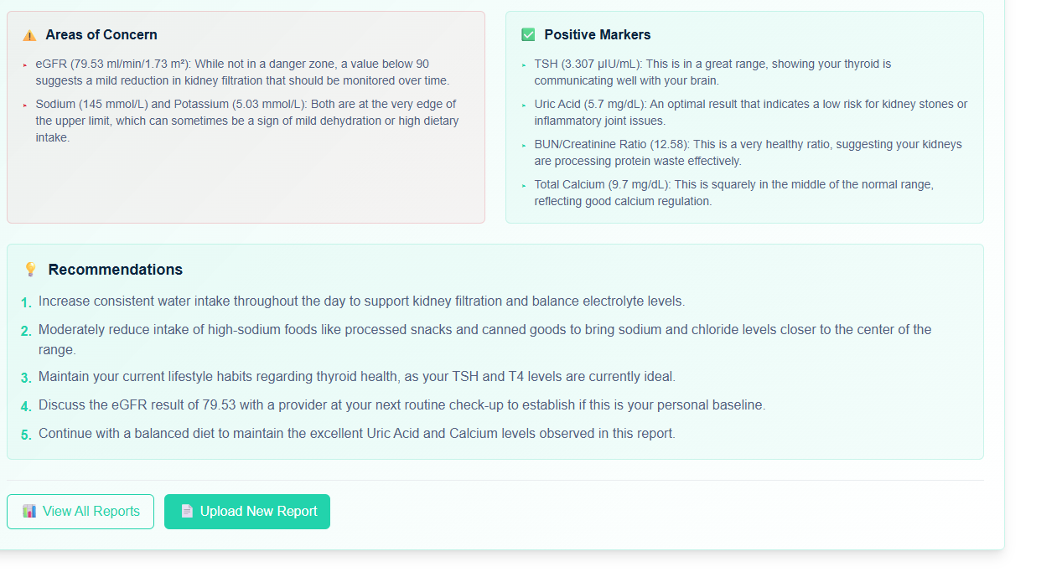

…continued

Slide 8
Heading Goes Here
Fhdsklf
Fjdsklf
Fjskldf

