Slide 1
Summarize PDF of Patient Test result

Slide 2
Summarize PDF of Patient Test result
Task:
You are given a Rx PDF data files:
rep1.pdf
rep2.pdf
Your task is to write a program that would extract relevant insight from it and present it to the patient.
You are NOT a programmer. Use any AI tools that you find comfortable. (ChatGPT, clause AI, etc) to write python code that would perform this task.

Slide 3
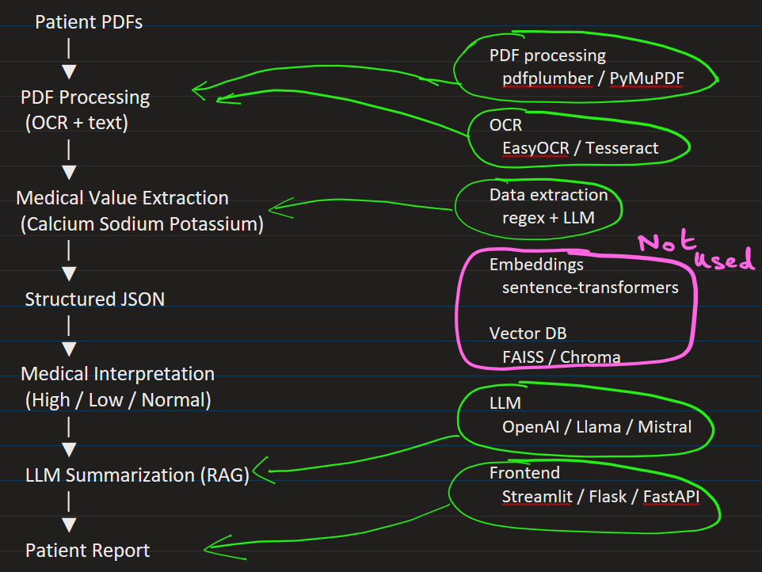
Pipeline / Workflow:

Slide 4
I used claude AI.

Slide 5
module1_pdf_to_sqlite.py
This extracts text from pdf file and stores in a SQL type database
module2_clean_db_content.py
Extract relevant text using Regex
Replace Patient Name with John Doe4
Remove Lines beginning with "Booking Centre", "Test Performed at", "The authenticity“
This reduces the number of tokens that would be sent later.
Then save the result into another table documents_clean

Slide 6
module3_extract_relevant.py
Extract name, calcium level, potassium level, and sodium level.
Write extracted fields into a NEW table `documents_relevant` in the SAME database `reports.db`.
module4_analyse_results.py
Read the data from table and put it in JSON file.

Slide 7
module5_RAG_analyser.py
Now we inject this JSON data with context using RAG concept, and ask AI model to generate output.
Generate open API key
Run the above program

Slide 8
FINAL STEP:
Use any AI tool to understand the module1 – module5 files

Slide 9
Heading Goes Here
Fhdsklf
Fjdsklf
Fjskldf

