Slide 2
🎯 Goal:
Understand how credit scores work
🧩 Topics:
📌 What is a Credit Score?
Number between 300 – 900
Used by banks
🏦 Example:
750+ → Safe
600–750 → Moderate
<600 → Risky
📊 Factors affecting score:
Income
Loan history
Payment delays
Credit utilization

Slide 3
🧠 ML Perspective:
Credit score = Prediction Problem
👉 Output:
Good customer (0)
Bad customer (1)
Mapping to ML:
Banking Term | ML Term
Default | Target Variable
Customer Data | Features
Risk Score | Prediction

Slide 4
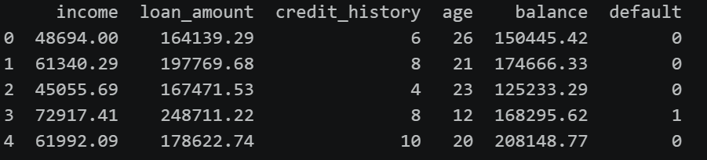
Raw Data

Slide 5
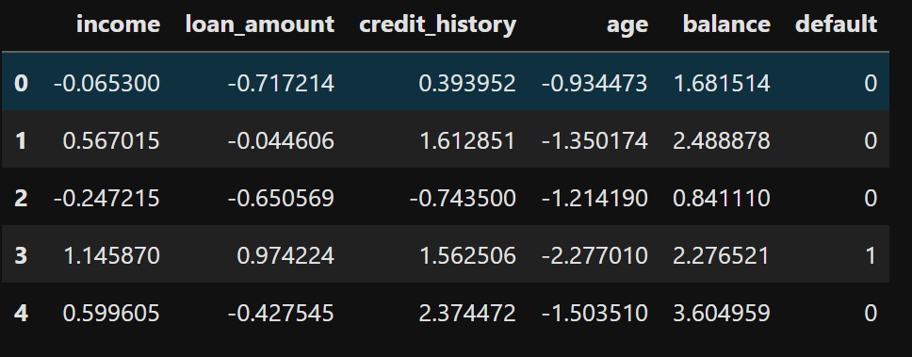
Normalized Data

Slide 6
STOP

