Slide 2
What is Credit Risk?
Credit Risk — The risk that a borrower will fail to repay a loan, causing a financial loss to the lender.
Probability of Default (PD) — The likelihood, expressed as a percentage, that a borrower will fail to meet their repayment obligation within a given time period.
Loss Given Default (LGD) — The percentage of the total exposure the lender actually loses after the borrower defaults, accounting for any recovery through collateral or collections.
Exposure at Default (EAD) — The total outstanding amount the lender is owed at the moment the borrower defaults.
Expected Loss = PD × LGD × EAD
A borrower can have high PD, but if EAD and LGD are small, the actual loss is manageable — this is why banks look at all three together, never in isolation.

Slide 3
Key Takeaways in Modelling:
Explainability is Crucial: Models must be able to justify why a loan was rejected (regulatory compliance).
Balancing Risk & Reward: Risk analytics aims to maximize profitability, not just eliminate risk.
Data Quality Matters: "Garbage in, garbage out" applies heavily to credit scoring.

Slide 4
🧩 Topics:
📌 What is a Credit Score?
Number between 300 – 900
Used by banks
🏦 Example:
750+ → Safe
600–750 → Moderate
<600 → Risky
📊 Factors affecting score:
Income
Loan history
Payment delays
Credit utilization

Slide 5
🧠 ML Perspective:
Credit score = Prediction Problem
👉 Output:
Good customer (0)
Bad customer (1)
Mapping to ML:
Banking Term | ML Term
Default | Target Variable - classification
Customer Data – Age, Income, Education | Features
Risk Score – 240 out of 500 | Prediction - Regression

Slide 6
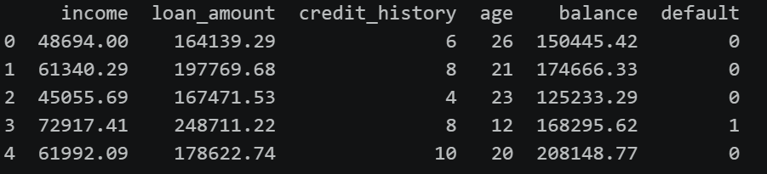
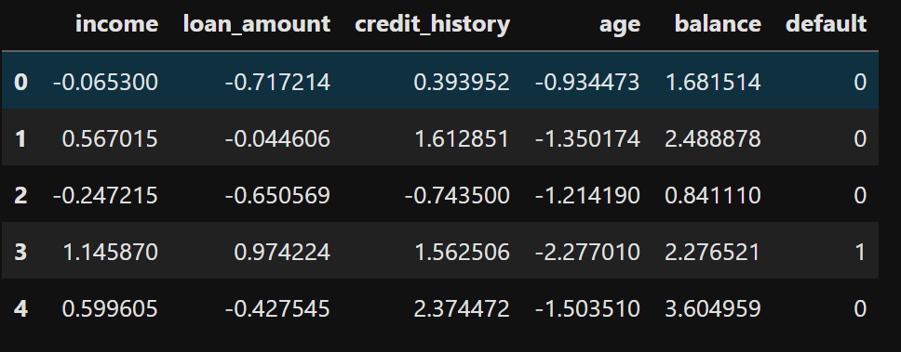
Raw Data – Not normalized
Normalized Data

