Slide 1
Python: Implementation, Architecture,

Slide 2
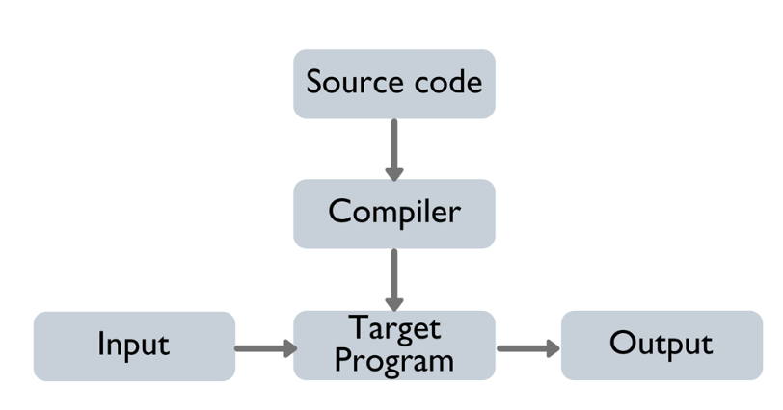
Implementations of Python
Cpython:
Default implementation of the Python is Cpython.
Cpython is written in C language.
Cpython compiles the python source code into intermediate bytecode, which is executed by the Cpython virtual machine. CPython is distributed with a large standard library written in a mixture of C and Python.
All versions of the Python language are implemented in C because CPython is the reference implementation.

Slide 3
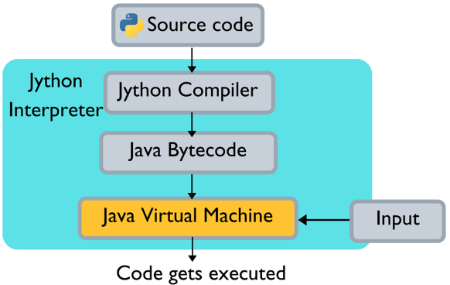
Jython
Jython is an implementation of the Python programming language that can run on the Java platform.
Jython programs use Java classes instead of Python modules
Jython compiles into Java byte code, which can then be run by Java virtual machine.
Jython is slow as compared to Cpython and lacks compatibility with CPython libraries.

Slide 4
IronPython
Python implementation written in C# targeting Microsoft’s .NET framework.
Similar to Jython, it uses .Net Virtual Machine i.e Common Language Runtime.
IronPython performs better in Python programs that use threads or multiple cores, as it has a JIT

Slide 5
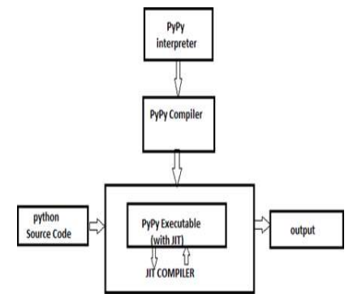
PyPy
PyPy is an implementation of the Python programming language written in Python. The Interpreter is written in RPython (a subset of Python).

Slide 6
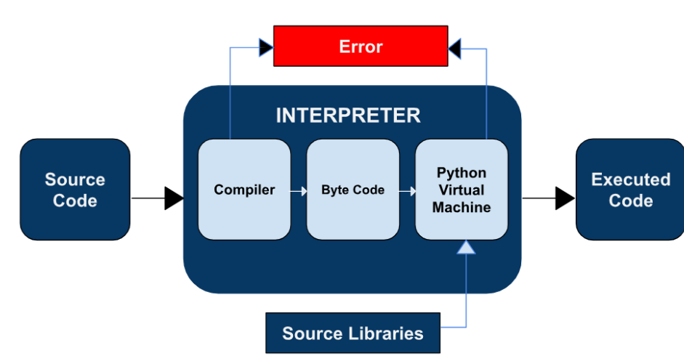
Architecture
Say we write a simple python program, hello.py.
It consists of human-readable instructions written using Python syntax.
For example:
print(“Hello World!”)
Interpreter:
The Interpreter is the core engine that reads the source code and converts it into a format the machine can understand (bytecode). The interpreter performs following tasks:
● Compiler: It first parses and compiles the source code into bytecode. Bytecode is an intermediate, platform-independent representation that Python’s virtual machine can execute.
● Bytecode: This is a lower-level code, which the interpreter generates to optimize execution. Python does not directly execute source code but executes this bytecode.
● Python Virtual Machine (PVM): The PVM reads the bytecode and executes it. This is the part of the interpreter that translates bytecode into machine-level instructions that the CPU can execute.
The interpretor is also responsible for throwing error if python code contains error.

