Slide 1
Python: Installation: virtualEnv, anaconda

Slide 2
Common venv commands:
.\.venv\Scripts\python.exe -m pip install jupyter (To install jupyter n/b)
.\.venv\Scripts\python.exe -m pip install <package> (To install via virtual env)
.\.venv\Scripts\python.exe -m pip install -r requirements.txt (To install from requirements file)
.\.venv\Scripts\python.exe -m pip freeze > requirements.txt (To create requirements file)
.\.venv\Scripts\python.exe -m jupyter notebook (To start jupyter n/b via virtual env)
.\.venv\Scripts\activate (To activate virtual env)

Slide 3
find all python
To find all python on your computer:
py -0 (lists all installed versions, * in front of default)
where python (lists all Python executables in your system PATH)
cd C:\Users\<YourUsername>\AppData\Local\Programs\Python
and then run ‘dir’. Here all python versions will be listed
-------------------------------------------------------------------------------------------------------

Slide 4
Create virtual env via cmd line:
To create virtual environ,. open Window Powershell:
PS C:\Users\hi> mkdir gemini
PS C:\Users\hi> cd gemini
PS C:\Users\hi\gemini> C:\Users\hi\AppData\Local\Programs\Python\Python311\python.exe -m venv env_test
Now you would see a new dir env_test in CWD:
4. PS C:\Users\hi\ gemini > dir
Directory: C:\Users\hi\ gemini
Mode LastWriteTime Length Name
---- ------------- ------ ----
d----- 5/5/2025 11:34 AM env_test
5. Now we activate virt env.:
PS C:\Users\hi\ gemini > .\env_test\Scripts\activate
(env_test) PS C:\Users\hi\ gemini >
6. Now you can install packages and open jupyter notebook:
(env_test) PS C:\Users\hi\ gemini > .\env_test\Scripts\python.exe -m jupyter notebook
C:\Users\hi\gemini\env_test\Scripts\python.exe: No module named jupyter
(env_test) PS C:\Users\hi\gemini> .\env_test\Scripts\python.exe -m pip install jupyter

Slide 5
Common conda commands
https://docs.conda.io/projects/conda/en/latest/_downloads/843d9e0198f2a193a3484886fa28163c/conda-cheatsheet.pdf
conda info
conda create --name ENV_NAME
conda create -n ENVNAME python=3.10
(create env with specific python)
conda rename -n ENV_NAME NEW_ENVNAME
conda remove -n ENVNAME –all (remove env)
conda activate ENV_NAME
conda list
conda env list
conda install PKGNAME
conda uninstall PKGNAME
conda export ENV_NAME>ENV.yml
conda env create -n ENV_NAME --file ENV.yml
(for importing the env)
where python (gives the path of python)
Steps to create a new environ:
Go inside the project_dir(e.g. gen_ai)
conda create --name env_genai
conda activate env_genai
conda list python (showed no python interpretor)
conda install python=3.12
conda install jupyter
conda list python (showed python interpretor)
conda list jupyter (showed jupyter installed)
python (make sure its python3.12)
python –m jupyter notebook
Now you can install packages from jupyter cells:
pip install pandas, etc

Slide 6
Issues with powershell:
1) Open powershell as Administrator:
2) C:\Users\Admin\Documents\WindowsPowerShell\profile.ps1 cannot be loaded because running scripts is disabled on this system. For more information, see about_Execution_Policies at https:/go.microsoft.com/fwlink/?LinkID=135170. At line:1 char:3 + . 'C:\Users\Admin\Documents\WindowsPowerShell\profile.ps1' + ~~~~~~~~~~~~~~~~~~~~~~~~~~~~~~~~~~~~~~~~~~~~~~~~~~~~~~~~ + CategoryInfo : SecurityError: (:) [], PSSecurityException + FullyQualifiedErrorId : UnauthorizedAccess . : Fi
PS C:\WINDOWS\system32> Set-ExecutionPolicy RemoteSigned -Scope LocalMachine
Execution Policy Change The execution policy helps protect you from scripts that you do not trust. Changing the execution policy might expose you to the security risks described in the about_Execution_Policies help topic at https:/go.microsoft.com/fwlink/?LinkID=135170.
Do you want to change the execution policy? [Y] Yes [A] Yes to All [N] No [L] No to All [S] Suspend [?] Help (default is "N"): Y
Following is NOT needed:
3) PS C:\WINDOWS\system32> Get-ExecutionPolicy -Scope LocalMachine RemoteSigned

Slide 7
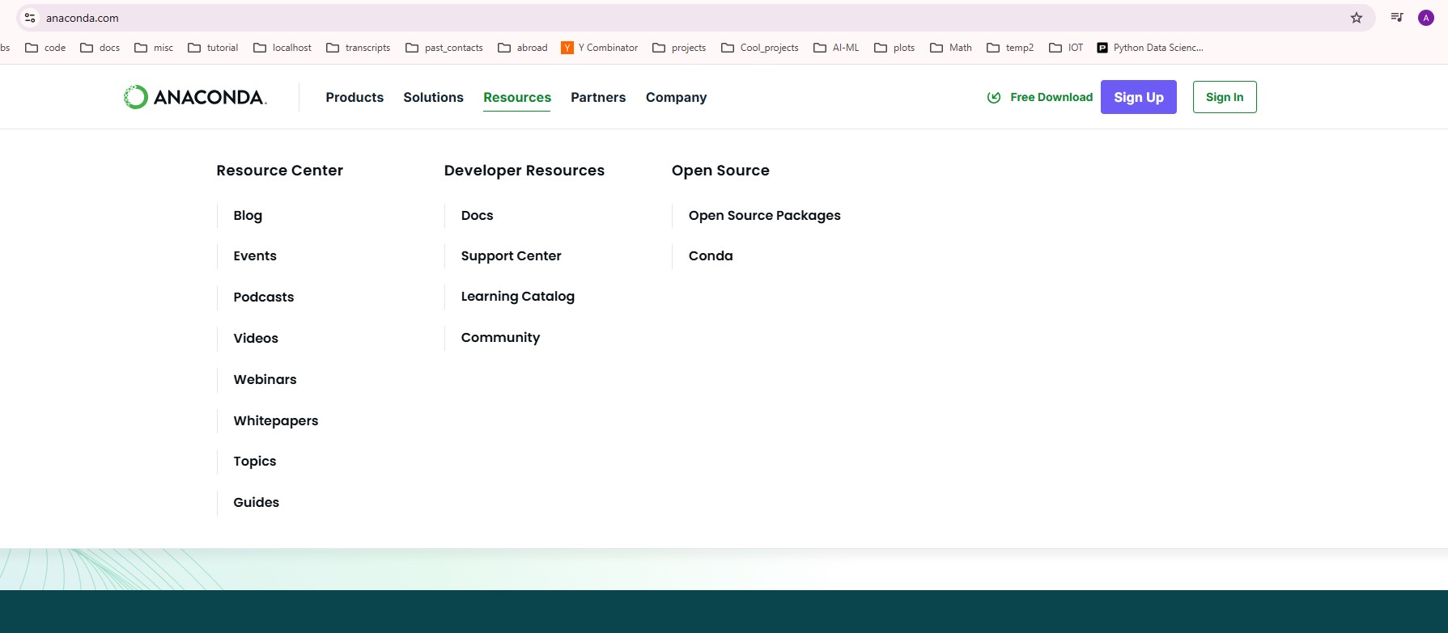
Anaconda(p1)
Step1: Click here

Slide 8
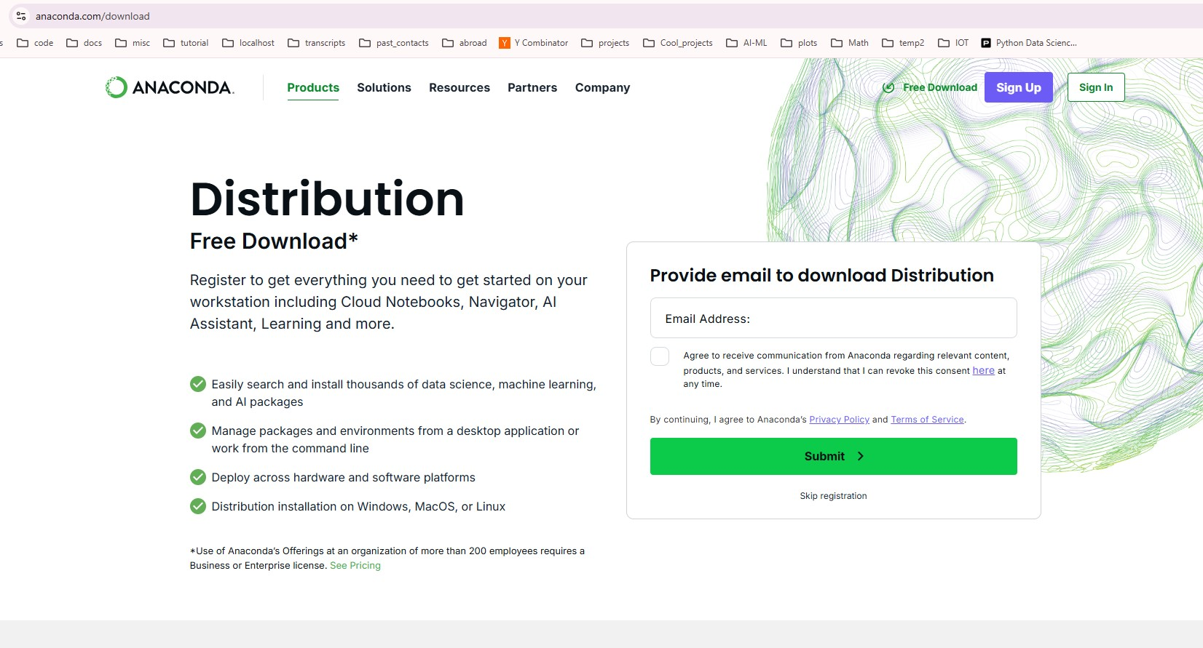
Anaconda(p2)
Step2: Click here…skip registration

Slide 9
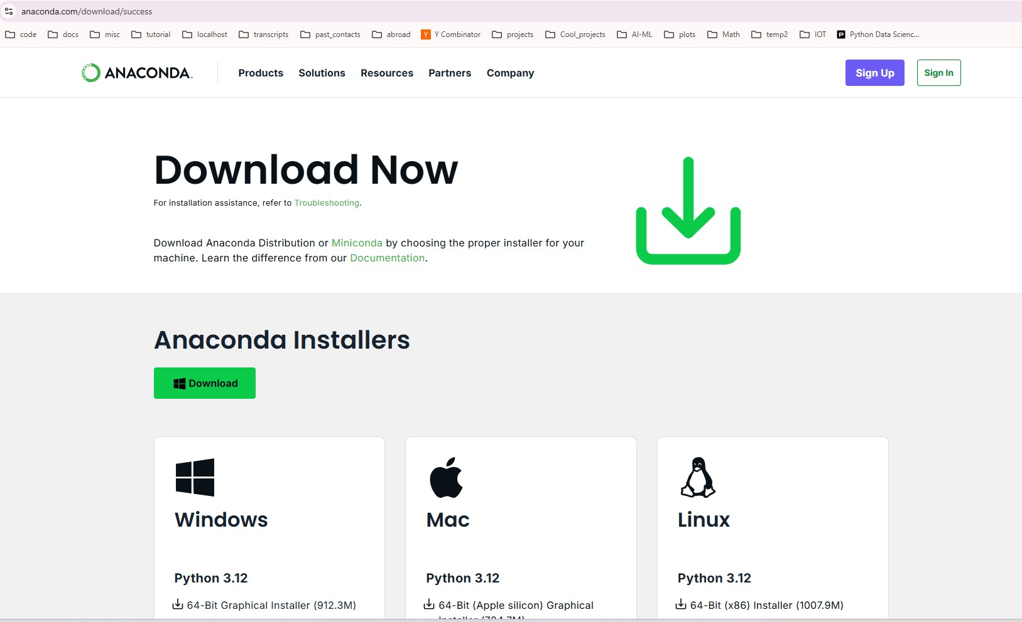
Anaconda(p3)
Step3: Click here…download. It took me 3 minutes. File size=950MB

Slide 10
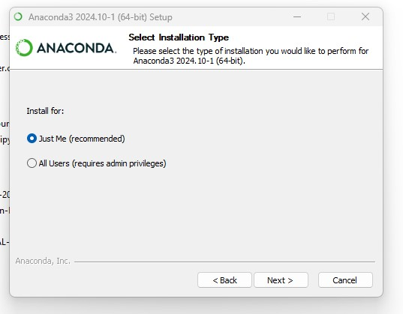
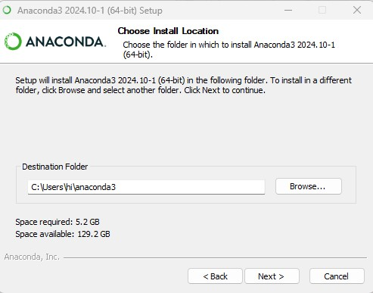
Anaconda(p4)
Step4: goto download dir
Click on anaconda_installer..
Agree to the terms..
Pick drive that has at least 15 GB free space

Slide 11
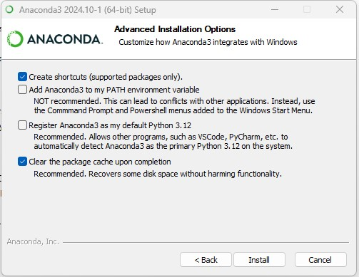
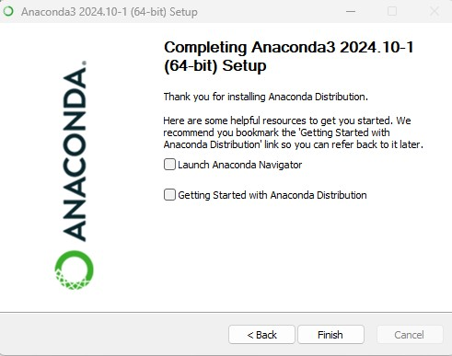
Anaconda(p5)
Step5:I select following options
It would take 5 minutes for installation to finish
After that answer series of qst., and then

Slide 12
Jupyter notebook
Some sites that offer online jupyter server:
Google colab
Kaggle
CoCalc
https://jupyter.org/try-jupyter/lab/
https://deepnote.com/
https://mybinder.org/
https://studiolab.sagemaker.aws/ -> create an account, and an email will be sent to you in next 30 seconds.. Open your mail-box and click on the email…and then have to wait another ?? time

Slide 13
Why Jupyter notebook(see jupyter n/b)
Allows to create/test snippets of code and after you are satisfied, keep necessary code and remove unwanted cells

