Slide 1
Installation – VS Code

Slide 2
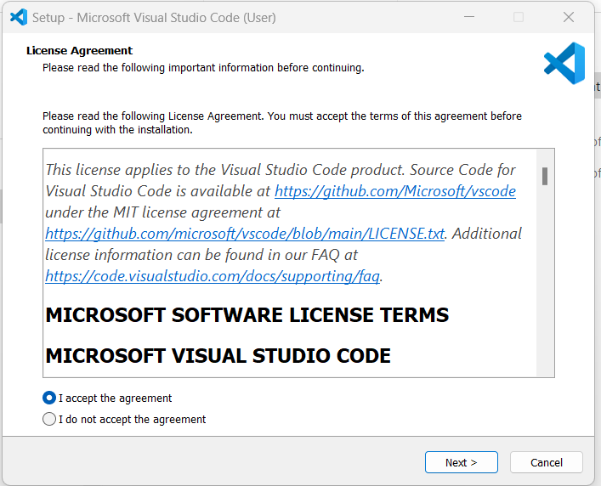

Installation of VS Code
To install VSCode: https://code.visualstudio.com/download
Click on Download for windows. This would install Vscode that is approx. 100MB in size. Double click on this downloaded file.
You will see a message that is displayed on RHS. Select I accept the agreement and then click Next

Slide 3
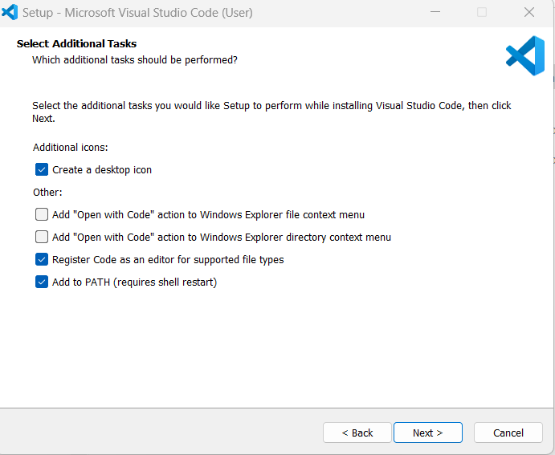

Installation of VS Code
Make sure you select following displayed select-box.
Click Next

Slide 4
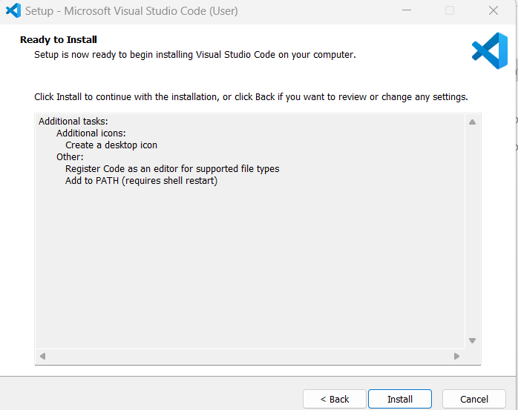

Installation of VS Code
Now you would see following screen.
Click Install

Slide 5
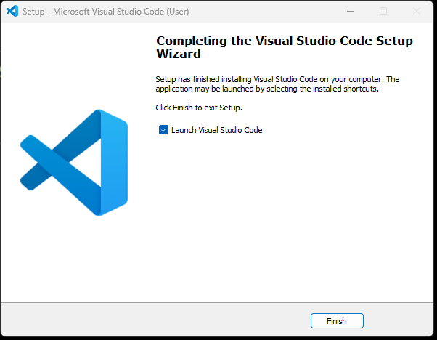

Installation of VS Code
Now you would see following screen.
Click Finish

Slide 6
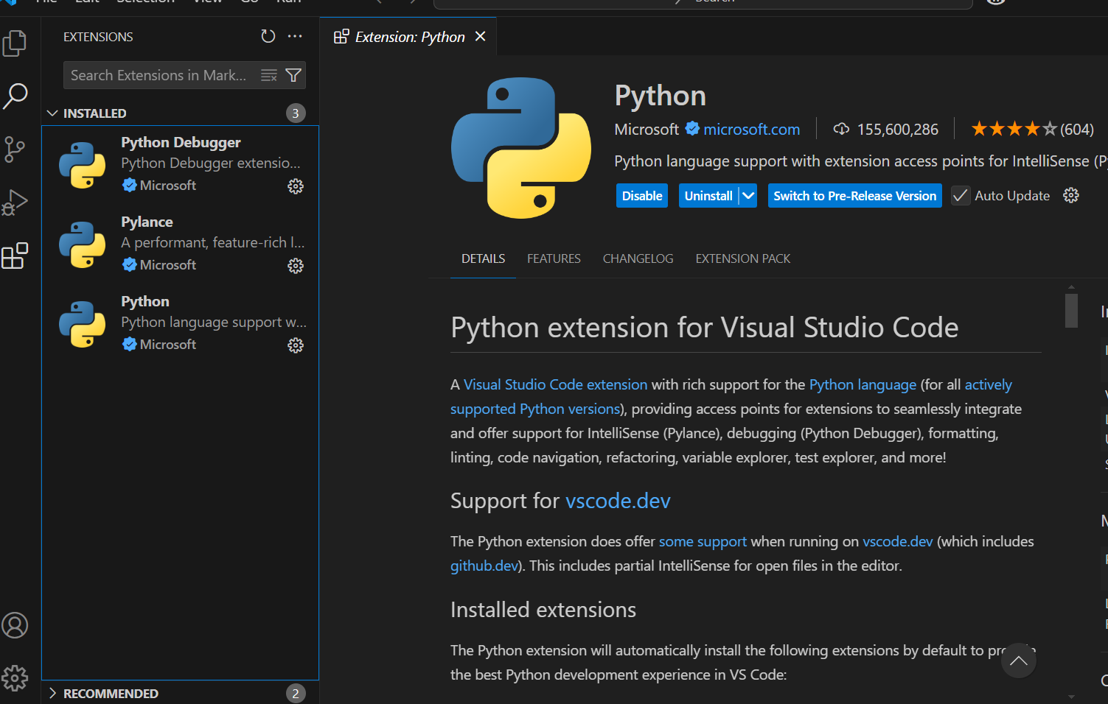
Installation of VS Code
Now we install python extension.
Click on LHS extension icon.
Type python microsoft:
Choose
Python debugger by Microsoft
Python by Microsoft
Python environment by Microsoft
It would provide features like syntax highlighting, code formatting, debugging, and integration with different Python interpreters. Also give us ability to create virtual environ.

Slide 7
EXTRA
Dghsjdsd

Slide 8
Create and activate virtual environment on VS Code
1. Open VSCode and open required folder where you want your python files
2. View -> command palette -> type python. Here you will see an option Python: Create environment. Select this.
3. You will receive 2 options: Venv and Conda. I prefer Venv. Select Venv
4. Then follow along the prompt and select python interpretor you want to use.
5. Finally you would see a directory created .venv which holds all python packages/libraries/etc for your venv
6. (OPTIONAL) To verify that the VSCode terminal is using virtual env python, not global, type command:
> Get-Command python ( For windows )
> which python (for Linux)
This should display the path of python and it should show .venv in its path. In case you do not get this, just close terminal and open new terminal.

