Slide 1
Python: Installation

Slide 2
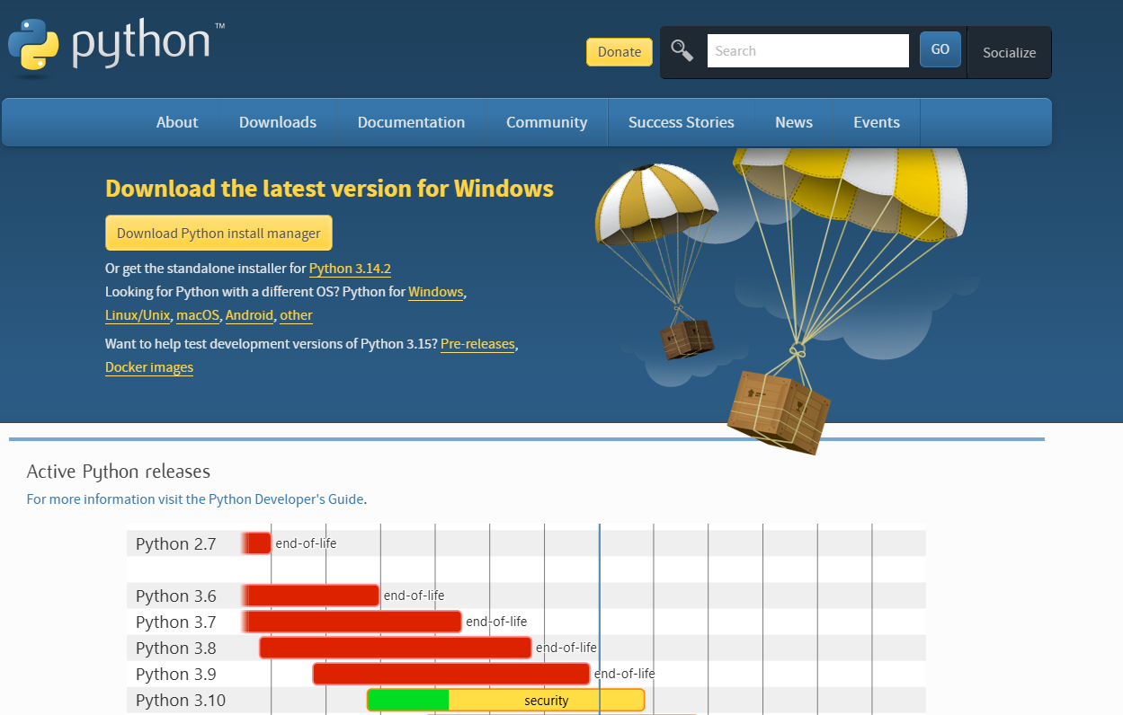
Installation of Python
Goto https://www.python.org/downloads/
You can click on
download python(on top) and it will download latest python.
You can also download older version: Scroll down for that

Slide 3
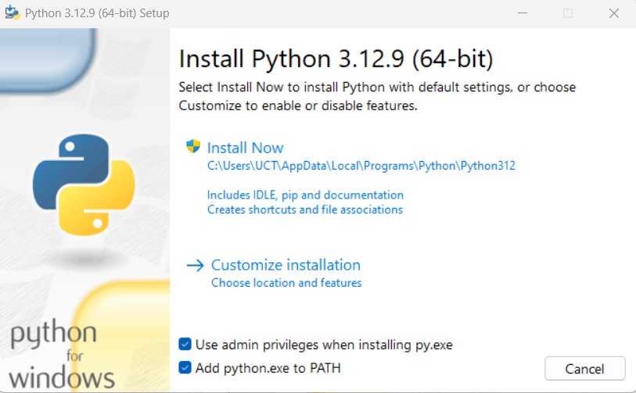



Installation of Python
After download is complete, double click on the downloaded file.
Select the check box: Add python.exe to PATH
Click Install Now
You will receive message Do you want this app to make changes to your device ?
Answer is Yes

Slide 4
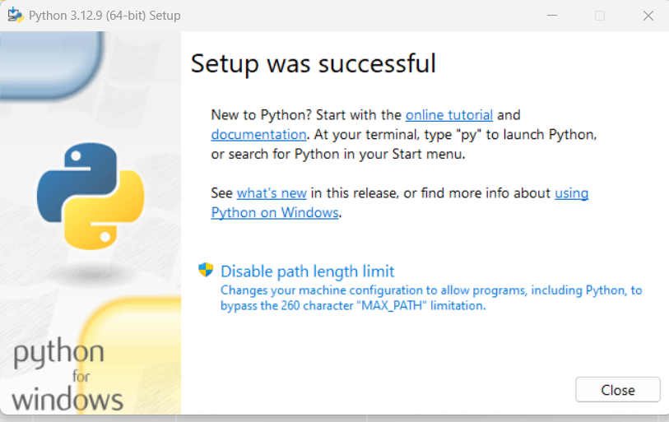
Installation of Python
After successful installation you will see following screen.
You can click on online tutorial to explore

Slide 5
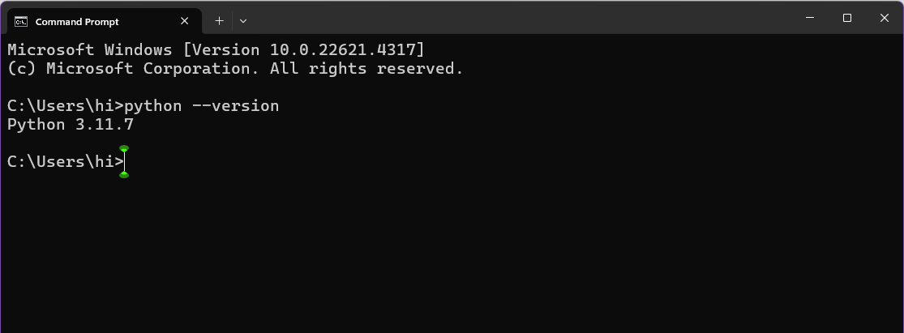


Installation of Python
Now we verify that python is installed.
Open command prompt and type following command:
python --version

