Slide 1
Python: Installation(python, vscode, virtualEnv, anaconda)

Slide 2
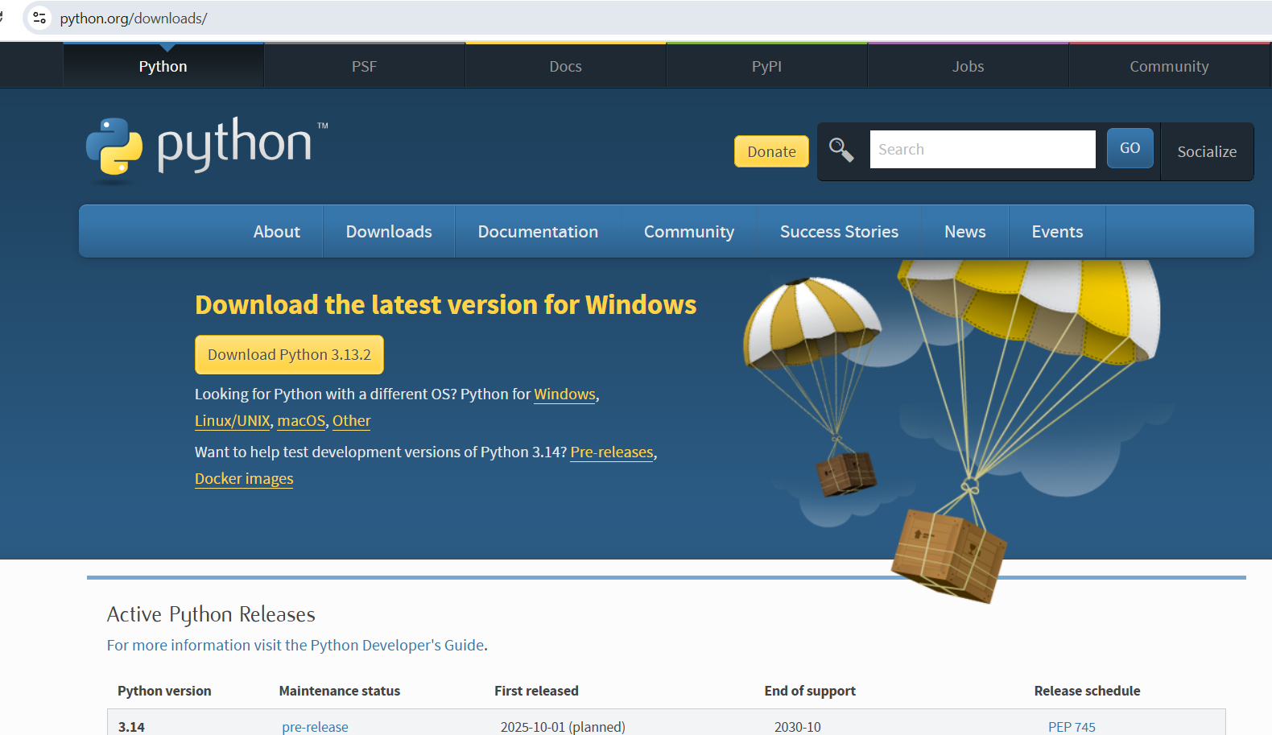
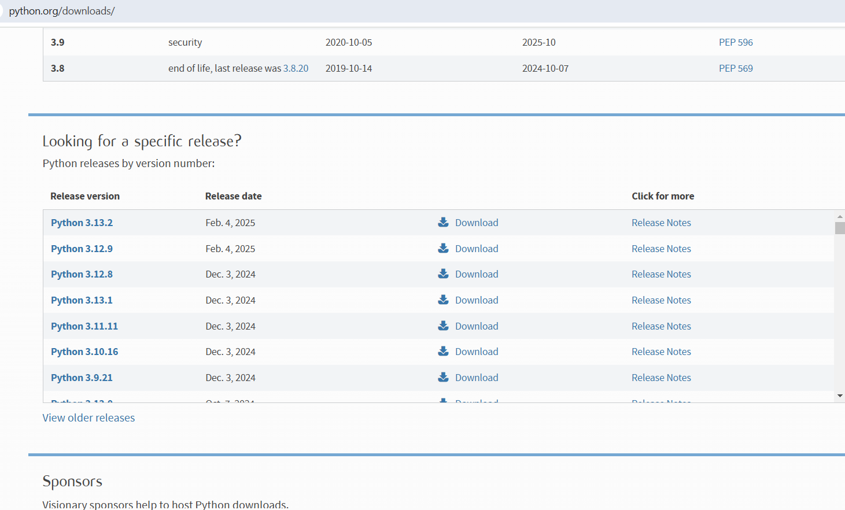
Installation of Python(p1)
Goto https://www.python.org/downloads/
- You can click on download python(on top) and it will download latest python. We would not do that here
- Here I will download an older version: python3.12. Scroll down and click on download Python3.12.X

Slide 3
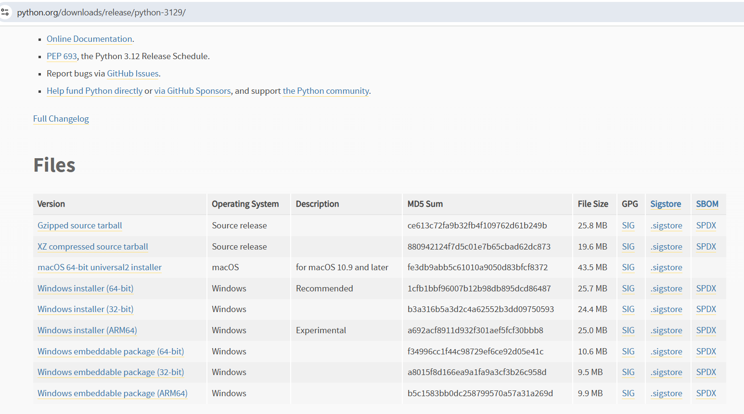
Installation of Python(p2)
You will be redirected to
https://www.python.org/downloads/release/python-3129/
Click on Windows Installer (64-bit), this architecture is of my computer.
This would download python in your download directory.

Slide 4
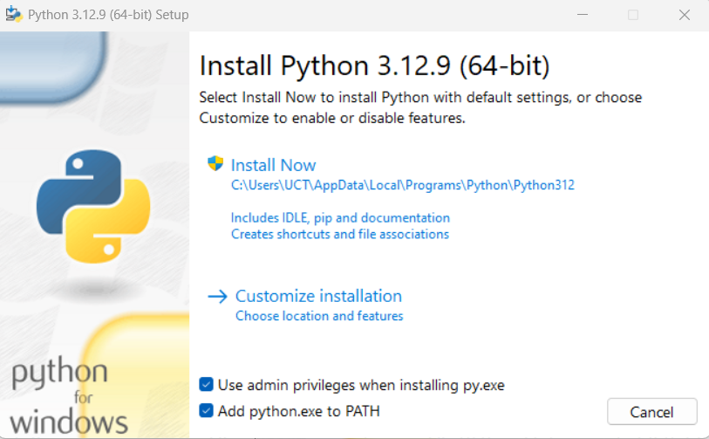
Installation of Python(p3)
3. After download is complete, double click on the downloaded file.
Select the check box: Add python.exe to PATH
Click Install Now
You will receive message Do you want this app to make changes to your device ? Answer is Yes

Slide 5
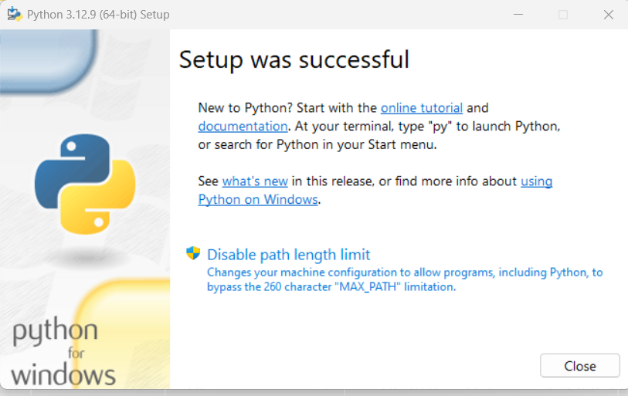
Installation of Python(p4)
4. After successful installation you will see following screen.
You can click on online tutorial to explore

Slide 6
VSCODE INSTALL

Slide 7
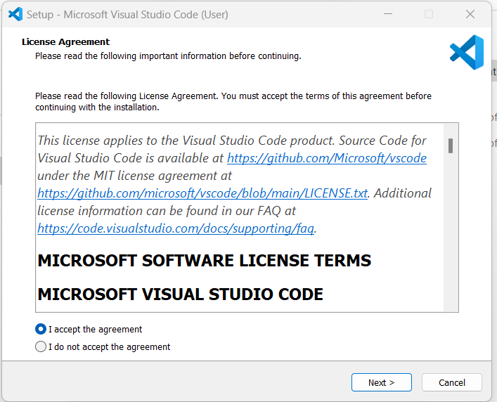
Installation of VSCode(p1)
First we install VSCode: https://code.visualstudio.com/download
1. Click on Download for windows. This would install Vscode that is approx. 100MB in size. Double click on this downloaded file.
2. You will see a message that is displayed on RHS. Select I accept the agreement and then click Next

Slide 8
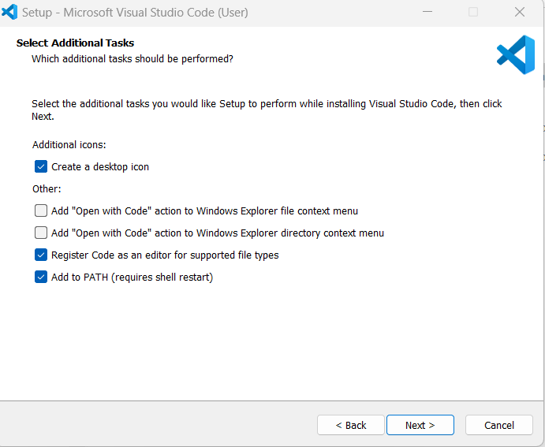
Installation of VSCode(p2)
3. Make sure you select following displayed select-box. Click Next

Slide 9
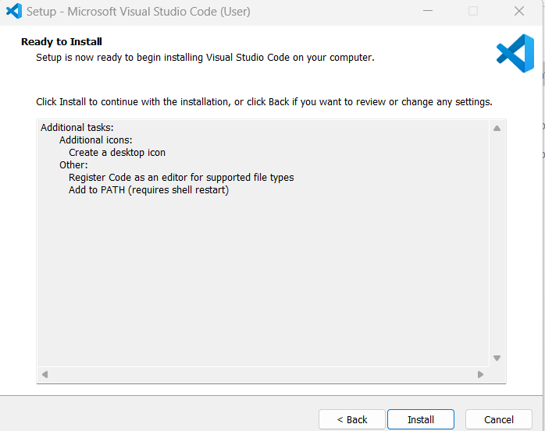
Installation of VSCode(p3)
4. Now you would see following screen. Click Install

Slide 10
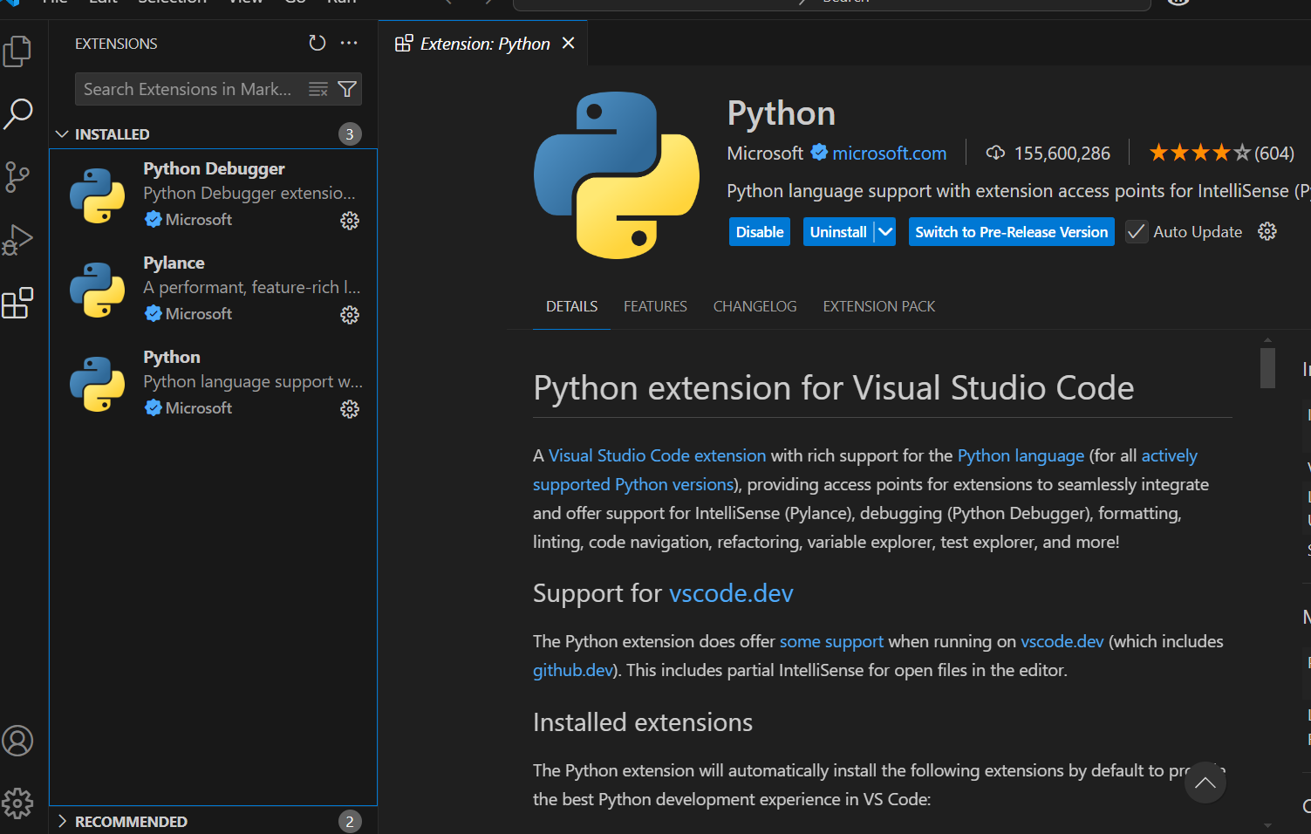
Installation of VSCode (p4)
5. Now we install python extension.
Click on LHS extension icon.
Type python:
Choose
Python debugger by Microsoft
Python by Microsoft
Python environment by Microsoft
It would provide features like syntax highlighting, code formatting, debugging, and integration with different Python interpreters. Also give us ability to create virtual environ.

Slide 11
Create and activate virtual environment on Vscode
1. Open VSCode and open required folder where you want your python files
2. View -> command palette -> type python. Here you will see an option Python: Create environment. Select this.
3. You will receive 2 options: Venv and Conda. I prefer Venv. Select Venv
4. Then follow along the prompt and select python interpretor u want to use.
5. Finally you would see a directory created .venv which holds all python packages/libraries/etc for your venv
6. (OPTIONAL) To verify that the VSCode terminal is using virtual env python, not global, type command:
> Get-Command python ( For windows )
> which python (for Linux)
This should display the path of python and it should show .venv in its path. In case you do not get this, just close terminal and open new terminal.

Slide 12
Common venv commands:
.\.venv\Scripts\python.exe -m jupyter notebook (To start jupyter n/b via virtual env)
.\.venv\Scripts\python.exe -m pip install jupyter (To install jupyter n/b)
.\.venv\Scripts\python.exe -m pip install <package> (To install via virtual env)
.\.venv\Scripts\activate (To activate virtual env)

Slide 13
Create virtual env via cmd line:
To find all python on your computer:
py -0 (lists all installed versions, * in front of default)
where python (lists all Python executables in your system PATH)
cd C:\Users\<YourUsername>\AppData\Local\Programs\Python
and then run ‘dir’. Here all python versions will be listed
-------------------------------------------------------------------------------------------------------
To create virtual environ,. open Window Powershell:
PS C:\Users\hi> mkdir gemini
PS C:\Users\hi> cd gemini
PS C:\Users\hi\gemini> C:\Users\hi\AppData\Local\Programs\Python\Python311\python.exe -m venv env_test
Now you would see a new dir env_test in CWD:
4. PS C:\Users\hi\ gemini > dir
Directory: C:\Users\hi\ gemini
Mode LastWriteTime Length Name
---- ------------- ------ ----
d----- 5/5/2025 11:34 AM env_test
5. Now we activate virt env.:
PS C:\Users\hi\ gemini > .\env_test\Scripts\activate
(env_test) PS C:\Users\hi\ gemini >
6. Now you can install packages and open jupyter notebook:
(env_test) PS C:\Users\hi\ gemini > .\env_test\Scripts\python.exe -m jupyter notebook
C:\Users\hi\gemini\env_test\Scripts\python.exe: No module named jupyter
(env_test) PS C:\Users\hi\gemini> .\env_test\Scripts\python.exe -m pip install jupyter

Slide 14
Common conda commands
https://docs.conda.io/projects/conda/en/latest/_downloads/843d9e0198f2a193a3484886fa28163c/conda-cheatsheet.pdf
conda info
conda create --name ENV_NAME
conda create -n ENVNAME python=3.10 (create env with specific python)
conda rename -n ENV_NAME NEW_ENVNAME
conda remove -n ENVNAME –all (remove env)
conda activate ENV_NAME
conda list
conda env list
conda install PKGNAME
conda uninstall PKGNAME
conda export ENV_NAME>ENV.yml
conda env create -n ENV_NAME --file ENV.yml (for importing the env)
where python (gives the path of python)
Steps to create a new environ:
Go inside the project_dir(e.g. gen_ai)
conda create --name env_genai
conda activate env_genai
conda list python (showed no python interpretor)
conda install python=3.12
conda install jupyter
conda list python (showed python interpretor)
conda list jupyter (showed jupyter installed)
python (make sure its python3.12)
python –m jupyter notebook
Now you can install packages from jupyter cells:
pip install pandas, etc

Slide 15
Issues with powershell:
1) Open powershell as Administrator:
2) C:\Users\Admin\Documents\WindowsPowerShell\profile.ps1 cannot be loaded because running scripts is disabled on this system. For more information, see about_Execution_Policies at https:/go.microsoft.com/fwlink/?LinkID=135170. At line:1 char:3 + . 'C:\Users\Admin\Documents\WindowsPowerShell\profile.ps1' + ~~~~~~~~~~~~~~~~~~~~~~~~~~~~~~~~~~~~~~~~~~~~~~~~~~~~~~~~ + CategoryInfo : SecurityError: (:) [], PSSecurityException + FullyQualifiedErrorId : UnauthorizedAccess . : Fi
PS C:\WINDOWS\system32> Set-ExecutionPolicy RemoteSigned -Scope LocalMachine
Execution Policy Change The execution policy helps protect you from scripts that you do not trust. Changing the execution policy might expose you to the security risks described in the about_Execution_Policies help topic at https:/go.microsoft.com/fwlink/?LinkID=135170.
Do you want to change the execution policy? [Y] Yes [A] Yes to All [N] No [L] No to All [S] Suspend [?] Help (default is "N"): Y
3) PS C:\WINDOWS\system32> Get-ExecutionPolicy -Scope LocalMachine RemoteSigned

Slide 16
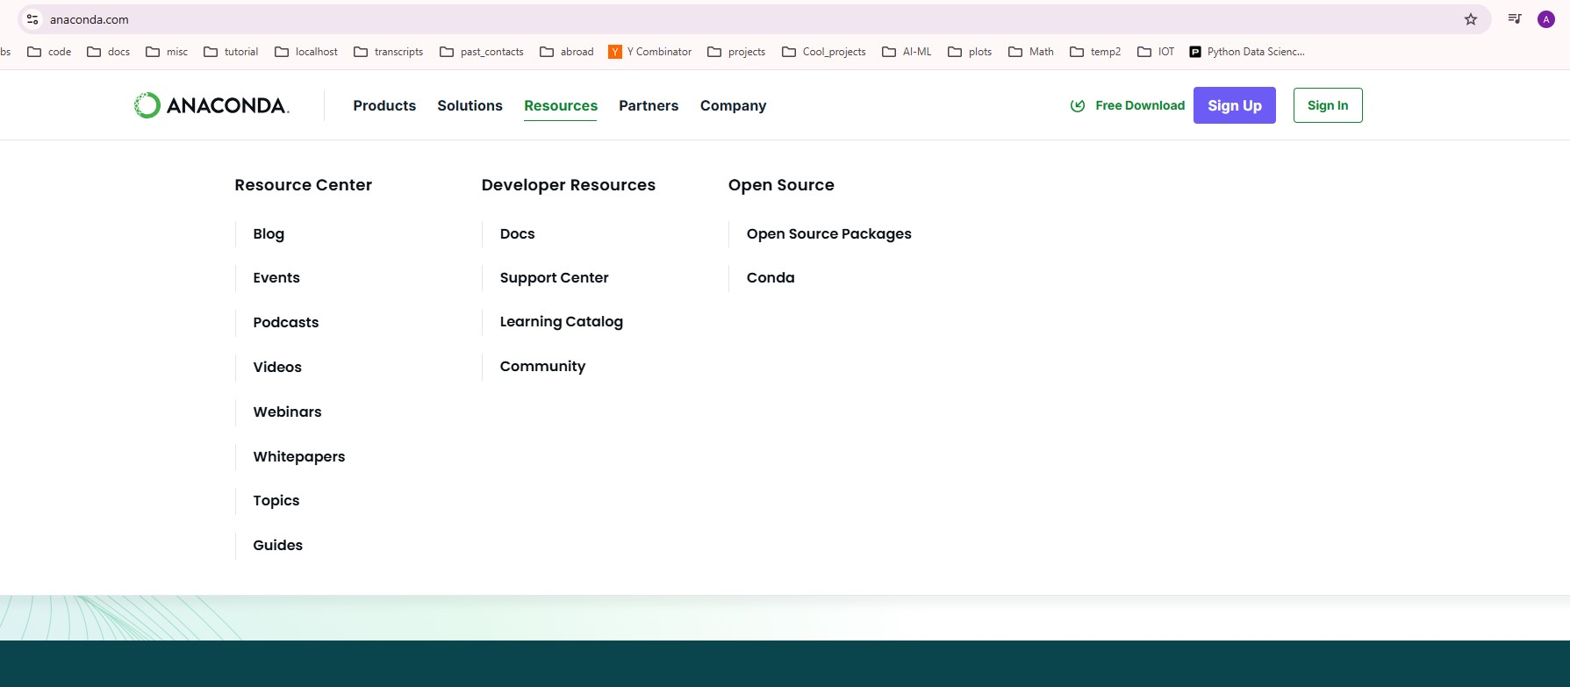
Anaconda(p1)
Step1: Click here

Slide 17
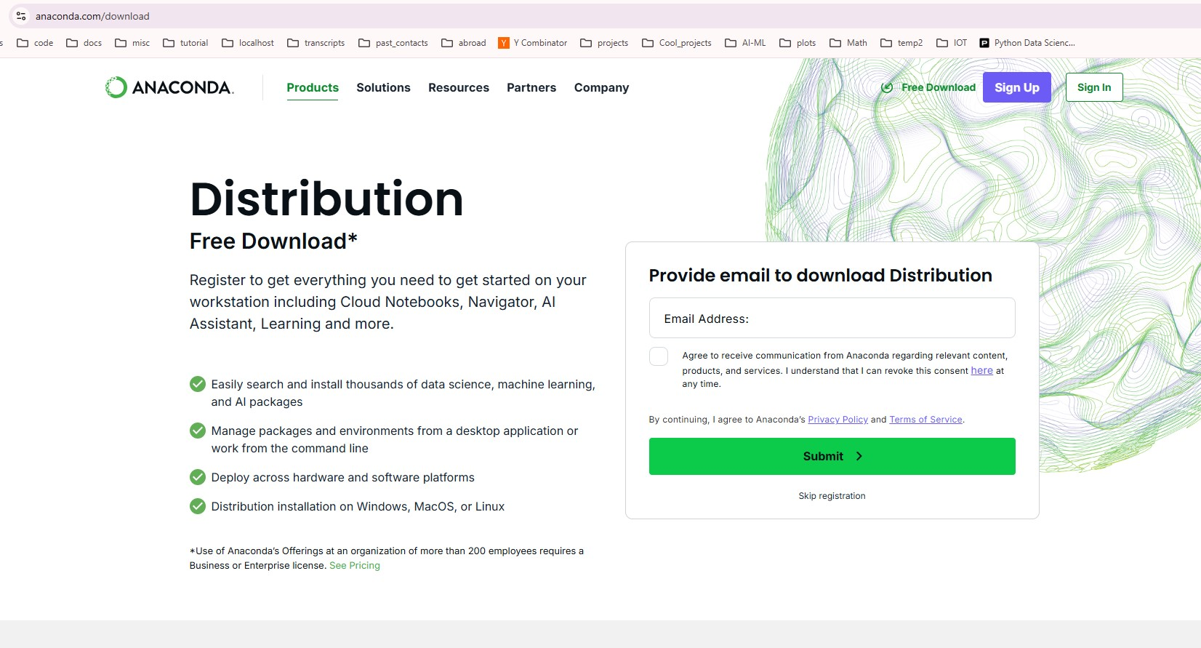
Anaconda(p2)
Step2: Click here…skip registration

Slide 18
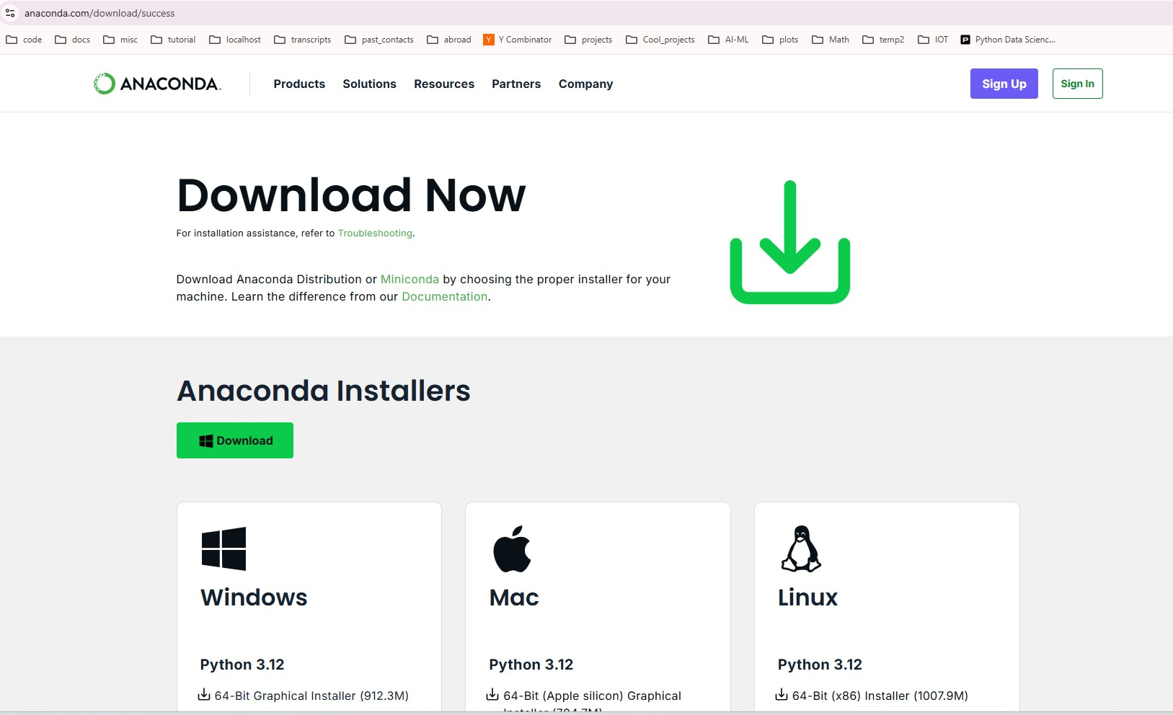
Anaconda(p3)
Step3: Click here…download. It took me 3 minutes. File size=950MB

Slide 19
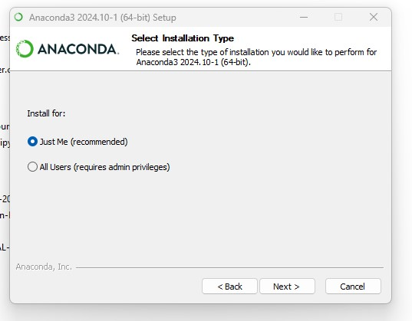
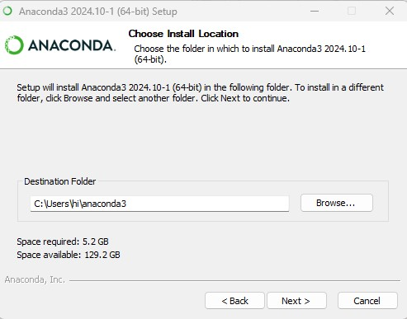
Anaconda(p4)
Step4: goto download dir
Click on anaconda_installer..
Agree to the terms..
Pick drive that has at least 15 GB free space

Slide 20
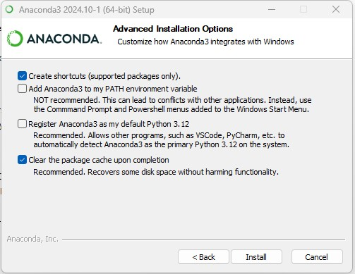
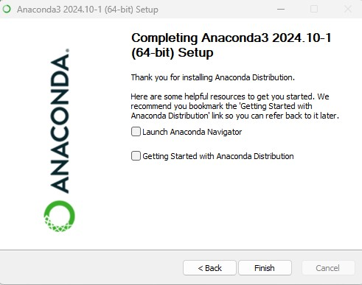
Anaconda(p5)
Step5:I select following options
It would take 5 minutes for installation to finish
After that answer series of qst., and then

Slide 21
Jupyter notebook
Some sites that offer online jupyter server:
Google colab
Kaggle
CoCalc
https://jupyter.org/try-jupyter/lab/
https://deepnote.com/
https://mybinder.org/
https://studiolab.sagemaker.aws/ -> create an account, and an email will be sent to you in next 30 seconds.. Open your mail-box and click on the email…and then have to wait another ?? time

Slide 22
Why Jupyter notebook(see jupyter n/b)
Allows to create/test snippets of code and after you are satisfied, keep necessary code and remove unwanted cells

