Slide 1
What is Programming?
Programming is the process of giving instructions to a computer so it can perform tasks for us.
Notes:
Computers are powerful, but they are not intelligent.
They only do exactly what we tell them to do.

Slide 2
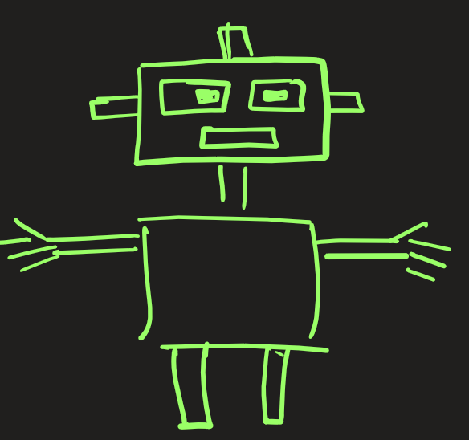
What is Programming?
Notes:
Imagine teaching a very obedient robot 🤖
You must say:
Step 1: Move forward
Step 2: Turn left
Step 3: Pick up the object
If you miss a step, the robot fails.
Programming is writing these step-by-step instructions in a language the computer understands.

Slide 3
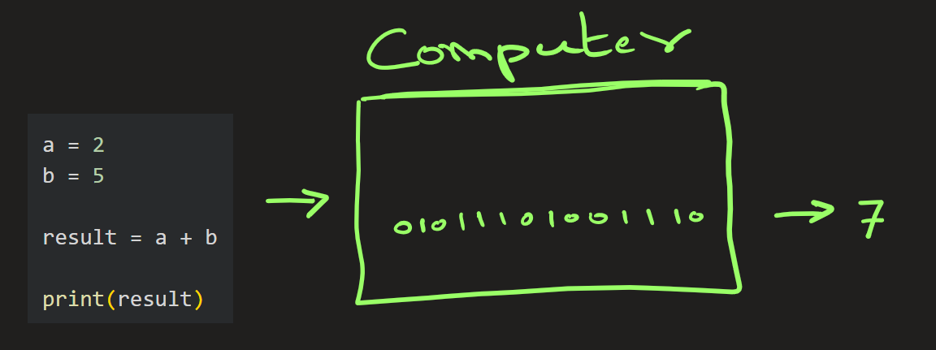
What Is a Program?
A program is a set of instructions written in a programming language.

Slide 4



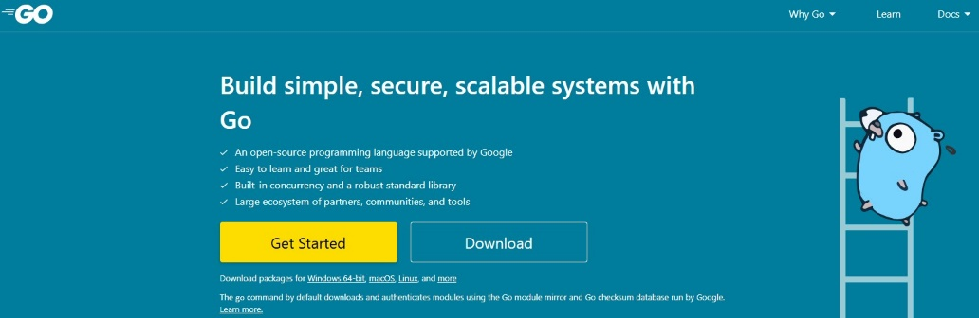
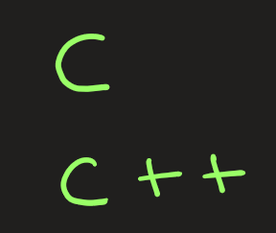


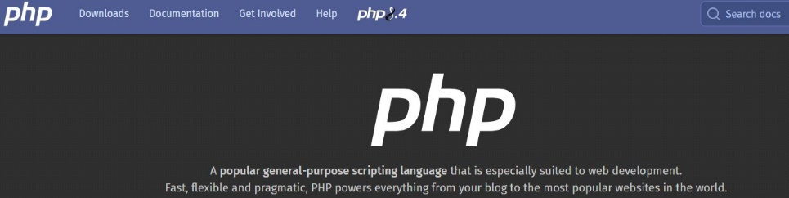
What are different programming languages ?

Slide 5
What Can Programming Do?
With programming, we can:
Build mobile apps
Create websites
Analyze data
Build AI & Machine Learning models
Create games
Automate medical systems

Slide 6
Why should I learn Python instead of other languages?
Python Is Easy to Learn
Compare this to other languages:
Fewer symbols
Less confusing syntax
Easy to read and write
✔ Perfect for beginners
✔ No programming background required

Slide 7
Why should I learn Python instead of other languages?
Python Is Beginner-Friendly but Powerful
Python is used by:
Beginners
Professionals, Scientists, AI Engineers

Slide 8
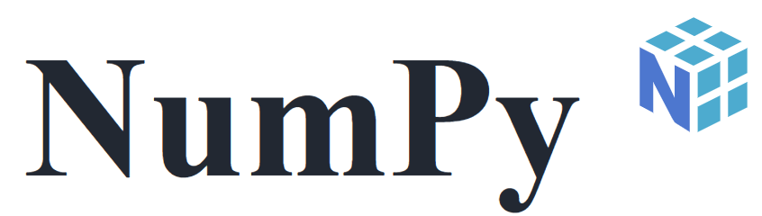


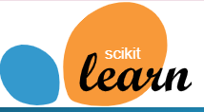
Why should I learn Python instead of other languages?
Python Has Huge Community & Libraries
Python has ready-made tools (called libraries):
numpy → math & arrays
pandas → data analysis
matplotlib → plotting graphs
scikit-learn → machine learning
tensorflow, pytorch → deep learning
You write less code and You build more powerful applications

Slide 9
Why should I learn Python instead of other languages?
Ideas into Reality
Notes:
It’s a tool to turn Ideas into reality

Slide 10
EXTRA
Notes:
It’s a tool to turn Ideas into reality

Slide 12
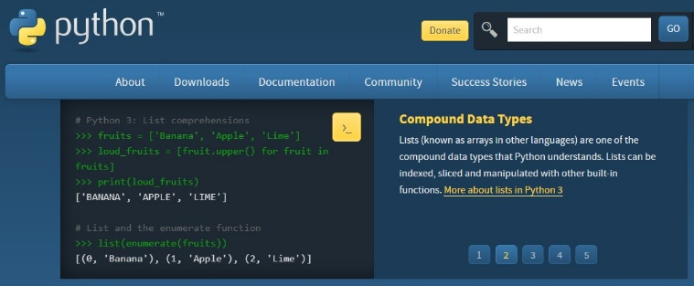
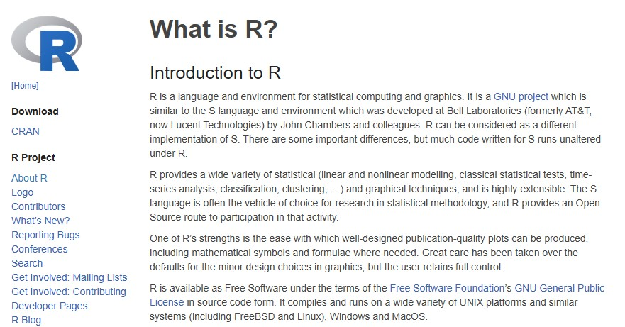
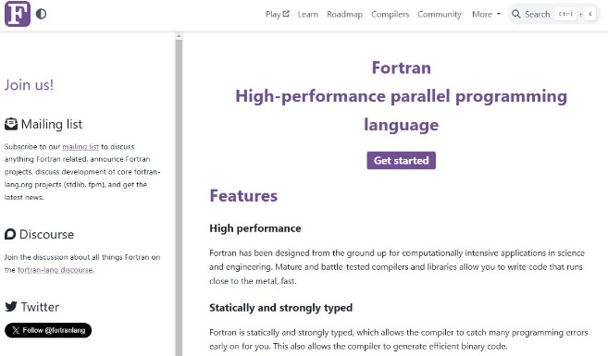
2. Introduction to Programming
Process that involves writing instructions for a computer to follow in order to solve problems. The instructions are written in a language that the computer can understand, and this process is a collaboration between humans and computers.
Common languages are Python, C, C++, java, GoLang, C#, R, VB.Net, PHP, R, Fortran, Pascal, Bash, PERL, prolog etc

Slide 13
Types of programming Language
Procedural programming languages: These languages follow a sequence of commands or statements to achieve a desired output. Example: Python, C, Fortran, Pascal, etc
Object-oriented programming languages (OOP): These languages help manage complexity in large programs by using class(say, Planets) and objects(say mars, saturn, earth,etc). Example: Java, Python, C++, C#, Delphi/Object Pascal, VB.NET
Scripting languages: These languages are used for specific purposes, such as web development. Example JavaScript, PHP, Python, Bash, Perl
Logic programming languages: These are another type of programming language. logic programming focuses on what the program should achieve: You define rules and facts(Knowledge Representation), and the system determines how to use them to reach a solution. Example Prolog, Answer Set Programming (ASP)

Slide 14
Evolution of Python
Created by Guido van Rossum in 1991.
Python 1.x (1991-2000)
  Introduced core features like exception handling, functions, and modules.
  Included basic data structures like lists, tuples, and dictionaries.
Python 2.x (2000-2010)
  Added list comprehensions, garbage collection, and Unicode support.
  However, it suffered from inconsistencies, leading to Python 3.
Python 3.x (2008-Present)
  Introduced better Unicode handling, print as a function, and type hints.
  Removed legacy features for better consistency.
  Gained popularity for web development, AI, and data science.
Over time, Python has become one of the most widely used programming languages, with major contributions in machine learning, data science, automation, and web development.

Slide 15
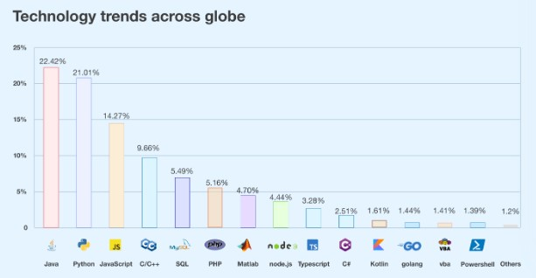
Where is Python Used?
Web Development (Django, Flask)
Data Science & AI (NumPy, Pandas, TensorFlow)
Automation & Scripting (Selenium, PyAutoGUI)
Cybersecurity (Scapy, Nmap)
Game Development (Pygame)
Embedded Systems & IoT (MicroPython, Raspberry Pi)

Slide 16
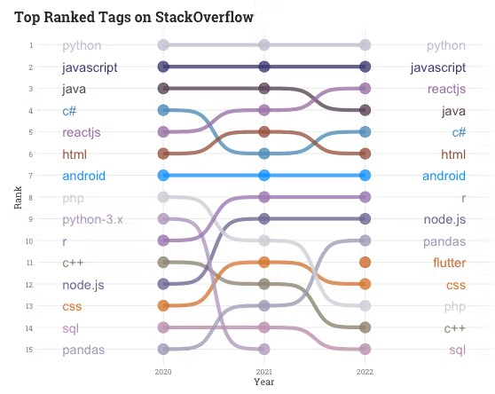
Popularity contest
According to current trends, the most widely used programming languages are Python, Java, and JavaScript; with Python generally considered the most popular overall, followed by Java and then JavaScript, based on data from the TIOBE Index and other developer surveys.

Slide 17
Companies that use Python:
Google makes extensive use of Python in its web search systems.
The popular YouTube video sharing service is largely written in Python.
The Dropbox storage service codes both its server and desktop client software primarily in Python.
The Raspberry Pi single-board computer promotes Python as its educational language.
EVE Online, a massively multiplayer online game (MMOG) by CCP Games, uses Python broadly.
The widespread BitTorrent peer-to-peer file sharing system began its life as a Python program.
Industrial Light & Magic, Pixar, and others use Python in the production of animated movies.
ESRI uses Python as an end-user customization tool for its popular GIS mapping products.
Google’s App Engine web development framework uses Python as an application language.
The IronPort email server product uses more than 1 million lines of Python code to do its job.
Maya, a powerful integrated 3D modeling and animation system, provides a Python scripting API.
The NSA uses Python for cryptography and intelligence analysis.
iRobot uses Python to develop commercial and military robotic devices.
Netflix and Yelp have both documented the role of Python in their software infrastructures.
Intel, Cisco, Hewlett-Packard, Seagate, Qualcomm, and IBM use Python for hardware testing.
JPMorgan Chase, UBS, Getco, and Citadel apply Python to financial market forecasting.
NASA, Los Alamos, Fermilab, JPL, and others use Python for scientific programming tasks

Slide 18
Python in AI & Data Science
Machine Learning (scikit-learn, TensorFlow, PyTorch)
Data Visualization (Matplotlib, Seaborn)
Big Data Processing (Dask, PySpark)

Slide 19
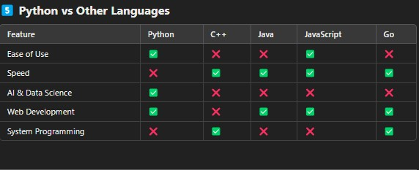
Compared with other languages

Slide 20
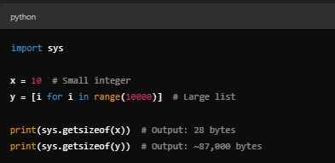
Disadvantages of Python(p2)
2. High Memory Usage
Reason: Python’s dynamic typing and garbage collection lead to high memory consumption.
Impact: Not ideal for applications with limited memory (e.g., embedded systems).
Lists consume more memory than arrays in C/C++.
Solution: Use NumPy arrays instead of lists for large data.

Slide 21
Disadvantages of Python(p3)
3. Global Interpreter Lock (GIL)
Reason: Only one thread executes at a time
Impact: Inefficient multi-threading for CPU-bound tasks
Solution: Use multiprocessing for CPU-heavy tasks
4. Weak in Mobile & Game Development
Reason: Not optimized for mobile or games
Impact: Rarely used for Android/iOS apps or major games
Solution: Use Kivy or BeeWare (limited support)
5. Limited Support for Frontend Web Development
Reason: Primarily a backend language
Impact: Cannot replace JavaScript for frontend
Solution: Use JavaScript + Python for full-stack
6. Poor Performance in Real-Time Applications
Reason: Interpreted nature and GIL cause delays
Impact: Not ideal for real-time systems
Solution: Use Cython or C/C++ modules
7. Dependency Management Issues
Reason: Multiple versions & libraries lead to conflicts
Impact: Harder to maintain projects
Solution: Use virtual environments (venv, conda)

Slide 22
Heading Goes Here
Fhdsklf
Fjdsklf
Fjskldf

