Slide 1
Embeddings

Slide 2
What is an embedding ?
An embedding is the process or result of turning data—like
words,
sentences, or
Images, Videos
Audio
—into a list of numbers (AKA vector) so a computer can understand their meaning and relationships
Example: Word embeddings of 6 dimensions
fish –> [0.1, -0.5, 3.1, -2, 3, 5 ]
water –> [-2, -0.42, 3.1, -1.9, 4, 0.004 ]
plane –> [0.1, 0.94, 0.013, -2.8, 3, 5 ]
air –> [0.2, 0.84, 0.023, -1.3, 2, 4 ]
Word embeddings have 100 to 300 dimensions.
Example: Sentence embeddings of 4 dim
I love juice –> [0.1, -0.5, 3.1, -2]
Eat a mango –> [-2, -0.42, 3.1, -1.9 ]
Sleep in class –> [0.1, 0.94, 0.013, -2.8]
Sentence embeddings have 384 to 1536 dimensions.

Slide 3



Example: Image embeddings of 4 dim
–> [0.1, -0.5, 3.1, -2]
–> [-2, -0.42, 3.1, -1.9 ]
–> [0.1, 0.94, 0.013, -2.8]
Image embeddings have 512 to 2048 dimensions.

Slide 4
Video or Audio embeddings: Range from 128 to 3,072 dimension

Slide 5
Core Idea of Embeddings:
The vectors that are similar in meaning would be near each other.
ocean
emperor
water
king
sea
queen
fish
ship
recliner
bed
sofa

Slide 6
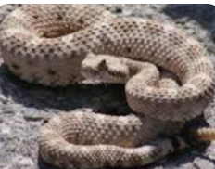
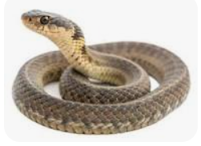
Advantage of using large dimension:
Superior Semantic Resolution - High-dimensional spaces allow the model to separate highly similar but distinct concepts.
For example, in an audio space, it can tell the difference between
a violin and a viola playing the exact same note, or
distinguish a polite tone(right) from a sarcastic tone(right) in speech.
Rattle snake and Garter snake in image

Slide 7
Libraries used to create embeddings
Word2Vec:
Uses shallow neural networks based on the distributional hypothesis to map words with similar meanings close together.
GloVe (Global Vectors for Word Representation):
Combines global matrix factorization and local context window methods to capture word co-occurrences.
Doc2Vec:
Builds upon Word2Vec to create vector representations for entire sentences or variable-length documents rather than single words.

Slide 8
Libraries used to create embeddings
BERT and RoBERTa:
Generates powerful contextual embeddings where the representation of a word shifts dynamically depending on the surrounding text in a sequence.
OpenAI Embedding Models:
Industry-standard commercial models like text-embedding-3-small and text-embedding-3-large accessed via the OpenAI API
Cohere Embed:
Highly optimized models like Cohere Embed v4 used widely for enterprise retrieval and multi-modal tasks.
Hugging Face Transformers:
Open-source platforms offering access to state-of-the-art embedding models like BGE-M3 and Jina Embeddings.

Slide 9
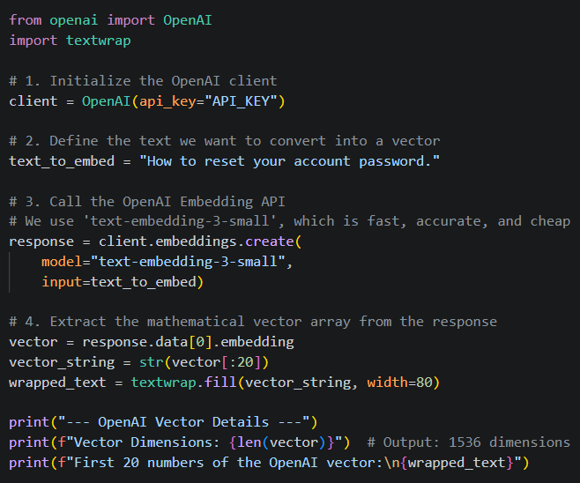
Example of embeddings using OpenAI: (See python code)

Slide 10
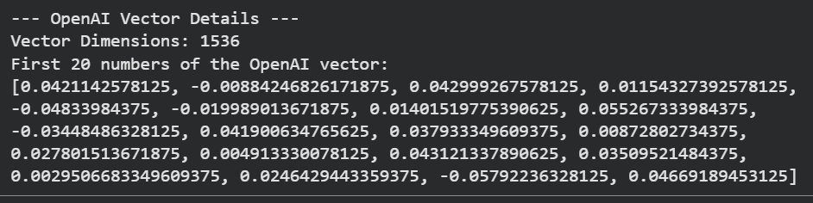
Example of embeddings: (See python code)
Embedding Model
“How to reset your account password”
Vector
[0.042, - 0.0008,….]

Slide 11
Application of Embeddings

Slide 12



User Query:
Automobile repair
1. Semantic Search and Information Retrieval
Traditional search engines look for exact keyword matches, which fails if a user searches for "automobile repair" but a document says "car maintenance."
How it works: The search engine calculates geometric proximity to find documents that match the intent and conceptual meaning of the query, rather than just matching characters.
Car maintenance
Plane Travel
Food
Plane travel
Car maintenance
Automobile repair
Food

Slide 13






2. Retrieval-Augmented Generation (RAG) for LLMs
RAG is the primary technique used to connect Large Language Models (like GPT or Claude) to private or dynamic data. Because LLMs have context limits and suffer from hallucinations, they cannot remember every company file: RAG solves this problem
How it works:
1) A user asks a question(‘automobile repair’)
2) an embedding model converts that question into a vector.
3) Find text blocks that are similar to the questions
4) Those specific text blocks are fed directly into the prompt alongside the question, allowing the LLM to generate context-aware, factually correct answers.
User
Embedding model
LLM
(ChatGPT)
Private Data
(Vector DB)

Slide 14






3. Text Classification and Clustering
Automated organization of massive datasets is critical for sorting unorganized enterprise text streams at scale.
How it works: Machine learning models process embedding vectors to evaluate how data naturally groups together or maps to predefined categories.
Why it's useful: Companies utilize this to instantly route thousands of incoming customer support tickets to the right departments (classification) or detect emerging global trends by grouping millions of social media posts into thematic bubbles (clustering).
Continued……
Computer Company
10,000 emails
Mouse issues
(5000 email)
Laptop Enquiry
(3000 email)
Returns
(2000)
New email from customer - refund

Slide 15

…..continued
1. Data Ingestion (Input)
The process starts with massive streams of unorganized text data, say thousands of raw incoming customer support emails.
2. Vector Conversion (Embedding)
An embedding model converts each email into an embedding vector. Machine learning models analyze the geometric positions of these vectors relative to one another to evaluate relationships.
3. Algorithmic Routing & Grouping
If a new email comes in, then the model evaluates how close a new email-vector lands next to predefined boundary zones.
For example, if a email-vector lands in the "Return" sector, it triggers an instant route to the RETURN department.
Computer Company
10,000 emails
Mouse issues
(5000 email)
Laptop Enquiry
(3000 email)
Returns
(2000)
New email from customer - refund

