Slide 1
1. Simple Trend Questions
Is the passenger trend going up or down over the years? - DONE
What was the total number of passengers for each year? - DONE
Which year had the highest number of passengers? - DONE
2. Simple Seasonality Questions
Which month is the busiest month of the year? - DONE
Which month has the lowest number of passengers? - DONE
Are summer months busier than winter months? - DONE
3. Simple Forecasting Questions
What is the average monthly growth rate of passengers? - DONE
Predict the passenger count for next month using a simple average. – DONE
4. Query
What was the passenger count in July 1960 compared to July 1950? - DONE

Slide 2
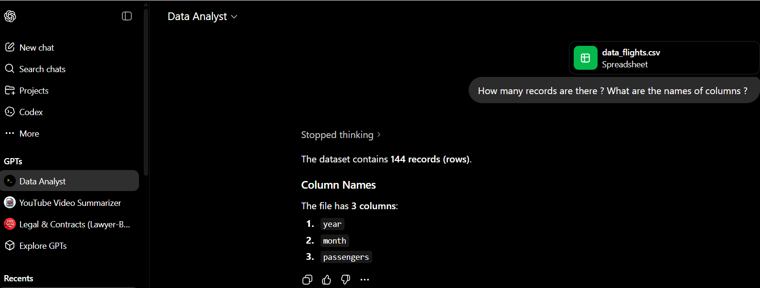




Slide 3
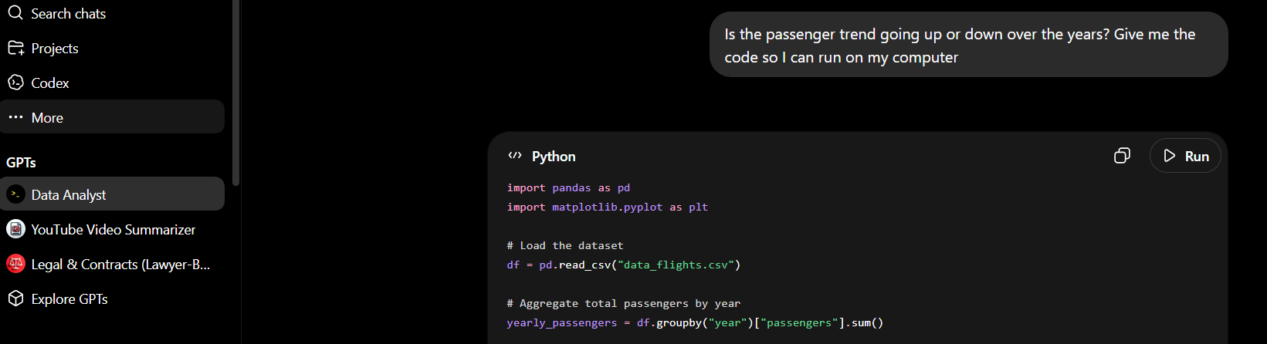

Slide 4
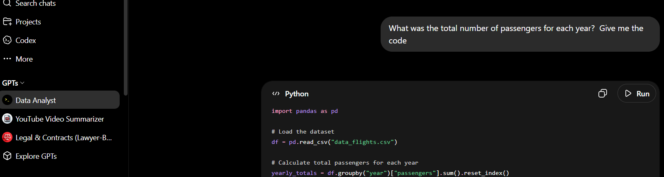


Slide 5
For the rest , look at jupyter notebook

