Slide 1
Optimizer

Slide 2
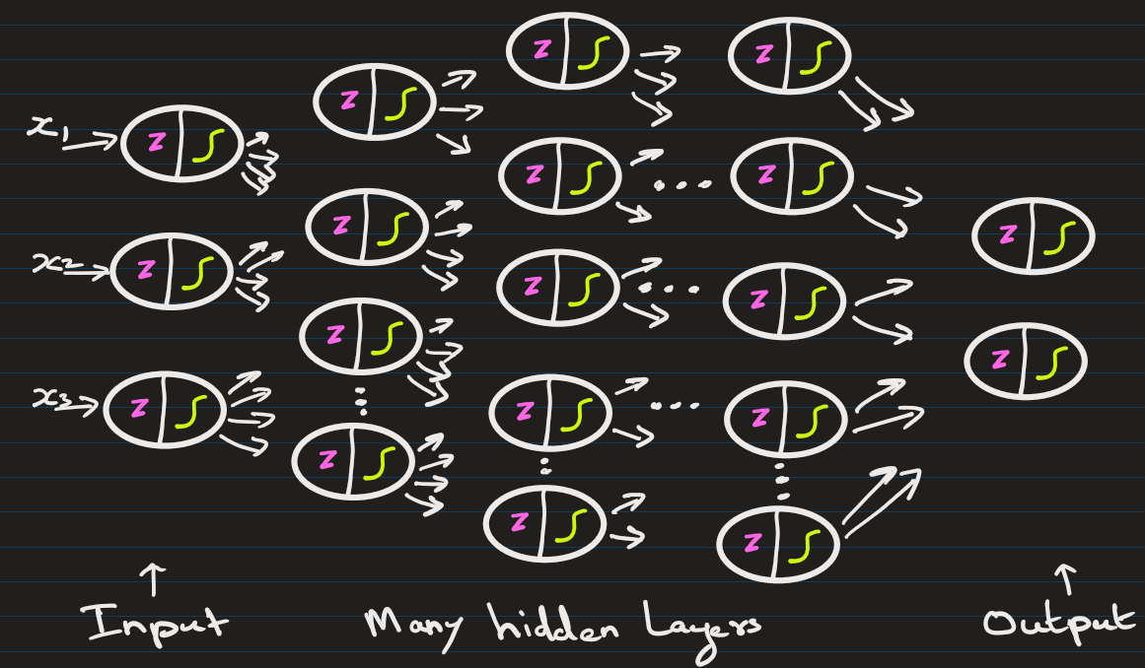
The flow
Make predictions (forward pass)
Calculate error between predictions and actual values
Propagate error backward through the network
Update weights/bias using gradient descent to minimize error/loss
Prediction target y`
Updates weights + bias
Optimizer
Loss score
Loss function
True/Actual target y
E.g.: SGD, AdamOptimzer, RMSProp, AdaGrad, etc.
E.g. : Mean Squared Error, Cross-Entropy, etc.

Slide 3
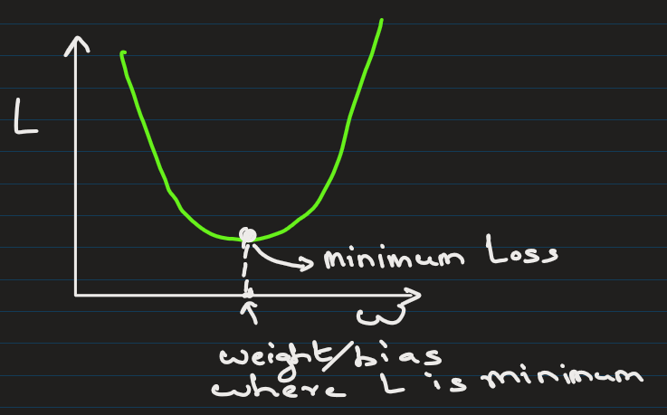
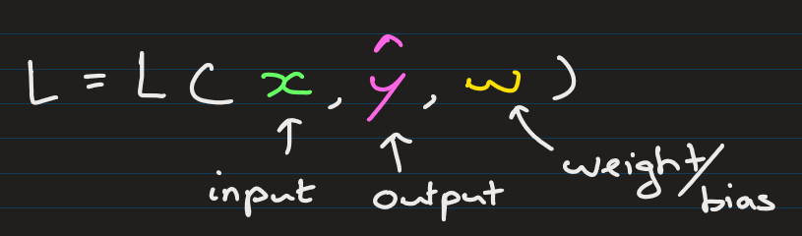
Goal is to find weights and bias such that the Loss is minimum

Slide 4
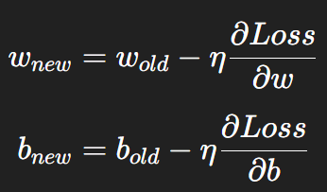
Most optimizers are variations of Gradient Descent.
They
Compute the gradient (slope of loss function with respect to weights).
Update weights in the opposite direction of the gradient (because we want to minimize loss).
Formula:
Where:
w, b is the weight, bias
η (eta) = learning rate

Slide 5
Full Batch Gradient Descent
Uses the entire dataset to compute gradient before updating weights.
Accurate but very slow for large datasets.

Slide 6
(b) Stochastic Gradient Descent (SGD)
Uses one sample at a time to update weights.
Much faster but updates are noisy (loss jumps around).
Analogy: Batch = careful slow walk, SGD = fast but shaky run downhill.

Slide 7
(c) Mini-Batch Gradient Descent
Middle ground: Uses a small batch of samples (like 32, 64).
Most common in practice.
Balances speed + stability.
Example: Keras model.fit(..., batch_size=32).

Slide 8
d) SGD With Momentum
Idea: Don’t just look at current gradient → also keep some memory of the past direction.
Helps smooth out noisy updates and speeds up downhill movement.
Analogy: Like a ball rolling down a hill — momentum carries it forward.

Slide 9
(e) AdaGrad
Adjusts the learning rate for each parameter individually.
Parameters with frequent updates get smaller steps; rare ones get bigger steps.
Downside: Learning rate shrinks too much over time.

Slide 10
(f) RMSProp
Fixes AdaGrad by keeping learning rate steady.
Works well for recurrent networks.

Slide 11
(g) Adam (Adaptive Moment Estimation)
Most popular today.
Combines Momentum + RMSProp.
Maintains a running average of past gradients (momentum) and squared gradients (adaptive learning rate).
Fast, efficient, works well in many cases.

Slide 13
EXTRA
Xxxxxxxxxxx
xxxxxxxxxxxx

