Slide 1
Model Building Using Keras

Slide 2
What is Keras?
High-level API for building deep learning models
Runs on top of TensorFlow
Makes neural networks easy to build compared to raw math / NumPy

Slide 3
2. Sequential API
What is Sequential API?
Simplest way to build neural networks
Layers are stacked one after another :
Input → Layer1 → Layer2 → Output

Slide 4
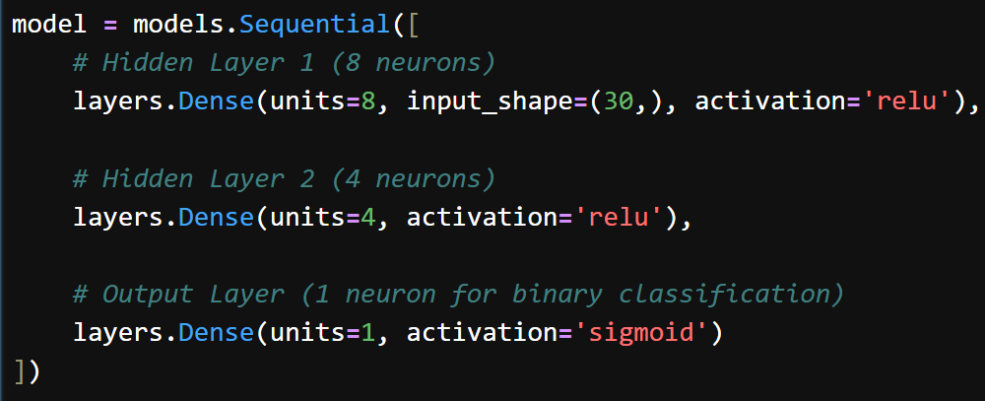




2. Sequential API
Output
layer2
Concept | Explanation
Sequential | Linear stack of layers
Dense | Fully connected layer
input_shape | Shape of input features
activation | Adds non-linearity
Hidden
layer1
Hidden
layer2

Slide 5




2. Sequential API
Dense Layer
layers.Dense(units=4, activation='relu’)
Meaning:
4 neurons
Each neuron connected to all inputs
Output
layer2
Types of Layers
Layer | Use
Dense | General purpose
Conv2D | Images
LSTM | Time series
Dropout | Prevent overfitting
Hidden
layer1
Hidden
layer2

Slide 6
3. Activation Functions
Why Activation?
Without activation → model becomes linear only
Activation | Use
relu | Most common
sigmoid | Binary output
softmax | Multi-class
tanh | Older networks
Output
layer2
Hidden
layer1
Hidden
layer2

Slide 7
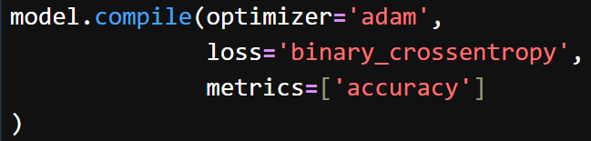
4. Compile Step
What is Compile?
Configures the model for training
Output
layer2
Parameter | Meaning
optimizer | How model learns
loss | Error function
metrics | Evaluation
Hidden
layer1
Hidden
layer2

Slide 8
4. Compile Step
Output
layer2
Common Choices
Hidden
layer1
Hidden
layer2
Problem | Loss | Activation
Regression | mse | none
Binary | binary_crossentropy | sigmoid
Multi-class | categorical_crossentropy | softmax

Slide 9
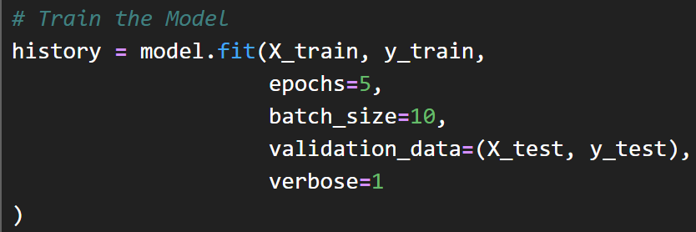
5. Training the model
Output
layer2
Parameter | Meaning
epochs | Number of passes
batch_size | Data per step
Hidden
layer1
Hidden
layer2

Slide 10
EXTRA
Xxxxxxxxxxx
xxxxxxxxxxxx

