Slide 1
Parameters

Slide 2
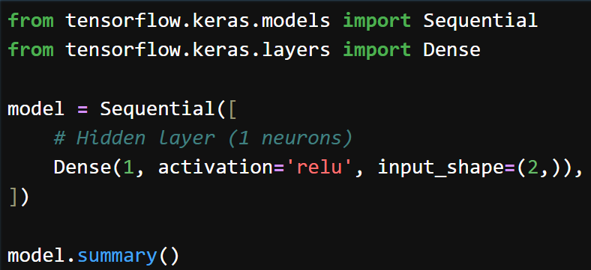
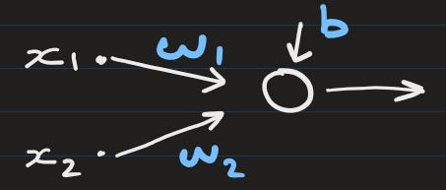
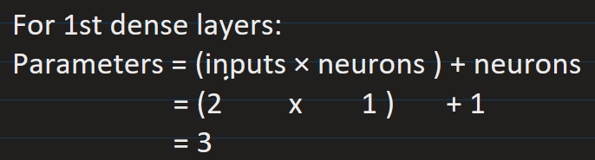
Number of parameters in any dense layer = (inputs × neurons) + neurons
Example 1
Layer type | Output shape | Param #
Dense (Dense) | (None, 1) | 3

Slide 3
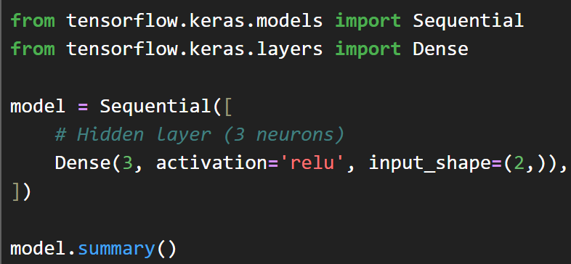
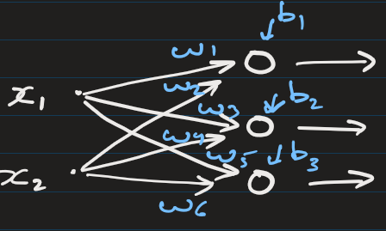
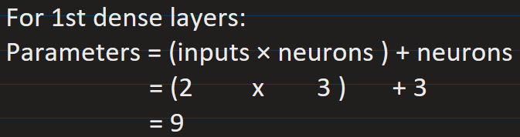
Number of parameters in any dense layer = (inputs × neurons) + neurons
Example 2
Layer type | Output shape | Param #
Dense (Dense) | (None, 3) | 9

Slide 4
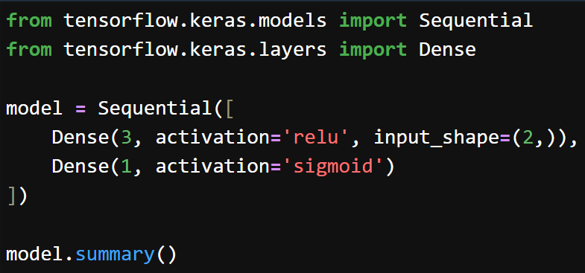
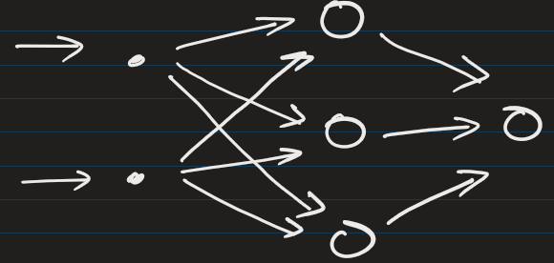
Number of parameters in any dense layer = (inputs × neurons) + neurons
Example 3
Layer type | Output shape | Param #
Dense (Dense) | (None, 3) | 9
Dense_1 (Dense) | (None, 1) | 4

Slide 5
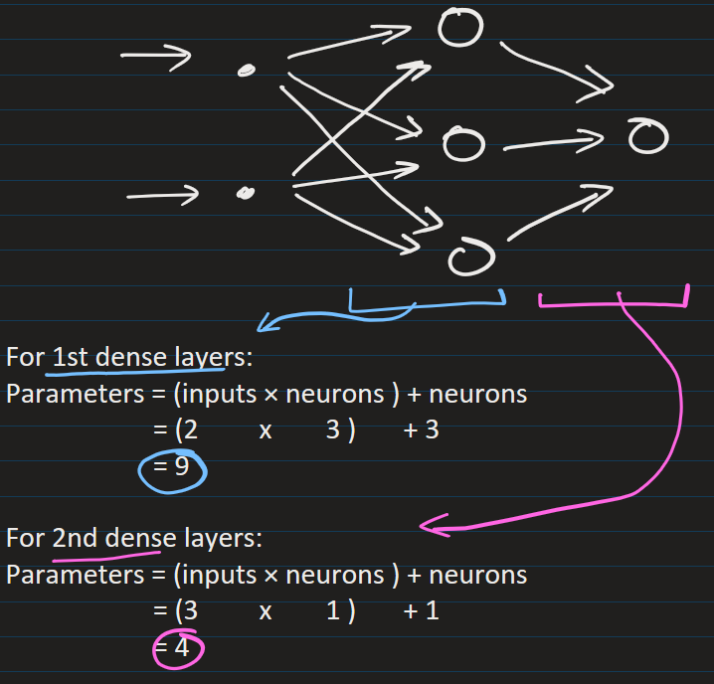
Number of parameters in any dense layer = (inputs × neurons) + neurons
Example 3
Layer type | Output shape | Param #
Dense (Dense) | (None, 3) | 9
Dense_1 (Dense) | (None, 1) | 4

Slide 6
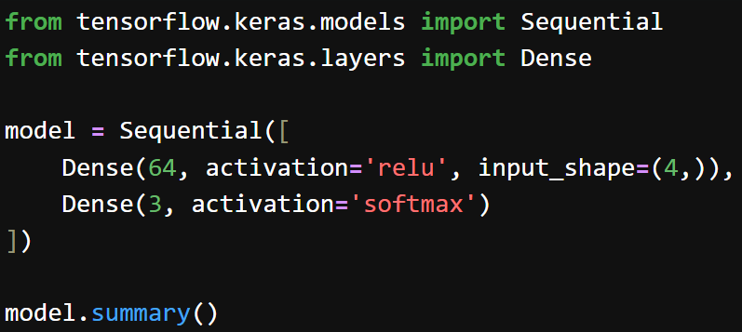
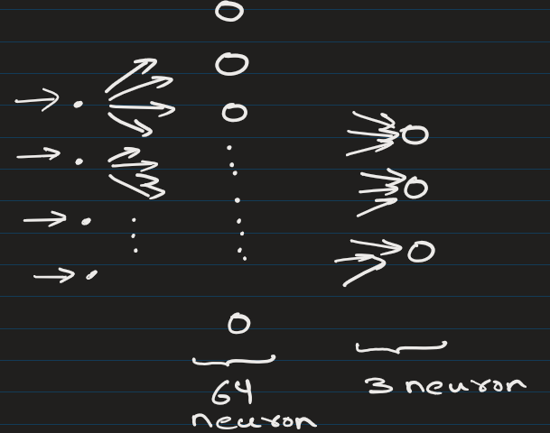
Number of parameters in any dense layer = (inputs × neurons) + neurons
Example 4
Layer type | Output shape | Param #
Dense (Dense) | (None, 64) | 320
Dense_1 (Dense) | (None, 3) | 195

Slide 7
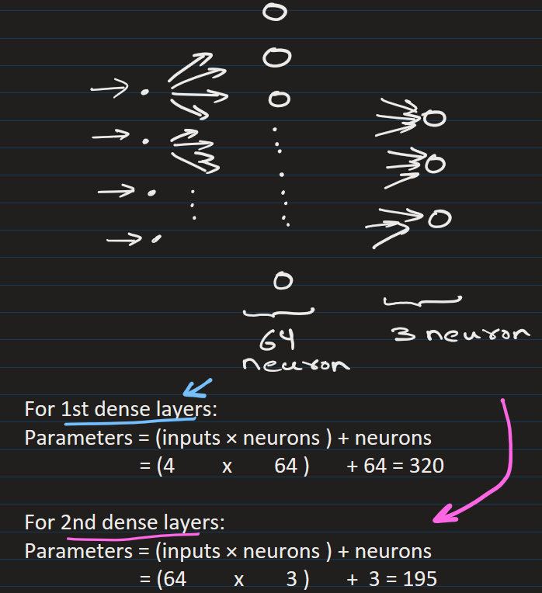
Number of parameters in any dense layer = (inputs × neurons) + neurons
Example 4
Layer type | Output shape | Param #
Dense (Dense) | (None, 64) | 320
Dense_1 (Dense) | (None, 3) | 195

Slide 8
Number of parameters in any dense layer = (inputs × neurons) + neurons

Slide 9
EXTRA
Xxxxxxxxxxx
xxxxxxxxxxxx

