Slide 1
AI – CNN-VGG-ResNET

Slide 2
VGG
VGG stands for Visual Geometry Group; it is a standard deep Convolutional Neural Network (CNN) architecture with multiple layers. The “deep” refers to the number of layers with VGG-16 or VGG-19 consisting of 16 and 19 convolutional layers.
The VGG16 model achieves almost 92.7% top-5 test accuracy in ImageNet. ImageNet is a dataset consisting of more than 14 million images belonging to nearly 1000 classes, including keyboard, animals, pencil, mouse, etc. Additionally, the model has an image input size of 224-by-224.
The size of VGG-16 trained imageNet weights is 528 MB. So, it takes quite a lot of disk space and bandwidth which makes it inefficient.
The VGG16 model was trained using Nvidia Titan Black GPUs for multiple weeks.

Slide 3
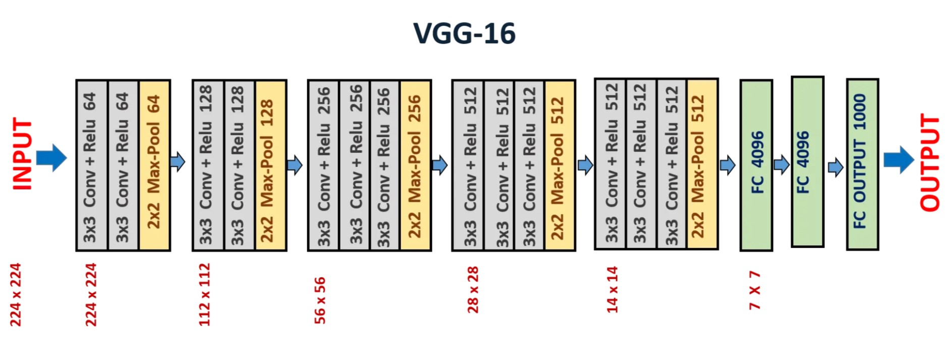
VGG16(see jupyter notebook)
VGG 16 has 13 convolutional layers and 3 fully connected layers.

