Slide 1
XXX

Slide 2
. 1. What is NLP Pipeline?
An NLP pipeline is a sequence of steps to convert raw text into a format a model can understand.
Pipeline Flow:
Raw Text → Tokenization → Integer Encoding → Padding → Embeddings → Model (RNN)

Slide 3
2. Tokenization
Concept
Tokenization = Breaking text into smaller units (words/subwords)
Example:
"I love Cherry" → ["I", "love", “Cherry"]

Slide 4
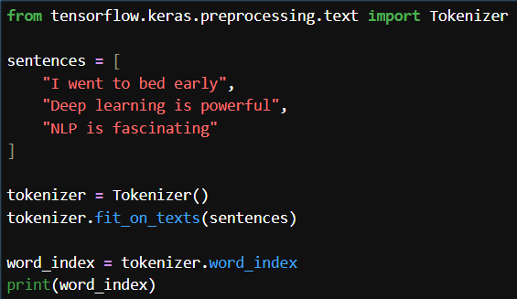

Slide 5
3. Text → Sequences (Integer Encoding)
Convert words into numbers:
Example:
"I love Cherry" → [3, 4, 7]

Slide 6
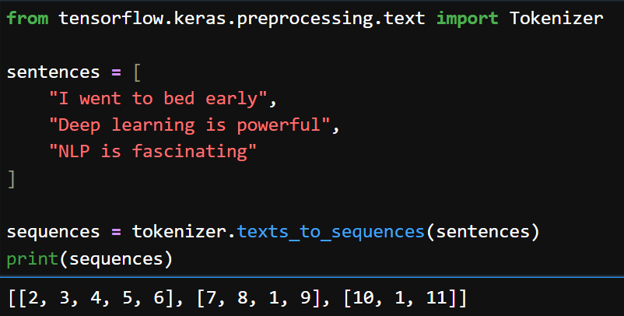

Slide 7
4. Padding (Very Important)
Problem:
Different sentences have different lengths → Neural networks need fixed size
Solution:
Add zeros (padding)

Slide 8
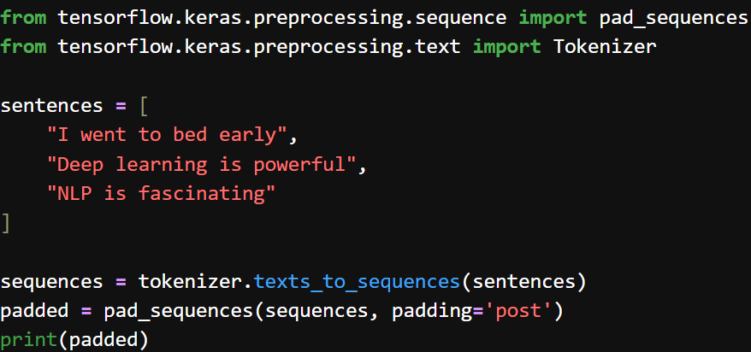
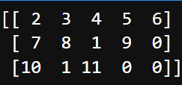
padding='pre' → add zeros at start
padding='post' → add zeros at end (recommended)

Slide 9
5. Embeddings (Core Concept)
👉 Problem:
Numbers like [3,4,7] have no meaning
👉 Solution:
Convert into dense vectors
Example:
3 → [0.2, -0.1, 0.9]

Slide 10
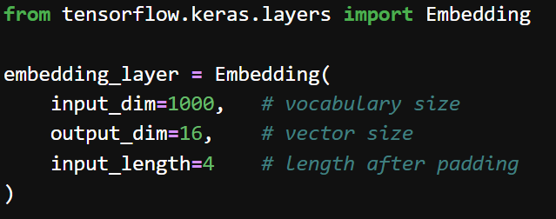

Slide 11
EXTRA
Xxxxxxxxxxx
xxxxxxxxxxxx

