Slide 1
Hypothesis Testing Understanding z-test for mean through examples

Slide 2
PART 1

Slide 3
A statistical hypothesis is a conjecture about a population parameter (e.g. mean, variance, std. dev., etc. ). This conjecture may or may not be true.
Null hypothesis (H0):
There is no difference between a population parameter and the observed parameter.
That is, nothing is happening. Status quo.
Alternative hypothesis (H1):
There is a difference between population parameter and the observed parameter.
That is, something is happening.

Slide 4
Simple Example: Imagine you want to test if a new teaching method improves test scores.
Null hypothesis (H0): The new teaching method has no effect on test scores.
( Students scores remained same as before. Nothing happened. No significant change)
Alternative hypothesis(H1): The new teaching method has positive effect test scores.
( Students scores increased. Something happened. There was significant change)
Side Note:
The null hypothesis isn’t always only about comparing “population mean vs observed mean” — it can also be about proportions, variances, correlations, regression coefficients, etc.

Slide 5
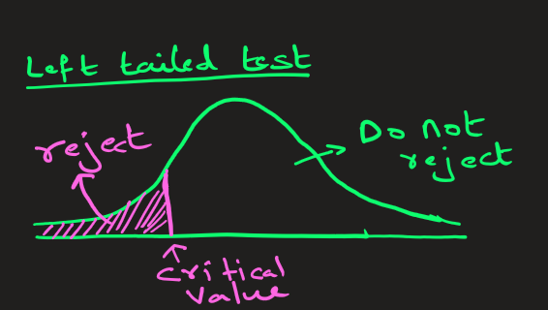
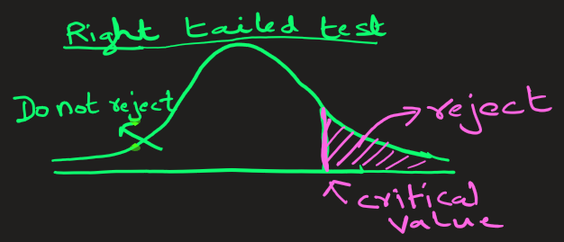
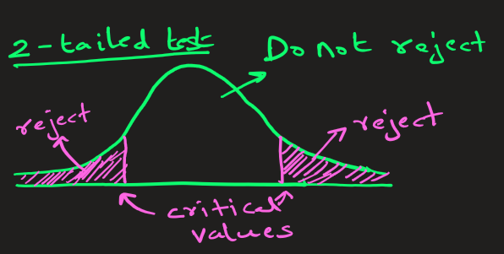
Hypothesis problems fall under following 3 categories:
Left-tailed test
Right-tailed test
2-tailed test

Slide 6
Left-tailed test
Example : A battery manufacturer claims that their new AA batteries last for exactly 50 hours of continuous use on average. A consumer protection agency wants to test if the batteries actually last shorter than claimed (the manufacturer might be overselling their product).
The hypothesis are
Null Hypothesis (H₀): μ = 50 hours (batteries last exactly as claimed)
Alternative Hypothesis (H₁): μ < 50 hours (batteries last shorter than claimed)
This is left-tailed because we're testing if the battery life is significantly below the claimed threshold.

Slide 7
Left-tailed test
Example: A water treatment plant claims their new filtration system reduces contaminant levels to below 5 ppm. Environmental engineers want to verify the claim that filtration system performs better.
The hypothesis are
Null Hypothesis (H₀): μ = 5 ppm (The mean contaminant level is = 5 ppm. No change)
Alternative Hypothesis (H₁): μ < 5 ppm (The mean contaminant level is less than 5 ppm)
This is left-tailed because we're testing if the contaminant level is significantly below the claimed threshold.

Slide 8
Right tailed test
Example : An engineer develops a new protective coating to increase the lifetime of a metal component used in automotive manufacturing. If the mean lifetime of the component without the coating is 36 months, then the engineer’s hypotheses are:
Null Hypothesis (H₀): μ = 36 month (the coating does not change the mean lifetime)
Alternative Hypothesis (H₁): μ > 36 months (the coating increases the mean lifetime)
This is right-tailed because we're specifically testing if after application of coating, the
lifetime significantly exceeds the minimum threshold.

Slide 9
Right tailed test
Example : Imagine you normally jog an average distance of 5 km in an hour. After 2 weeks of a new jogging plan, you want to prove that your average jogging distance has improved.
Null Hypothesis (H₀): μ = 5 Km (the new jogging plan does not change the average)
Alternative Hypothesis (H₁): μ > 5 Km (the new jogging plan did increase the average )
This is right-tailed because we're specifically testing if employing new plan, the
average distance jogged significantly increased.

Slide 10
2-tailed test
Example : A medical researcher is interested in finding out whether a new medication will have any undesirable side effects. The researcher is particularly concerned with the pulse rate of the patients who take the medication. Will the pulse rate increase, decrease, or remain unchanged after a patient takes the medication? Since the researcher knows that the mean pulse rate for the population under study is 82 beats per minute, the hypotheses for this situation are
Null Hypothesis (H₀): mean μ = 82 ( mean will remain unchanged)
Alternative Hypothesis (H₁): mean μ ≠ 82 BPM ( mean will change: the mean could be either > 82 or < 82 BPM
This test is called a two-tailed test since the possible side effects of the medicine could be to significantly raise or lower the pulse rate.

Slide 11
2-tailed test
Example : A soft drink company has a bottling machine that's supposed to fill bottles with exactly 500 ml of soda.
The quality control manager suspects the machine might be malfunctioning - it could be overfilling OR underfilling bottles. The hypothesis for this are
Null Hypothesis (H₀): μ = 500 ml (the machine is filling correctly - No change)
Alternative Hypothesis (H₁): μ ≠ 500 ml (the machine is NOT filling correctly - There is change . Could be more OR less.)
This test is called a two-tailed test since the machine could be filling less or more.

Slide 12
PART 2

Slide 13
Scenario: Here the population standard deviation (σ) is known
2 assumptions for the z-test for a mean when σ Is known:
The sample is a random sample.
2. Either n > 30 or the population is normally distributed when n < 30.
Here n is the number of samples

Slide 14
The critical or rejection region is the range of z-values that indicates that
there is a significant difference between the population and observed means, and
that the null hypothesis should be rejected.
The rejection region for the most part are towards the end of Normal distribution curve
A one-tailed test indicates that the null hypothesis should be rejected when the z test value is in the rejection region on one side of the mean.
A one-tailed test is either a right-tailed test or a left-tailed test, depending on the direction of the inequality of the alternative hypothesis.
In a two-tailed test, the null hypothesis should be rejected when the test value is in either of the two rejection regions.

Slide 15
Table to find critical value for few common α
α significance level | Test Type | Critical z-value(s) (Found from z-table)
0.10 | 2-tailed | ± 1.645
0.10 | 1-tailed | ±1.28 (+ for Right Tailed and – for Left Tailed)
0.05 | 2-tailed | ±1.96
0.05 | 1-tailed | ±1.645 (+ for Right Tailed and – for Left Tailed)
0.01 | 2-tailed | ±2.576
0.01 | 1-tailed | ±2.33 (+ for Right Tailed and – for Left Tailed)

Slide 16

Steps for solving hypothesis-testing problems
Preliminary:
Make sure that 2 assumptions for the z test for a mean when σ Is known are satisfied before proceeding:
1. The sample is a random sample.
2. Either n > 30 or the population is normally distributed when n < 30.

Slide 17
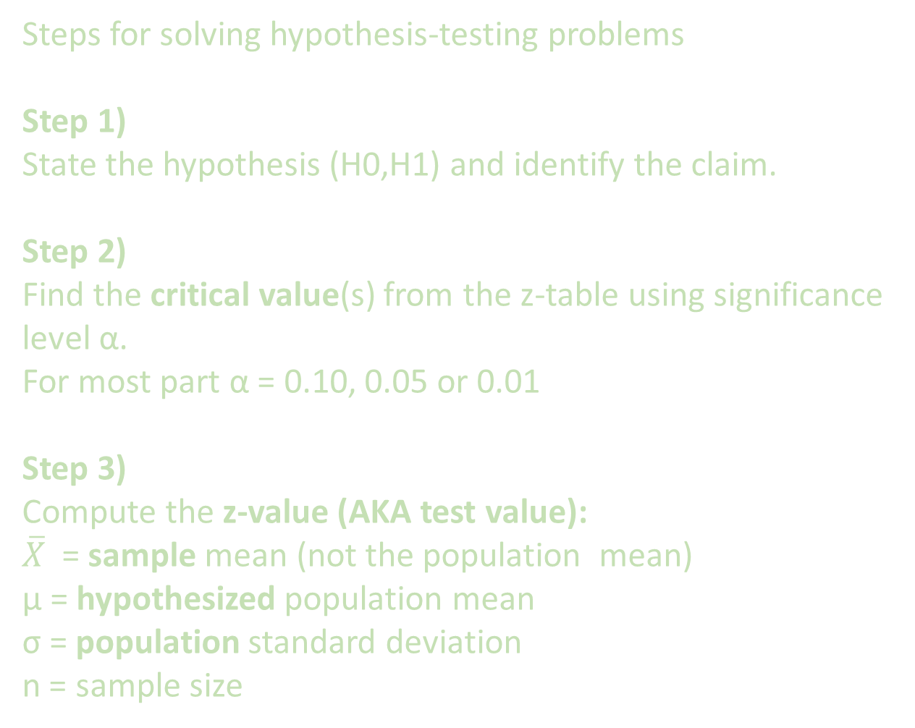
Steps for solving hypothesis-testing problems
Step 1)
State the hypothesis (H0,H1) and identify the claim.
Step 2)
Find the critical value(s) from the z-table using significance level α.
For most part α = 0.10, 0.05 or 0.01
Step 3)
Compute the z-value (AKA test value):
$\overline{X}$ = sample mean (not the population mean)
μ = hypothesized population mean
σ = population standard deviation
n = sample size

Slide 18
Steps for solving hypothesis-testing problems
Step 4)
Make the decision to reject or not reject the null hypothesis.
Right-tailed test: if z-value > critical value, reject the null hypothesis H0
Left-tailed test: if z-value < critical value, reject the null hypothesis H0
Two-tailed test: if z-value falls in reject-region, reject the null hypothesis H0
Step 5)
Summarize the results.

Slide 19
Example (Right-Tailed):
In a population of metal components, the average lifetime without a protective paint coating is 101 months. The lifetime is normally distributed, and the population standard deviation is 15 months. An engineer claims that applying the new protective paint coating increases the mean lifetime of the component beyond 101 months.
She tests this claim by selecting a random sample of 50 components with the coating.
Following is 50 sample values:
[114 107 115 124 106 106 125 116 104 114 104 104 111 90 92 103 99 112 100 95 123 107 109 95 103 110 97 113 103 106 103 127 109 98 117 97 111 89 96 111 116 111 108 106 94 102 104 119 112 91]
Test this claim at significance level, α = 0.05 (i.e. 5%). ( or at 95% confidence)

Slide 20

Answer:
Step 1)
State the hypothesis and identify the claim.
H0: μ= 101 (The mean lifetime is 101; coating has no effect)
H1: μ > 101 (Claim: The coating increases mean lifetime. This is R-tailed test)
Step 2)
Find the critical value.
Since α = 0.05 and the test is a right-tailed test, the critical value is z-critical = +1.65.
Step 3)
Compute the z test value .
The sample mean of above samples is calculated to be 107.
Step 4)
Make the decision to reject or not reject the null hypothesis.
Since 1.65 < 2.82 (the critical value), so reject the null hypothesis.
Step 5)
Summarize the results:
At the 5% significance level, there is enough statistical evidence to support the claim that the paint coating increases the mean lifetime of the component.

Slide 21
Example (Left-Tailed):
A water treatment plant claims their new filtration system reduces contaminant levels to below 5 ppm which is the population mean. Environmental engineers want to verify that the system performs better than this standard.
A random sample of 60 water samples is taken after treatment. The sample shows a mean contaminant level of 4.9 ppm, with a known population standard deviation of 0.8 ppm.
Test the claim that filtration decreases contaminant level at significance level, α = 0.05 (i.e. 5%). ( or Test the claim at 95% confidence interval)

Slide 22

Step 4)
Make the decision to reject or not reject the null hypothesis.
Since -1.28 < -0.968 (the critical value), so do NOT reject the null hypothesis.
Answer:
Step 1)
State the hypothesis and identify the claim.
H0: μ = 5 ppm ( No improvement )
H1: μ < 5 ( Claim: System reduces mean contaminant level. This is Left- tailed test )
Step 2)
Find the critical value.
Since α = 0.10 and the test is a left-tailed test, the critical value is z-critical = -1.28
Step 3)
Compute the z test value .
Step 5)
Summarize the results:
At the 5% significance level, there is not enough evidence to conclude that the new filtration system reduces the mean contaminant level below 5 ppm.

Slide 23
Example (2-Tailed Test):
A medical researcher is interested in finding out whether a new medication will have any undesirable side effects on patients’ pulse rates. The researcher is concerned with whether the pulse rate increases, decreases, or stays the same after taking the medication. The researcher knows that the mean pulse rate for the population under study is 82 beats per minute (BPM), with a population standard deviation of 5 BPM.
To investigate, the researcher selects a random sample of 60 patients who take the medication and finds that their mean pulse rate is 80.7 BPM.
Test the claim that medication does affect the mean pulse rate at significance level, α = 0.01 (i.e. 1%).

Slide 24

Answer:
Step 1)
State the hypothesis and identify the claim.
H0: μ = 82 BPM (The medication has no effect on BPM.)
H1: μ != 82 BPM (Claim: The medication does affect the BPM. This is 2-tailed test )
Step 2)
Find the critical value.
Since α = 0.01 and the test is a two-tailed test, the critical value are
z-critical = - 2.58 and
z-critical = +2.58
Step 3)
Compute the z test value .
Step 4)
Make the decision to reject or not reject the null hypothesis.
Since -2.58 (the critical value) < -2.0137, so do not reject the null hypothesis.
Step 5)
Summarize the results:
At the 1% significance level, there is not enough evidence to conclude that the medication has any effect on mean pulse rate.

