Slide 1
Implement Your LangChain
Code Here without making changes to .venv file

Slide 2
# STEPS
## Work with python3.11. ### 1) Create virtual environment (Took 2 minutes):
> C:\Users\hi\AppData\Local\Programs\Python\Python311\python.exe -m venv .venv
### 2) Activate virtual environment
> .venv\Scripts\Activate.ps1

Slide 3
# STEPS
### 3) Install following packages (Took 5 minutes)
> !pip install langchain==1.3.6 langchain-openai==1.2.2 tabulate==0.10.0
### 4) run the program
> python -m streamlit run app.py

Slide 5
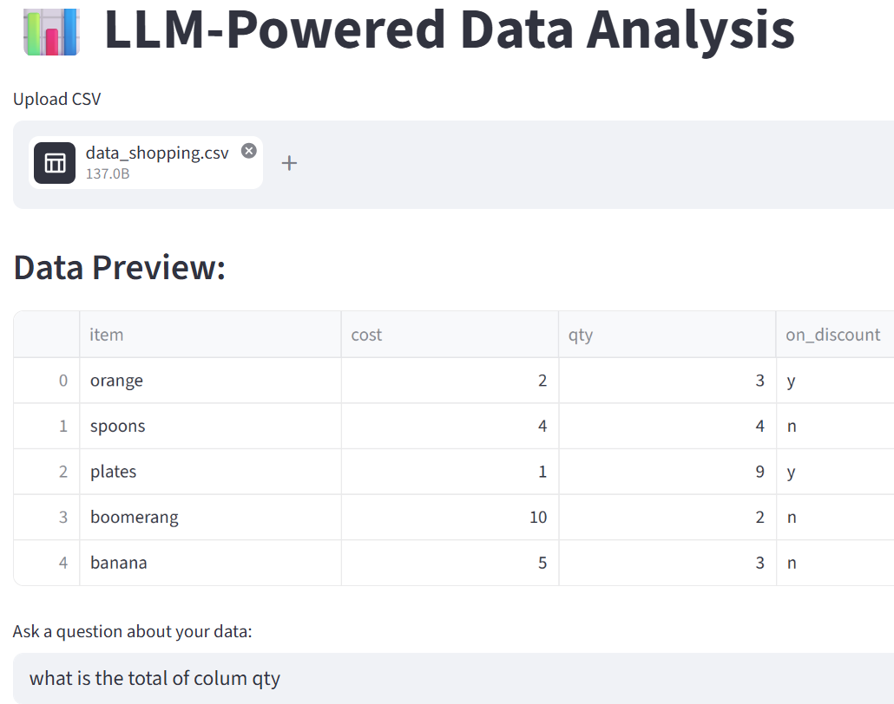
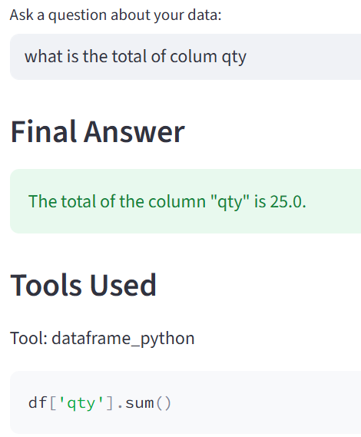

Slide 6
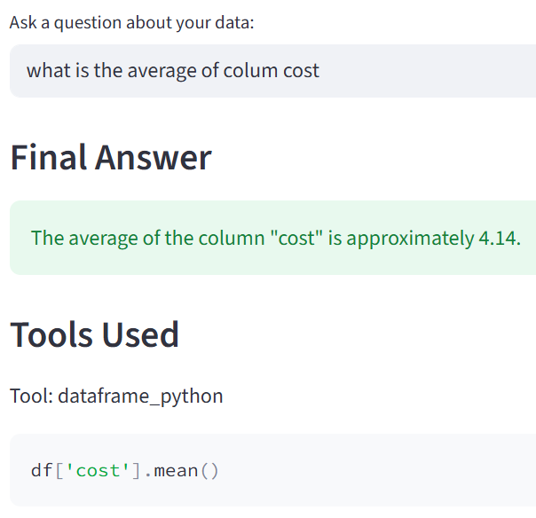

Slide 7
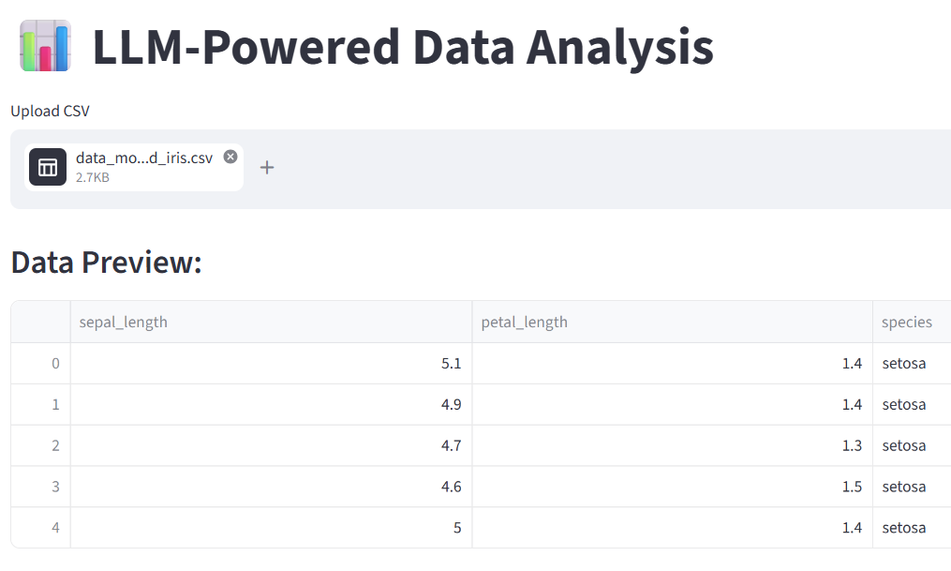

Slide 8
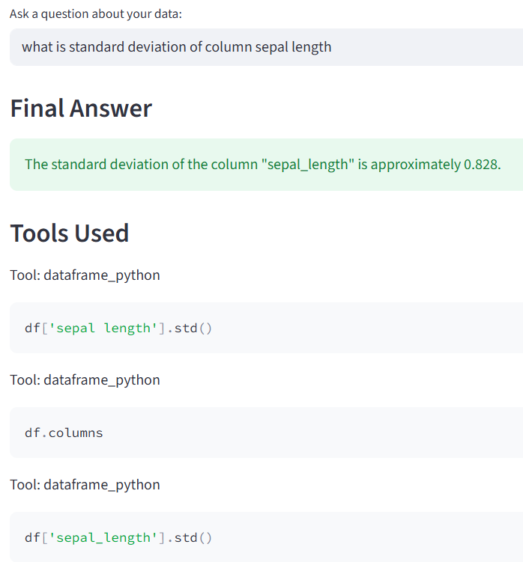

Slide 9
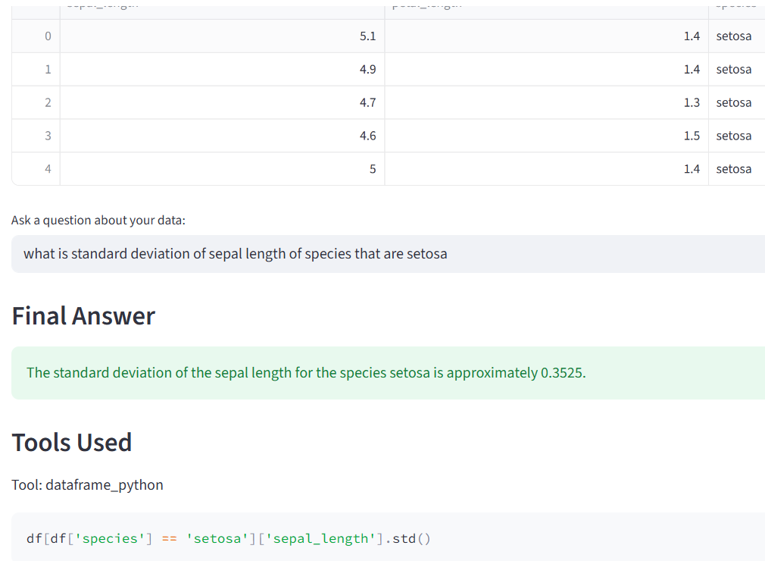

Slide 10
EXTRA
Ffnbksdfd
Fdslj;f
Fl;ds

