Slide 2
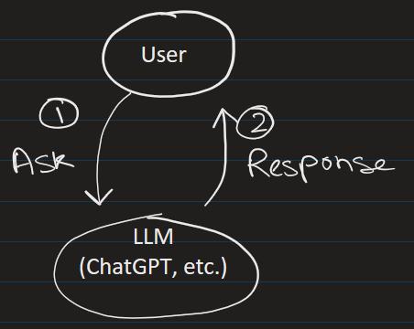
What is LlamaIndex?
LlamaIndex is a Python framework designed to connect Large Language Models (LLMs) to your own data.
What it is
At its core, LlamaIndex solves one fundamental problem:
LLMs like GPT-4 are trained on public internet data up to a cutoff date — they know nothing about your private documents, your company's reports, or any data you haven't shared with the world.
Personal File:
PDF, DB, Excel, etc
llamaindex

Slide 3
LlamaIndex bridges that gap by giving you tools to:
Load your documents (PDFs, Word files, databases, APIs, web pages)
Process them into searchable chunks
Index them using vector embeddings
Query them in plain English — getting answers grounded in your actual data
This pattern is called RAG — Retrieval-Augmented Generation.
Personal File:
PDF, DB, Excel, etc
llamaindex

Slide 4
How it differs from just prompting an LLM
Without LlamaIndex, you'd have to manually paste document text into a prompt — but LLMs have context limits (you can't paste 500 pages).
LlamaIndex handles
chunking,
embedding,
retrieval, and
prompt construction automatically.
So, the LLM only ever sees the most relevant pieces.
Personal File:
PDF, DB, Excel, etc.
llamaindex

Slide 5
Typical data sources:
PDFs
Word docs
SQL databases
APIs
websites
Notion
Google Drive
SharePoint
medical documents
research papers
Personal File
llamaindex

Slide 6
Where it is used
Finance
Querying earnings reports, regulatory filings (10-Ks, 10-Qs), and research notes in natural language
Internal chatbots over proprietary investment research
Automating analysis of loan agreements or contracts
Legal
Searching across thousands of case documents or contracts
Due diligence tools that surface relevant clauses on demand
Personal File
llamaindex

Slide 7
Where it is used
Healthcare
Q&A over clinical trial reports and medical literature
Patient record summarization
Enterprise / Corporate
HR chatbots over internal policy documents and handbooks
IT helpdesks that answer from internal knowledge bases
Customer support bots trained on product documentation
Personal File
llamaindex

Slide 8
Where it is used
Education
Tools like the one in your notebook — building a Q&A system over course material, textbooks, or institutional documents
Personal File
llamaindex

Slide 9
How it compares to LangChain
Both frameworks tackle RAG, but with different philosophies.
LangChain is broader — it covers agents, chains, and tool use across many use cases.
LlamaIndex is more focused and opinionated specifically around data indexing and retrieval, which makes it simpler and faster to build document Q&A systems.
In practice, many production systems use both together — LlamaIndex for the data layer and LangChain for orchestrating agents around it.
Personal File
llamaindex

