Slide 1
Tableau

Slide 2
Download public tableau desktop version:
https://www.tableau.com/products/public/download

Slide 3
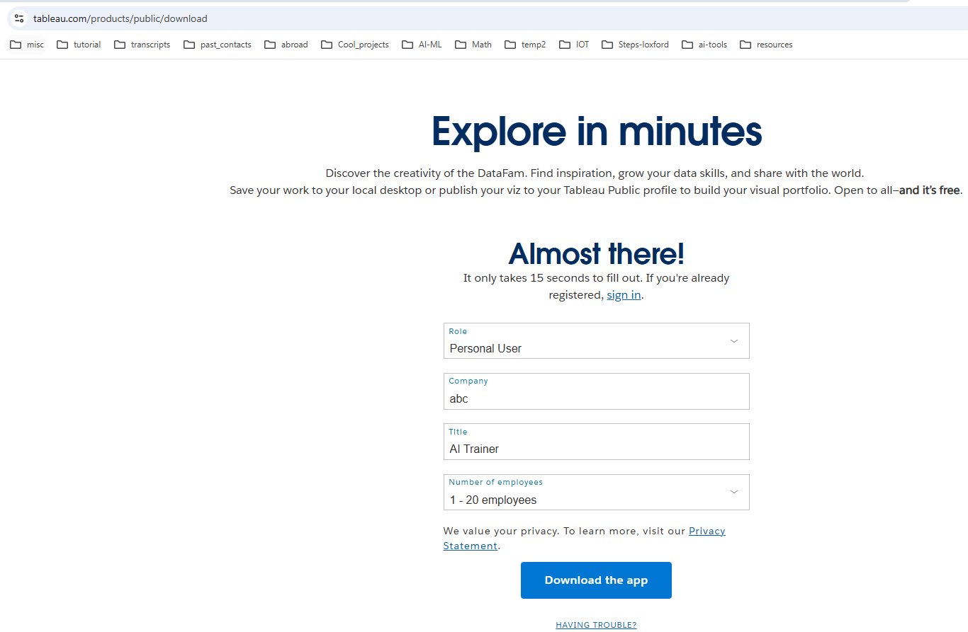

Slide 4
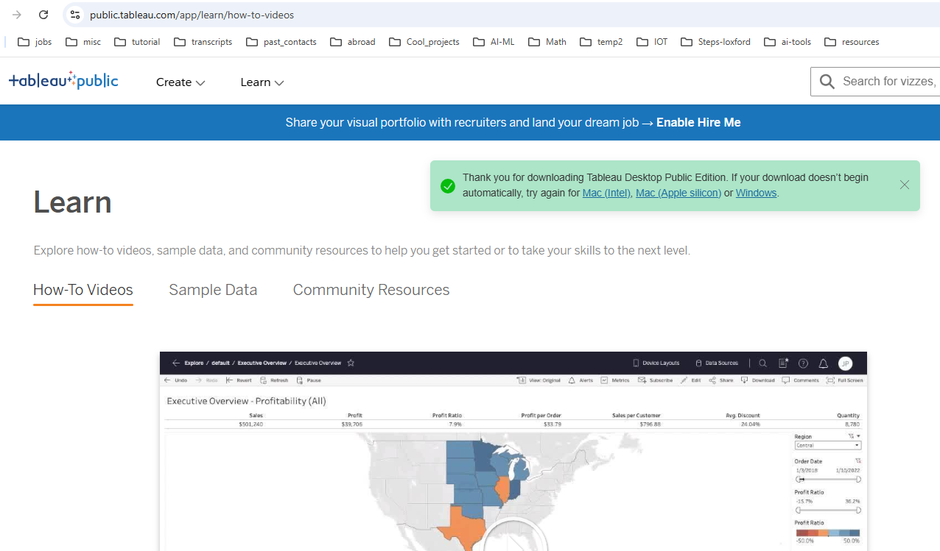

Slide 5
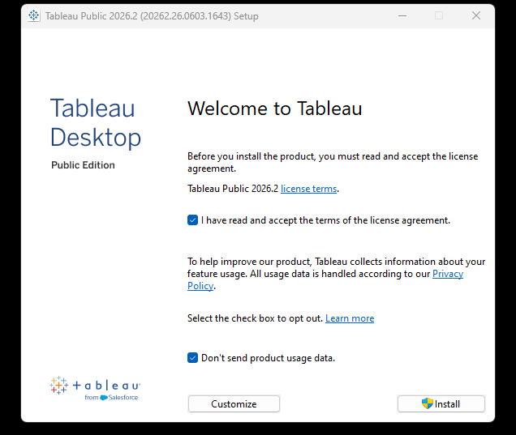

Double click on the installed file
It will take 5 minutes

Slide 6
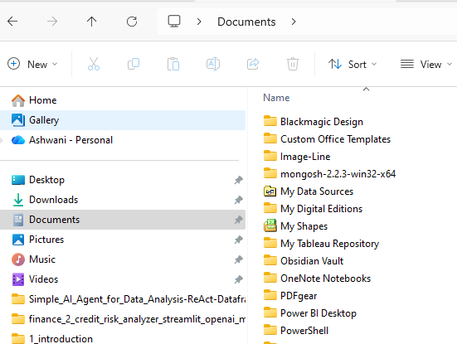


After successful download, you should see
My Tableau Repository

