Slide 1
Tree Of Thought
Reflexion
Self-Consistency

Slide 3
Tree of Thoughts (ToT) – Exploring Multiple Reasoning Paths
What is Tree of Thoughts?
Tree of Thoughts (ToT) is a prompting technique where AI is encouraged to explore multiple possible reasoning paths before choosing the best solution.
Instead of following only one thinking path, AI:
Generates multiple ideas
Evaluates each idea
Selects the best possible answer
This technique mimics human brainstorming.

Slide 4
Example Without Tree of Thoughts
Prompt:
Suggest a business idea for a 50000 dollars.
AI might give only one idea without exploring alternatives.

Slide 5
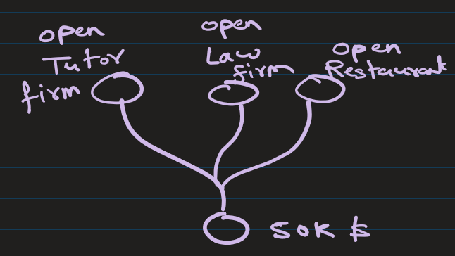
Example With Tree of Thoughts
Prompt:
Suggest three different business ideas for a 50000 dollars
For each idea:
1. Explain benefits
2. Explain risks
3. Suggest expected profitability
Then choose the best idea and justify your choice.
This forces AI to explore multiple reasoning paths.

Slide 6
You are an AI Solution Architect.
Problem: Design an AI agent that can answer questions from PDF documents.
Use Tree of Thought reasoning.
Step 1: Generate at least 4 different architectures.
Step 2: For each architecture, explain:
- How it works
- Components required
- Advantages
- Limitations
Step 3: Compare architectures on Accuracy, Cost, Scalability
Step 4: Select the best architecture and explain why.
Show your reasoning as a decision tree.

Slide 7
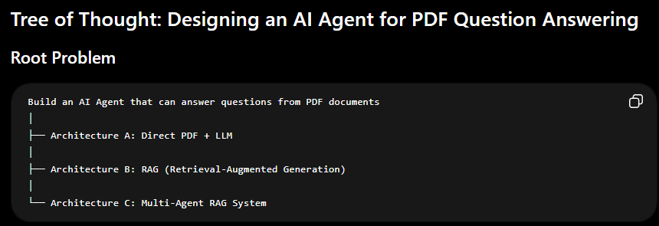

Slide 8
Branch A: Direct PDF + LLM
PDF ↓ Text Extraction ↓ Entire Text Sent to LLM ↓ Answer Generated
Components Required: PDF Parser (PyPDF2, pdfplumber), LLM (GPT, Claude, Gemini) ,Simple Application Layer
Advantages
✅ Easiest to build
✅ No vector database required
✅ Low development effort
✅ Good for small documents
Limitations
❌ Context window limitations
❌ Expensive for large PDFs
❌ Slow for hundreds of pages
❌ Cannot efficiently search documents
Example
A user uploads a 10-page report.
Entire report is sent to the LLM.
Question: What were the Q4 sales figures?
LLM reads all 10 pages and answers.

Slide 9
Branch B: RAG (Retrieval-Augmented Generation)
PDF ↓ Text Extraction ↓ Chunking ↓ Embeddings ↓ Vector Database ↓ Retriever ↓ LLM ↓ Answer
Components Required: PDF Parser, Text Chunking, Embedding Model, Vector Database, Retriever, LLM
Advantages
✅ Handles thousands of pages
✅ Much cheaper than sending entire PDFs
✅ Fast retrieval
✅ Scales well
✅ Industry standard approach
Limitations
❌ Retrieval can miss relevant chunks
❌ Chunking strategy affects performance
❌ Requires vector database infrastructure

Slide 10
Branch C: Multi-Agent RAG System
PDF ↓ Document Agent ↓ Retriever Agent ↓ Reasoning Agent ↓ Answer Agent ↓ Final Response
Components Required: PDF Parser , Vector Database , Multiple Specialized Agents, Agent Orchestrator (LangGraph, CrewAI), LLM
Agent Responsibilities
Document Agent: Understands document structure and finds sections
Retriever Agent: Retrieves relevant content
Reasoning Agent: Synthesizes evidence and Resolves contradictions
Answer Agent: Creates final response
Advantages
✅ Highest accuracy
✅ Better reasoning
✅ Handles complex questions
✅ Easier to extend
Limitations
❌ Most expensive
❌ Higher latency
❌ More engineering effort
❌ More infrastructure to maintain

Slide 11
When to Use Tree of Thoughts
Tree of Thoughts is useful when:
Making strategic decisions
Brainstorming creative solutions
Solving complex business or technical problems
Evaluating multiple alternatives
Planning projects

Slide 12
2. Reflexion – Asking AI to Critique and Improve Its Own Output
What is Reflexion?
Reflexion is a technique where AI is asked to:
Generate an answer
Critically analyze its answer
Improve or correct its response
This technique helps AI simulate self-review and quality improvement.

Slide 13
Example Without Reflexion
Prompt:
Write an email requesting leave.
AI provides one response without quality review.

Slide 14
Example With Reflexion
Prompt:
Write an email requesting leave.
After writing the email:
1. Review the email for clarity and professionalism.
2. Suggest improvements.
3. Provide a revised version.
This produces higher quality results.

Slide 15
When to Use Reflexion
Reflexion is particularly useful for:
Writing tasks
Coding improvement
Research summaries
Report generation
Professional communication

Slide 16
3. Self-Consistency – Generating Multiple Answers and Choosing the Best
What is Self-Consistency?
Self-Consistency is a technique where AI is asked to generate multiple independent answers to the same question and then select the most reliable or common answer.
The process usually involves:
Ask AI to generate multiple solutions
Compare the solutions
Choose the most logical or consistent answer
Instead of trusting one output, this method relies on repeated reasoning.

Slide 17
Example Without Self-Consistency
Prompt:
Solve this math problem:
A train travels at a speed of 40 km/h for 3 hours.
It then travels at 60 km/h for 2 hour.
What is the average speed of the train for the entire journey?
AI may produce one answer without verification.

Slide 18
Example With Self-Consistency
Prompt:
Solve this math problem using three different reasoning methods.
A train travels at a speed of 40 km/h for 3 hours.
It then travels at 60 km/h for 2 hour.
What is the average speed of the train for the entire journey?
After solving:
Compare the results and select the most consistent answer.

Slide 19
When to Use Self-Consistency
Self-Consistency is useful for:
Mathematical problems
Logical reasoning tasks
Coding solutions
Data analysis
Scientific calculations

Slide 20
Combining All Three Techniques
Example Combined Prompt
Generate three different marketing strategies for launching a new mobile app.
For each strategy:
1. Explain implementation steps
2. Evaluate advantages and disadvantages
Then review all strategies and identify weaknesses.
Finally, choose the most effective strategy and explain why.
------------------------------------------------------------------
This prompt uses:
Tree of Thoughts (multiple strategies)
Reflexion (review weaknesses)
Self-Consistency (choose best option)

