Slide 1
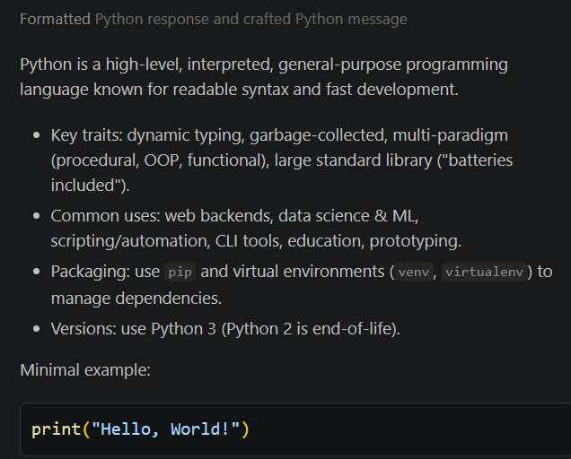
Use Python examples because they are easy to understand.
Example 1: Definition
Type:
Build me a simple python file that prints hello world message on screen

Slide 2
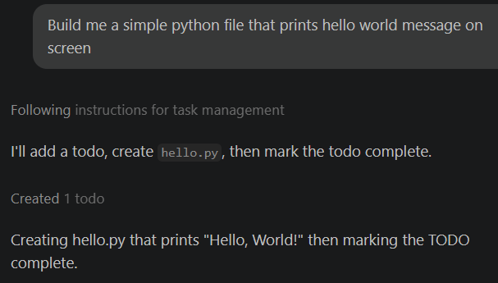
Example 2: A simple hello world program
Type:
Build me a simple program that prints hello world on the screen

Slide 3
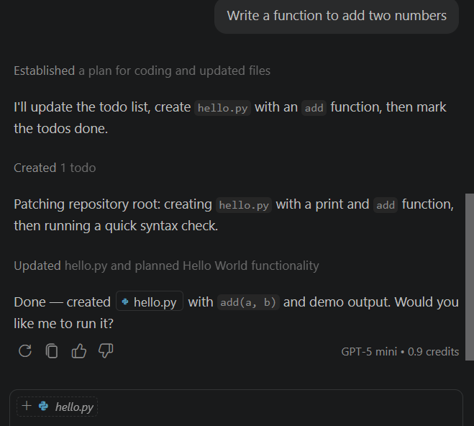
Example 3

Slide 4
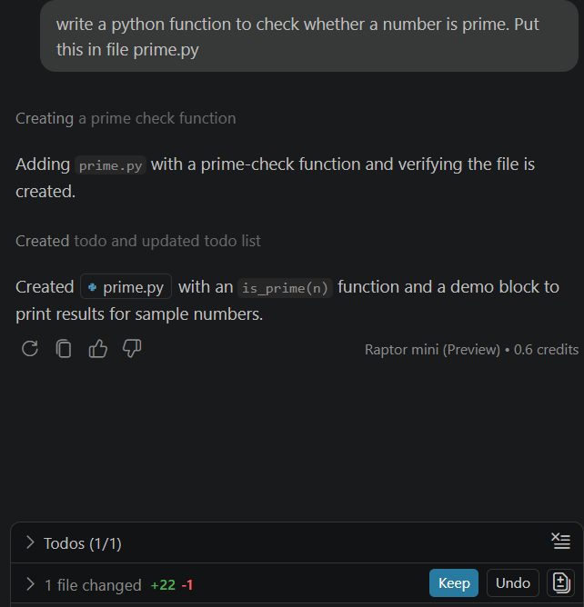

Example 4:
Write a python function to check whether a number is prime.
Put this in file prime.py

Slide 5
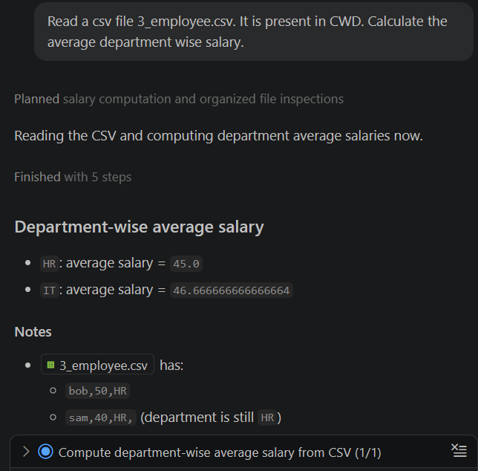
Example 5:
Read a csv file 3_employee.csv. It is present in CWD. Calculate the average department wise salary.

Slide 6
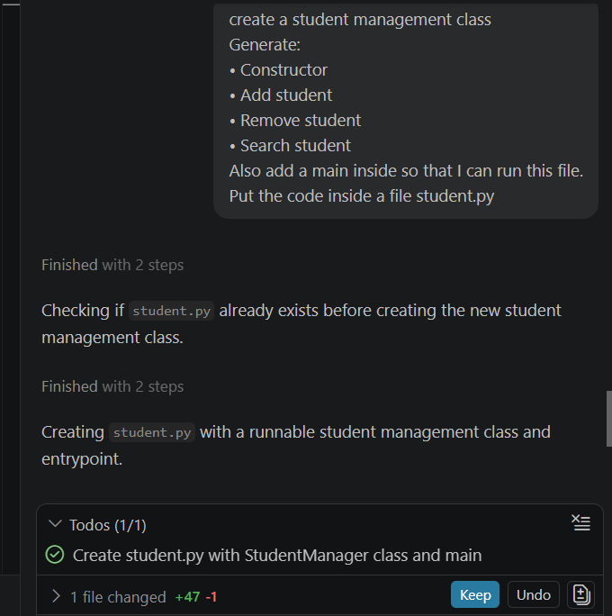
Example 6:
Create a student management class
Generate:
• Constructor
• Add student
• Remove student
• Search student
Also add a main inside so that I can run this file.
Put the code inside a file student.py

