Slide 1
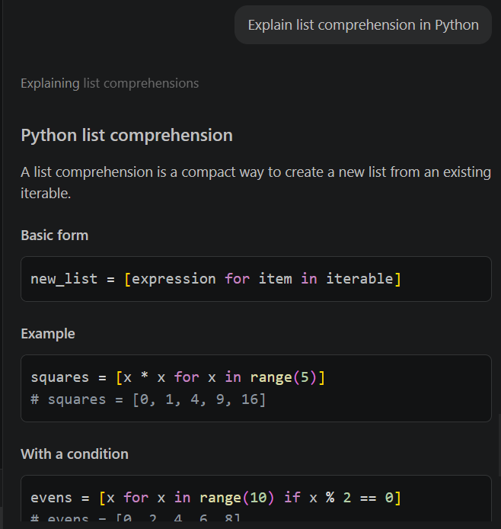
Examples:
Explain list comprehension in Python

Slide 2
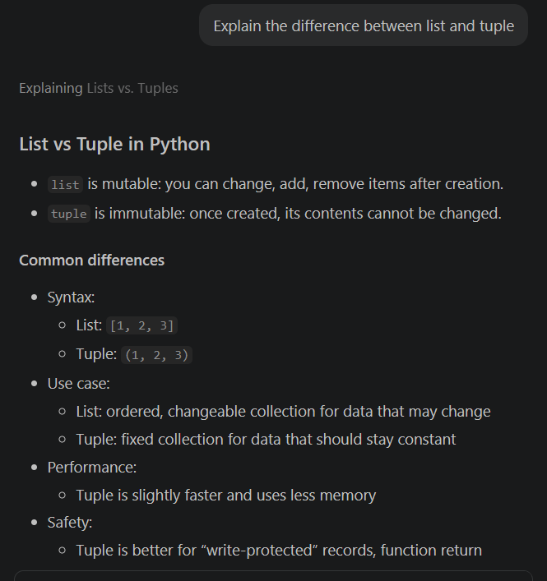
Examples:
Difference between tuple and list

Slide 3
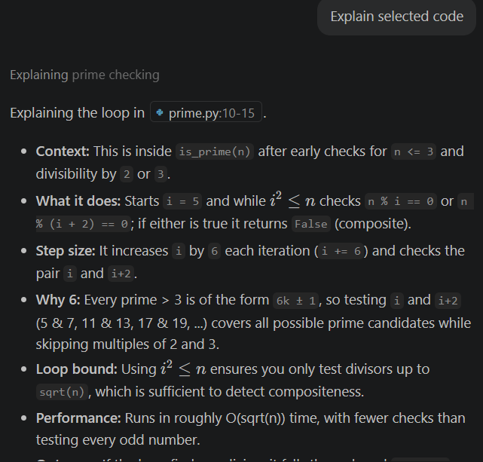
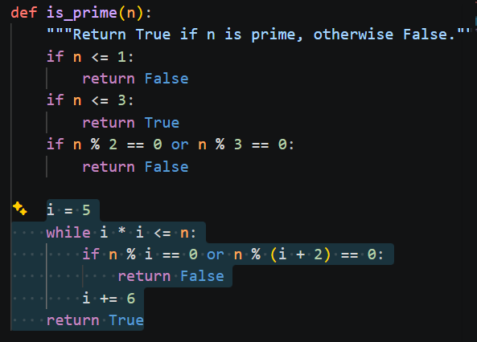
Examples:
Explain the selected code

Slide 4
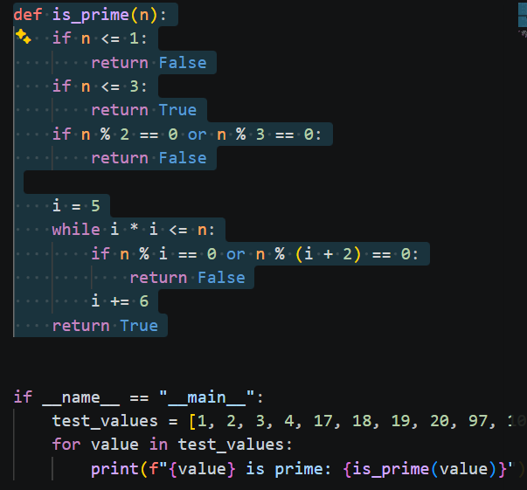
Generate Documentation
Select function and ask:
Generate docstring

Slide 5
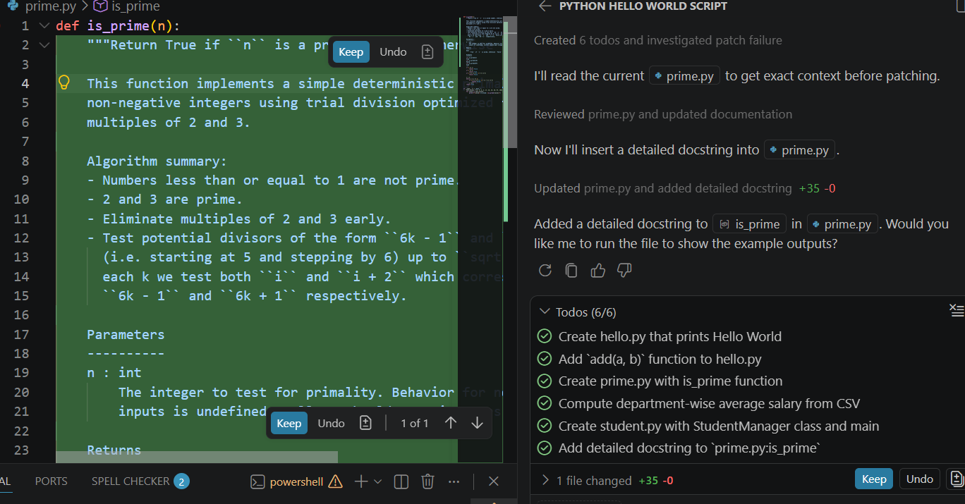

Slide 6
Generate Comments
Add comments to this code

